Slide 1

Christopher B. Barrett
Weill Cornell Global Health Grand Rounds
New York City, NY
December 2014
The Global Food Security Challenge Of The Coming Decades

Slide 2
Background
Food systems successes in 1940s-80s enabled dramatic poverty reduction and improved standards of living
Today >6(~4-5) bn people have adequate calories (micronutrients), up from only about 2 billion 50 years ago.
Public/private ag R&D and policy reforms led productivity growth to outpace demand growth, increasing land/water efficiency use and steadily lowering real food prices through 2000, lifting hundreds of billions from poverty and hunger.
Successes enabled population growth, urbanization and income growth over the “Long Peace” of the late 20th century
… and induced a dangerous complacency.

Slide 3
Background
Complacency led to underinvestment. Food output growth slowed relative to demand growth. Result: higher food prices.
OECD/IFPRI/FAO all forecast food prices 5-20% higher than 2012 levels for the next decade as demand growth continues to outpace supply expansion worldwide.

Slide 4
Background
This matters to global food security because poverty and prices are the biggest drivers of global food security.
Internationally agreed definition:
Food security exists if and only if “all people at all times have physical, social, and economic access to sufficient, safe and nutritious food that meet their dietary needs and food preferences for an active and healthy life” (1996 FAO Food Summit).
1940s-70s: Focus was on food availability
1980s-90s: post-Sen, emphasis turned to socioeconomic access
2000s: increased emphasis on utilization and stability

Slide 5
Overview
The challenge of the coming decades:
Addressing stability/utilization/access dimensions while recognizing that the complacency of the past generation has introduced a higher food price regime that imperils advances in global food security.
How to respond?
The keys lie in recognizing the:
  constraints we face
  consequences of insufficient (or slow) response
  opportunities ahead

Slide 6
Constraints
Aggregate Demand Growth Is Largely Unavoidable
A more populous, urban, and wealthier world is inevitable and will demand 70-100% more food by 2050 than today.
Why?
Population growth of ~2-3 bn people
Population will urbanize, up from 50% to >70%
Income growth: Marginal growth in food demand due to income growth in LDCs is 5-8x that in the US.
Result:>90% of demand growth will be in Africa/Asia
And that is something to celebrate!
Cannot reduce demand growth significantly
Reduced food waste reduction, over-consumption, food/feed/ biofuel competition, or dietary change away from ASFs
… Demand-side adjustment offers only modest gains

Slide 7
Constraints
Must grow supply by 1 or more of 3 methods:
More inputs … but extensification unlikely b/c
Arable land essentially fixed without major (ecologically risky) conversion of forest, wetlands, or drylands
Limited capacity to expand ag frontier in Asia/MENA
Increasing competition for land from urban expansion and protected areas
Ag already accounts for ~70% of human water usage, > 80% in Africa and Asia
Climate change will aggravate water shortages in critical regions, esp. in tropics with fastest demand growth
Marine capture fisheries stable or declining

Slide 8
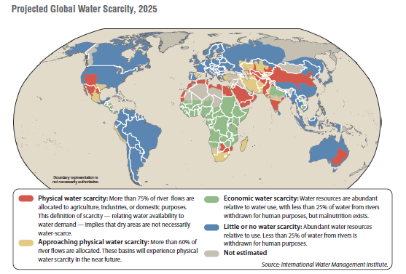
Constraints
Notes:
Source: “Global Water Outlook to 2025.” International Food Policy Research Institute. (the map and barchart can be split up very easily)
This graph & report includes data on water consumption across regions (and growth), and relative water scarcity in different regions of world.

Slide 9
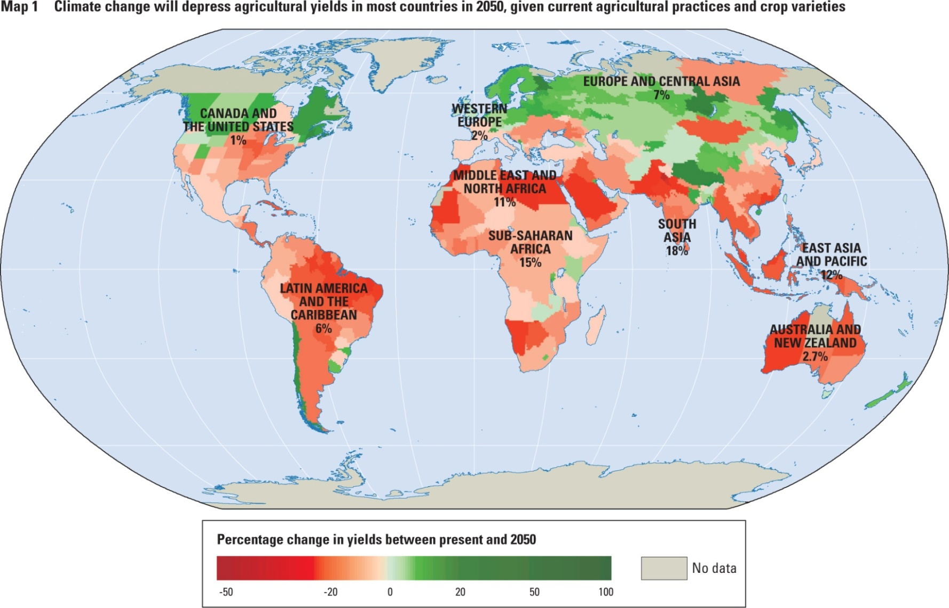
Constraints
Adverse expected yield change in 11 key crops due to climate change
Source: World Bank WDR 2010
Notes:
Sources: “World Development Report 2010: Development and Climate Change.” World Bank. Page 9.
“Note: The coloring in the figure shows the projected percentage change in yields of 11 major crops (wheat, rice, maize, millet, field pea, sugar beet, sweet potato, soybean, groundnut, sunflower, and rapeseed) from 2006 to 2055, compared with 1996–2005. The yield-change values are the mean of three emission scenarios across five global climate models, assuming no CO2 fertilization (a possible boost to plant growth and water-use efficiency from higher ambient CO2 concentrations). The numbers indicate the share of GDP derived from agriculture in each region. (The share for Sub-Saharan Africa is 23 percent if South Africa is excluded.) Large negative yield impacts are projected in many areas that are highly dependent on agriculture.”

Slide 10
Constraints
Improved efficiency given current inputs/tech. But …
Smallholder ‘inefficiency’ mainly due to variable agro-environmental conditions and untargetable
Inverse farm size-productivity relationship hard to exploit for yield gains (b/c arises from market failures)
The true extent of waste in post-harvest food systems remains unclear, as does the question of whether it’s cost-effective to reduce waste substantially

Slide 11
Constraints
So must rely mainly on technological advances to resolve demand-supply growth imbalance. But …
  Slowing growth in yields (esp. w/climate change)
  Challenge of widespread opposition to GMOs
  IP regimes and associated ‘gene grabs’ pose obstacles
  Site specificity due to agroecological heterogeneity
  Innovation most needed in Africa/Asia, where demand growth will occur but ag R&D capacity also most limited
  Technological advance requires investment, and governments and philanthropies are essential but insufficient … will rely heavily on the private sector.

Slide 12
Constraints
Productivity growth must occur in Africa/Asia, where most demand growth will occur because 85-90% of food is consumed within the country where it is grown, even with food trade growing faster than production.

Slide 13
Constraints
But increasing food availability is only necessary, not sufficient, to improve food security.
  Improved access is key and depends mainly on poverty reduction and improved social protection measures to ensure that ample food gets distributed equitably.
  The biggest challenges surround utilization and especially micronutrient deficiencies, which are more widespread and respond more slowly to productivity/ income growth than does macronutrient intake and associated undernutrition.
  So cannot focus just on cereals or even just staples … must pay more attention to fruits and vegetables.

Slide 14
Constraints
More than just stunting problems;
micronutrient deficiencies persists far longer…
Countries by malnutrition problem and ag productivity (SOFA 2013)

Slide 15
Constraints
… and lead to irreversible cognitive/physical effects, nutritional poverty traps.
1/3 of the global population suffers from zinc deficiency
25% of the global population suffers from anemia
1/3 of school age children suffer from iodine deficiency
21% of children under 5 suffer from vit A deficiency
Source: Barrett and Bevis, in press

Slide 16

If we fail to accelerate productivity growth and improve food access, utilization and stability …
Consequences
- More sociopolitical instability due to food prices and resource competition
- Environmental degradation
- Sharply slowed poverty reduction

Slide 17
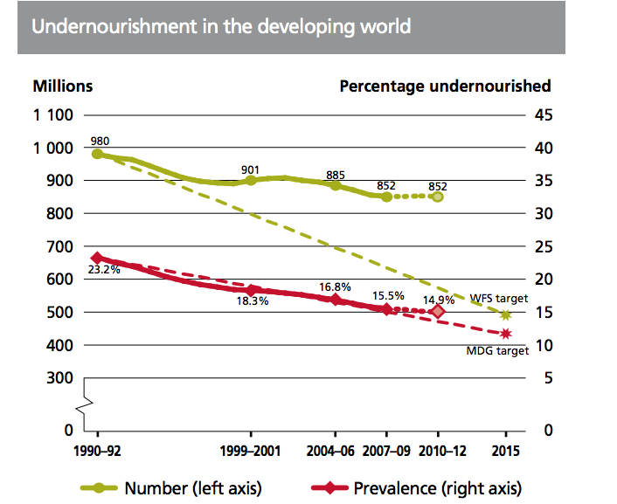
Consequences
As food prices began rising from 2000, progress on MDGs/WFS food security goals began to lag.
(Source: FAO SOFI 2012)
Notes:
Source: The State of Food Insecurity in the World 2012.” FAO. <http://www.fao.org/docrep/016/i3027e/i3027e00.htm> Undernourishment around the world section. Page 9 (PDF).
Source: “World Agriculture: towards 2015/2030.” FAO. <ftp://ftp.fao.org/docrep/fao/004/y3557e/y3557e.pdf>. Page 19.
Progress in reducing the hungry and undernourished will be slowest in Africa, with the greatest global density of the world’s hungry in 2030.
Undernutrition has negative effects on income & economic growth. It also increases necessary health spending per person while decreasing human productivity.

Slide 18
Opportunities
Threats imply corresponding opportunities
I’m optimistic for two reasons:
1) Renewed gov’t/philanthropic investments can/will crowd-in private investment through:
Renewed donor/gov’t attention to basic ag/NRM R&D and agricultural sciences capacity building
Greater attention to institutional/physical infrastructure … reliable water, transport systems; clear/fair resource tenure rules and product grades/standards; reduced trade barriers/farm support payments; proper env’t regulation
Reliable and inclusive social protection programs. Cash transfers revolution. Plus every $1 invested in nutritional programs produces $16 of benefits.

Slide 19
2) Higher food prices induce private innovation
Opportunities
R&D in improved agricultural technologies (ex: GM).
FDI in developing country agriculture, which is generally capital starved, helps close yawning yield gaps.
New business models to transform agricultural value chains in ways that boost productivity, improve sustainability, and promote healthier diets.

Slide 20
Looking Forward
Past success proves the potential of food systems to reduce human suffering.
Structural demand and supply patterns for food pose major challenges, as reflected in higher food prices of 21st century. Need to combat complacency!
Almost inexorable demand growth, land/water scarcity, climate change, more complex IP regimes pose harder constraints than we faced 1940s-80s.
Most importantly, must focus most attention where the needs are and will be greatest – in Africa and Asia – and increasingly on micronutrient-rich foods

Slide 21
Looking Forward
If we fail to meet this challenge, the environmental, human, and sociopolitical consequences are grave.
But opportunities are great, especially with symbiotic investments by governments/philanthropies and by profit-seeking firms following any of several models.
Global food security can be achieved via greater nutrient productivity per worker/ha/m³, improved food distribution/processing systems, and social protection policies
… help stimulate growth and meet the challenge …
equitably, profitably, and sustainably.

Slide 22
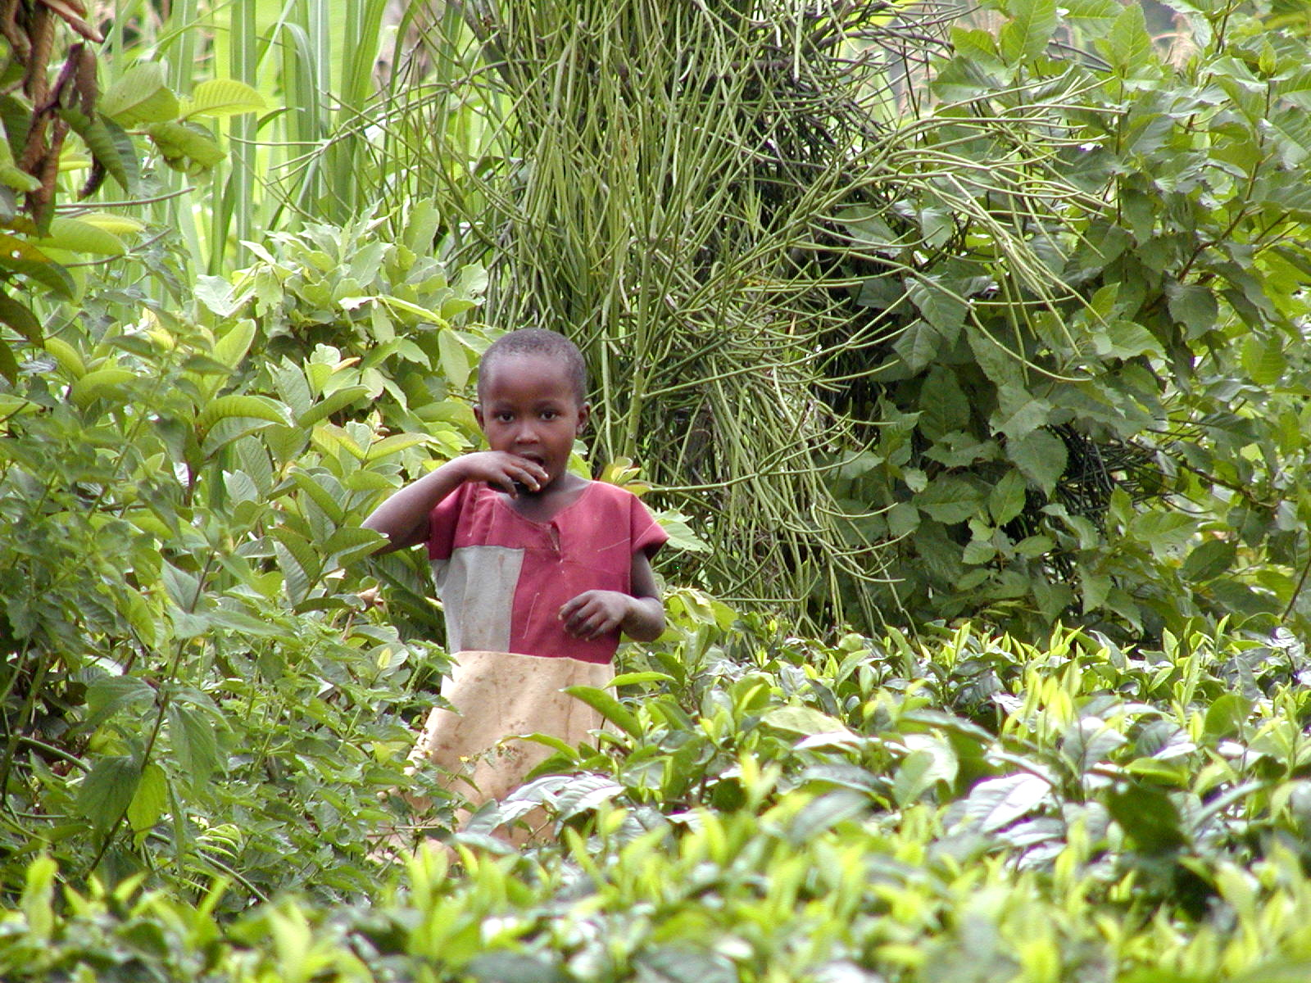
Thank you
Thank you for your time, interest and comments!

