Slide 1
Food Security As Resilience:
Reconciling Definition And Measurement
Joanna Upton, Jenn Cissé and Chris Barrett
Dyson School, Cornell University
USDA Economic Research Service
Workshop on ‘Finding Meaning in Our Measures: Overcoming Challenges to Quantitative Food Security’
Washington, DC
February 9, 2015

Slide 2

Motivation
Measurement matters
  But must be founded on agreed definition of subject
  The internationally agreed (1996) definition of FS:
  “Food security exists when all people at all times have physical, social, and economic access to sufficient, safe and nutritious food that meet their dietary needs and food preferences for an active and healthy life.”
  This is challenging to measure because intrinsically unobservable
  Nonetheless, definition implies some axioms of measures

Slide 3
Motivation
Decades of grappling with measurement…
  Different metrics have different goals (to meet different needs)
  Metrics each reflect one or more observable dimension of food security
  Sometimes try to combine dimensions uses indices, with their many, well-known problems
  But, no existing measure well captures “food insecurity” per internationally agreed definition and derivative axioms

Slide 4
Punchline
The emergent concept of resilience may offer a way forward (in time, not immediately) ….
  Barrett and Constas (PNAS 2014) offer a theoretical foundation for development resilience that fits the 1996 definition of food security.
  Current efforts to measure resilience might be harnessed for food security measurement. This approach seems to come closer to satisfying 4 axioms

Slide 5
Evolving Definition of Food Security
1943-96: a sequence of international declarations that steadily evolve the definition of food security
  Examples: 1974 World Food Conference:
“Availability at all times of adequate world food supplies of basic foodstuffs to sustain a steady expansion of food consumption and to offset fluctuation in production and prices”
  1983 FAO definition:
  “Ensuring that all people at all times have both physical and economic access to the basic food stuff that they need.”
  Roughly, moved from supply-side to demand focus

Slide 6
Defining Food Security
1996, FAO Food Summit definition integrated these various threads:
“Food security exists when all people at all times have physical, social, and economic access to sufficient, safe and nutritious food that meet their dietary needs and food preferences for an active and healthy life.”
Widely recognized four dimensions of:
  Availability
  Access
  Utilization
  Stability

Slide 7
Axioms of Measurement
This definition implies 4 core axioms for measurement:
“all people” – the scale axiom (must address both individuals and groups at various scales of aggregation)
“at all times” – the time axiom (assess stability, given both predictable and unpredictable variation)
“physical, social, and economic access” – the access axiom (poverty, institutions, infrastructure)
“an active and healthy life” – the outcomes axiom (that nutrition and health are ultimately achieved)

Slide 8
Data Challenges
Measures necessarily depend on data. And data quality issues abound and must be considered.
Shortcomings in national-level data
  Often constrained to rely on national governments
    Disagreement on what to collect, and/or how
    Resource and capacity constraints make for unreliable quality

Slide 9
Data Challenges
…also shortcomings in household-level data
  Analytical challenges (sampling and survey design)
  Data often unreliable (proxy reporting, recall, accounting for income…)
  Nutrient composition tables not universal
  Limited comparability between data sets
  Attrition
  And so on…

Slide 10
Data Challenges
Consistency over time
  Funding streams usually have short-term time scales
  Methods & priorities change with actors and institutions
Cost
  Often greater challenge for household-level data, especially large scale
Challenges often greatest where need is greatest
BUT, some new opportunities are emerging
  New data sources and technologies (e.g., ICT, RS)

Slide 11
Existing Metrics…
We can rate metrics for how they perform in addressing the 4 axioms that follow from the agreed FS definition
Other criteria are also important
  Cost; difficulty (analytical and logistical); comparability between countries and other groups
And, different metrics address different needs
  A health metric may capture the end outcome, but we need other metrics to understand mechanisms in order to design appropriate interventions
  Food security is ultimately about individuals, but national- and multinational-level information is needed

Slide 12
Existing Metrics…
Metrics fall into two broad categories, based on the initial level of aggregation
Macro-level
  Aggregated, national-level data
  May be disaggregated to apply to smaller groups, using various methods and (often untenable) assumptions
Micro-level
  Survey data from households or individuals
  May or may not be aggregable to apply to larger groups, depending on sampling design and implementation

Slide 13
Existing Metrics: Macro
FAO prevalence of undernourishment
  Assesses “sufficient food energy availability adequate to cover minimum needs for a sedentary lifestyle”
In terms of the four axioms…
  Nations, not individuals (assumed intra-national distribution of food energy)
  Annual, not accounting for seasonality and shocks
  No accounting for access
  Treat all calories equally; no measure of health
Sensitivity to assumptions (and methods) is a problem
  Estimates change with methods, with implications for how we assess progress and current needs

Slide 14
Existing Metrics: Macro
ERS prevalence of food insecurity, nutritional gap, and distribution gap
  Using current and projected food production, macroeconomic data, and food aid
Similar limitations in meeting the four axioms
  Estimate of individuals based on distributional assumptions and macroeconomic data
Also in part about prediction, which is a different business

Slide 15
Existing Metrics: Macro
IFPRI Global Hunger Index
  Combined indicator of undernourishment, child underweight, and child mortality
  National level; annual; does not address access
  Better meeting the outcomes axiom
  Highly sensitive to arbitrary index weighting
Economist Intelligence Unit index
  Range of data on availability, access, food safety…
  National level; annual
  Attention toward access and outcomes (-but)
  Highly sensitive to arbitrary index weighting

Slide 16
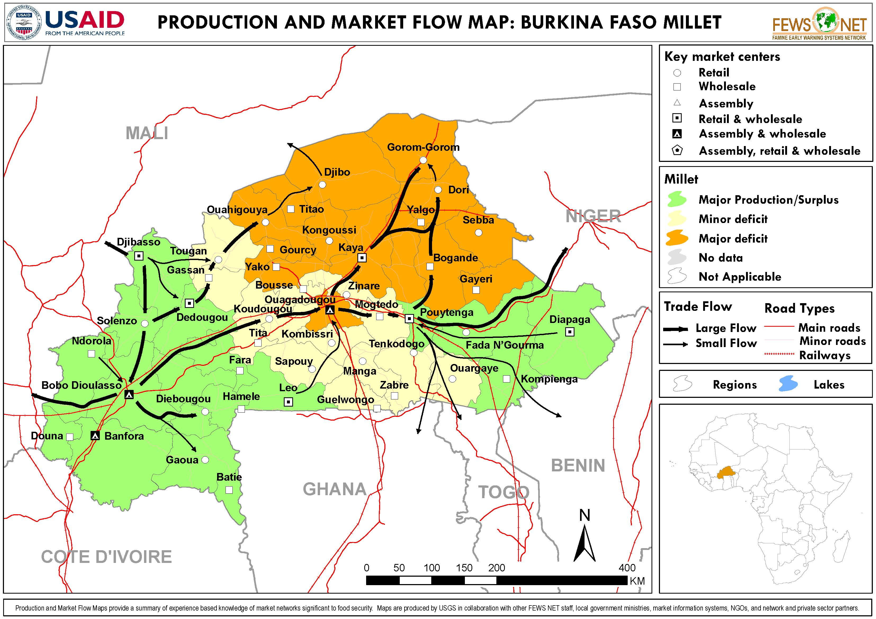
Existing Metrics: Macro
FEWS, GIEWS, and the IPC System
  Use diverse data to map patterns
  Better performance with respect to the time axiom
  Also addresses spatial access
  Very good for intended
  use (EW), less so for
  measurement

Slide 17
Existing Metrics: Micro
For all household- or individual-level metrics, meeting the scale and time axioms depends on quantity and frequency of survey data
Household income and expenditure
  Focus on the access axiom (economic access)
  Not a direct assessment of outcomes; but sometimes a reasonable proxy (especially food expenditure)
  Measurement error a problem

Slide 18
Existing Metrics: Micro
Coping Strategies Index
  Responses to questions about various food-related strategies
  Related to the HFIAS and the HHS (reduced versions)
  Focus on access axiom (social, physical, and economic)
Subjective or Experiential Indicators
  Various questions about the subjective sense of food insecurity
  Can speak to time axiom by collecting hard-to-capture information about shocks and changes over time
These too are necessarily very limited

Slide 19
Existing Metrics: Micro
Dietary diversity and/or food consumption indicators
  Several metrics, can be tailored to different contexts
  Also a proxy for food security; nutrients may not be consumed by all members of the household equally, and/or absorbed by individuals due to poor health
Anthropometric Measures
  Various measures capture different health phenomena (HAZ, WAZ, WHZ, MUAC)
  Reasonable health indicators
  Attention to the time scale (impact measurement)

Slide 20
Visualizing Metrics vs. Food Security Axioms
For the most part, the choice of metric involves trade-offs…
  1 – One-off, ag.availability
  2 – Annual, ag. availability
  3 – One-off, hh-level (e.g.,DD)
  4 – HF, ag. availability & access
  5 – Annual, ag. composite
  6 – Annual, hh-level poverty
  7 – Annual, hh-level DD
  8 – HF, hh-level health outcomes
Scale
7
8
3
6
5
4
1
2
  [Larger – reflects access;
  Darker – reflects outcomes]
Time

Slide 21
Development Resilience
As applied to humans, development resilience is both a capacity and a state (Barrett and Constas PNAS 2014):
Capacity: The likelihood over time of a person, household or other aggregate unit being non-poor in the face of various stressors and in the wake of myriad shocks.
State: If and only if that likelihood is and remains high, then the unit is resilient.
Potential to adapt this using FS-related indicators

Slide 22
Development Resilience
Describe stochastic well-being dynamics (in reduced form) with moment functions:
m^{k}(W_{t+s} | W_{t}, X_{t}, ε_{t})
where m^{k} represents the k^{th} moment (e.g.,
mean (k=1), variance (k=2))
W_{t} is well-being at time t
X_{t} is vector of conditioning variables at time t
ε_{t} is an exogenous disturbance (scalar or
vector) at time t

Slide 23
Development Resilience
Nonlinear expected well-being dynamics with multiple stable states (m¹(W_{t+s} | W_{t}, X_{t}, ε_{t}) ):
Clear hierarchy between basins of attraction (NPZ>>CPZ>>HEZ)
The path dynamics (nature of equilibria) reflect institutional setting and individual/collective behaviors within the system
Notes:
Note that there are animated CIRCLES (to show the equilibiria) and arrows to show the thresholds, then the two thresholds are animated AFTER the line “clear hierarchy between states”.

Slide 24
Development Resilience
Explicitly incorporate risk by integrating broader set of moment functions; expand from conditional mean to conditional transition distribution of outcomes:
Transitory shocks (+ or -) can have persistent effects (…and so can interventions)
Notes:
Note that there are animated CIRCLES (to show the equilibiria) and arrows to show the thresholds, then the two thresholds are animated AFTER the line “clear hierarchy between states”.

Slide 25
Development Resilience
Key Elements:
Focus on the time path of individual standards of living (aggregable to larger groups)
Allows for (but does not require) multiple equilibria
If there exist thresholds, then normative implications
    Escape from chronic poverty (development ambition) and/or
    Avoidance of emergency states (humanitarian ambition)

Slide 26
Food Security as Resilience?
We can adapt the concept of development resilience for food security:
Capacity: Food security resilience represents the likelihood over time of a person, household or other aggregate unit being food secure in the face of various stressors and in the wake of myriad shocks.
State: If and only if that likelihood is and remains high, then the unit is food secure.

Slide 27
Food Security as Resilience?
Fares better in addressing all 4 food security axioms:
Satisfies the time and scale axioms (short and long term time trends; estimate for individuals/ households but aggregable to larger groups)
The access outcome can be addressed by conditioning the moments on any host of economic, physical, or social characteristics
We take as outcomes either proxy or direct indicators of health/nutrition status

Slide 28
Summary & Next Steps
Key limitation remains data
  Some possibilities, and proposals for easing this constraint (see Barrett & Headey 2014 on sentinel sites)
Data on shocks not previously systematically considered…but increasingly possible (satellite imagery, etc.)
We have illustrative applications of the metric to evaluate food insecurity among rural households in northern Kenya (Joanna Upton to discuss in panel)

Slide 29
Summary & Next Steps
Food security measurement is important.
The world is making slow but steady progress in improving these measures.
But need to maintain fidelity to agreed definitions and the axioms they imply.
An adaptation of emergent development resilience measures show real promise as a next-generation food security measure.

Slide 30
Thank you!
Thank you for your time and attention.
This is a first draft. We greatly welcome comments!

