Slide 1
Christopher B. Barrett Cornell University National Academies Food and Nutrition Board Workshop on Maximizing Agriculture to Enhance Nutrient Composition to Better Fulfill Dietary Recommendations January 30, 2024
Is Healthy Food Appealing, Accessible, Credible, and Profitable?
The Economics of Agrifood Transformation to Promote Nutritious Diets

Slide 2
Economics
Both human and environmental health depend on the diets we choose. Economics is the scientific study of choices and their consequences. Perhaps useful?
What drives food production/consumption choices?
Preferences: does it appeal (sensorily, socioculturally)?
Constraints: is it accessible (money, time)?
Information: Are claims about a food’s desirable attributes known and credible (to consumers/producers)?
Incentives: does it pay (productivity, prices, risk)?

Slide 3
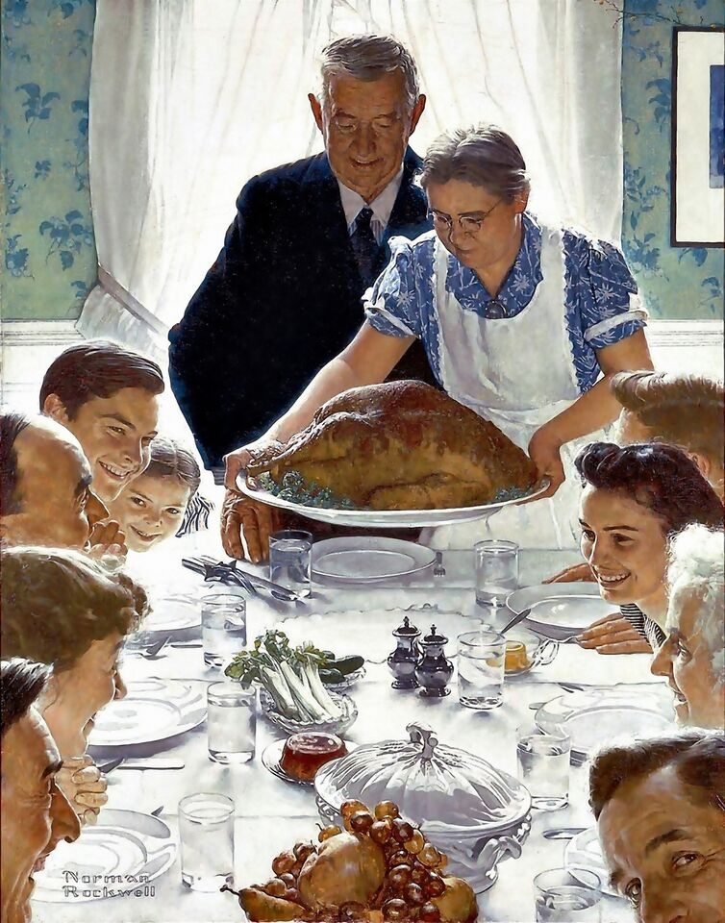
Preferences
Consumer demand drives economic phenomena, including (especially?) around food.
Foods bring joy and are central to culture, not just a means to producing good health.
People therefore seek foods that yield immediate sensory and social satisfaction. Especially in ‘fast thinking’ mode around the >200 food decisions we make each day.
Tastes can be cultivated, but typically change slowly as culture (and genetics) evolve.
An improved food product only gains acceptance if it appeals to consumers on a basic sensory and sociocultural level.
Norman Rockwell, Freedom from Want (1943)

Slide 4
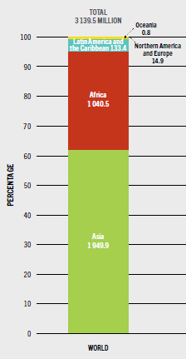
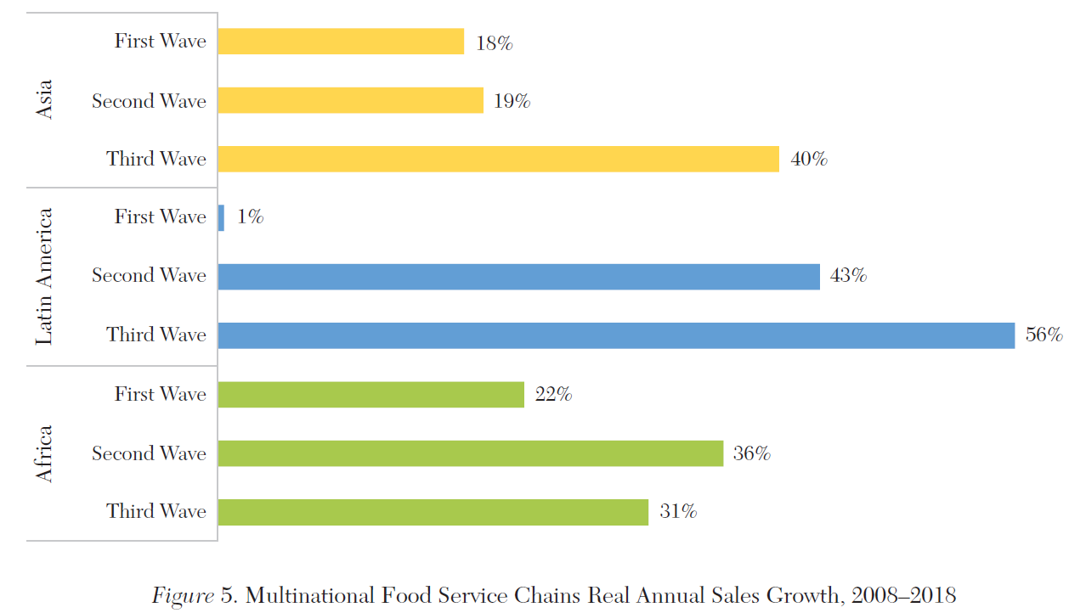
Constraints
Choice is limited by time/money (which resolve physical access limitations).
Cost – >3.1 bn people worldwide cannot afford a healthy diet. More nutrient rich foods are typically more expensive. Healthy foods that aren’t affordable for the poor and working class, won’t get eaten at scale.
Convenience – Time is scarce. As wages rise, so does the opportunity cost of time spent on meals. In US, $ spent on food away from home > food at home. FS is fastest growing.
More nutritious foods only get eaten if affordable/convenient for consumers.
FAO, Cost and Affordability of a Healthy Diet (2023)
Barrett et al., J. Econ. Literature (2022)

Slide 5
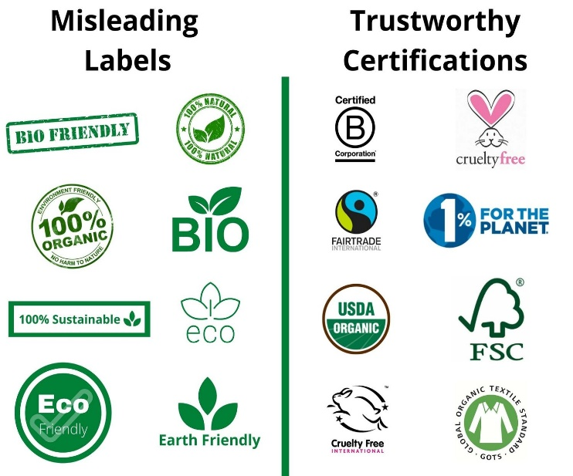
Information
People will pay a (small) premium for products or processes good/safe for them, others, or the planet if claimed benefits are credible (hopefully true!). Fundamental problems of ‘credence goods’, noisy signals and misinformation.
But if the cost to provide/communicate that benefit > consumers’ WTP, then need gov’t or industry to set/enforce standards (e.g., mineral/vitamin fortification).
Producers must know the production process that yields the benefits (extension).
Source: copythatco.com
Need extension and credible/cost-effective labeling .

Slide 6
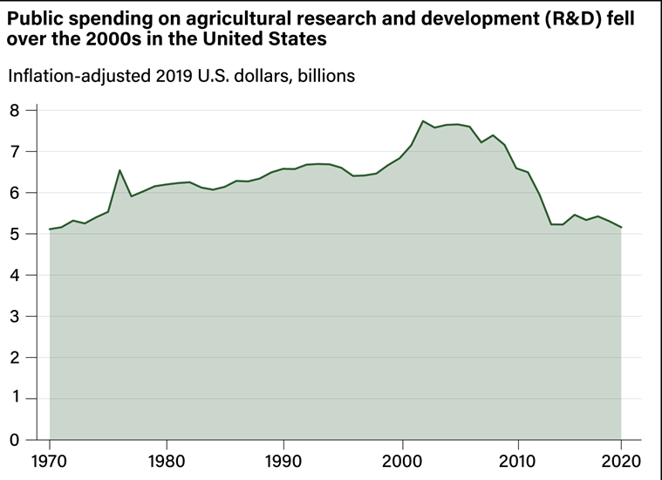
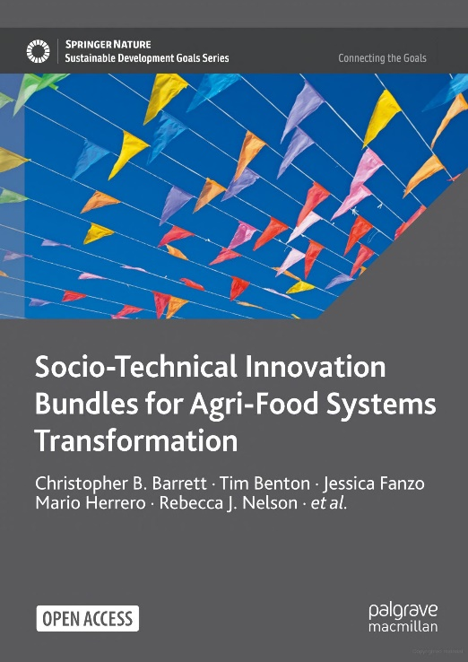
Incentives
Producers must profit w/acceptable risk exposure.
No producer can sustain losses indefinitely. Many can’t withstand one catastrophic loss.
Ag productivity turns on pests, soils and weather. So need to accelerate R&D to adapt and produce more food off-farm. (Yet it’s falling in the US!!!)
Productivity and prices drive profits. Farm prices driven by mid-stream actors who get >70% consumer $ and influence consumer preferences.
Need R&D for novel, healthy foods and processes, as well as extension and insurance for farmers and standards for processors/retailers.
Source: USDA ERS

Slide 7
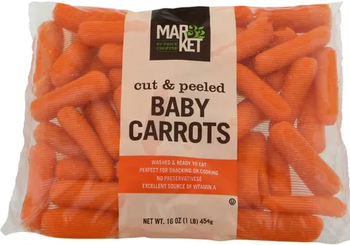
Summary
Agrifood systems innovations can advance health, equity, resilience and sustainability goals.
Requires foods that are affordable, convenient, sensorily and socio-culturally appealing to consumers and profitable for producers and distributors.
Any non-obvious benefits must be credibly/cheaply communicable or enforced via science-based standards.
Thank you for your interest!

