Slide 1

Christopher B. Barrett
Charles H. Dyson School, Cornell University
Presentation at the Cornell University/Institute on Science for Global Policy conference on Food Safety, Security, and Defense:
Focus on Food and the Environment
October 6, 2014
Building Resilience for Global Food Security

Slide 2
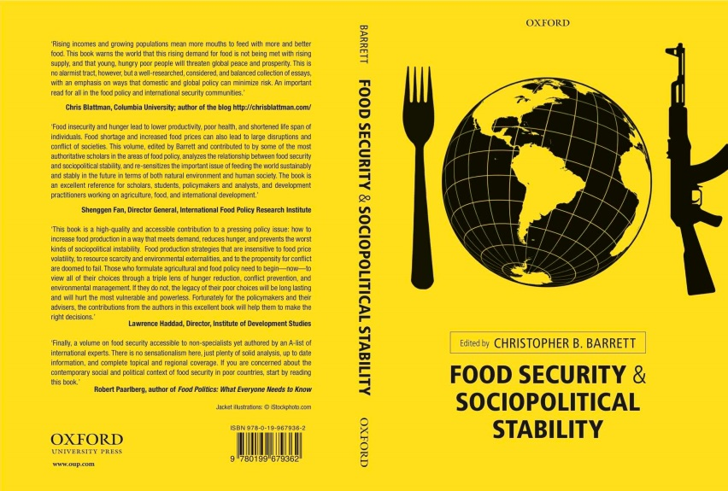
Motivation
Why development and humanitarian communities’ current fascination with “resilience”?
Risk increasing in frequency/intensity
Recurring crises in chronically food insecure regions make it difficult to reconcile humanitarian response to disasters with longer-term development efforts.
Concerns that food insecurity affects national security (esp. since 2008)

Slide 3
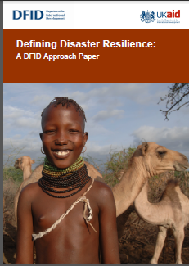
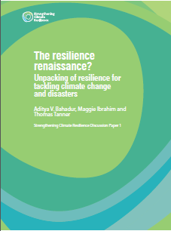
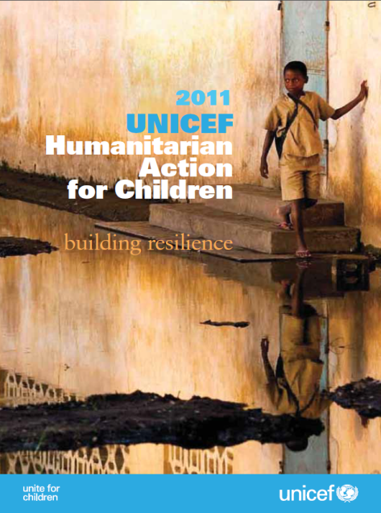
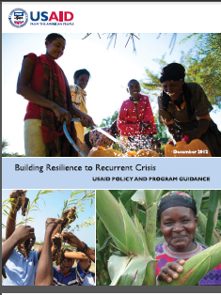
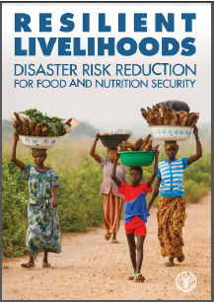
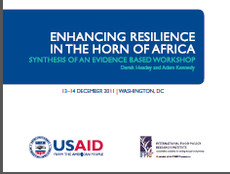
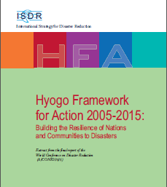
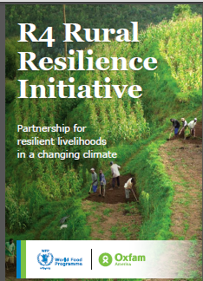
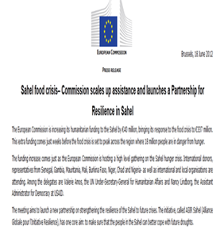
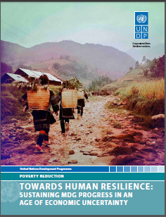
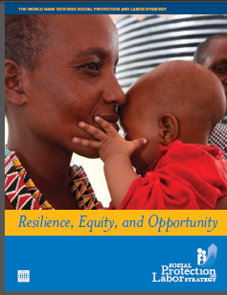
Motivation
“Resilience” has become a buzzword within the development/humanitarian communities … policy is out ahead of the science ! ☹

Slide 4
Theory and Measurement
New innovations in resilience theory/measurement
resilience = a tolerably low probability over time of enduring unacceptable living standards
relate directly to food security/poverty traps and enable rigorous evaluation of interventions.
Barrett and Constas, Proceedings of the National Academy of Sciences, 2014.

Slide 5
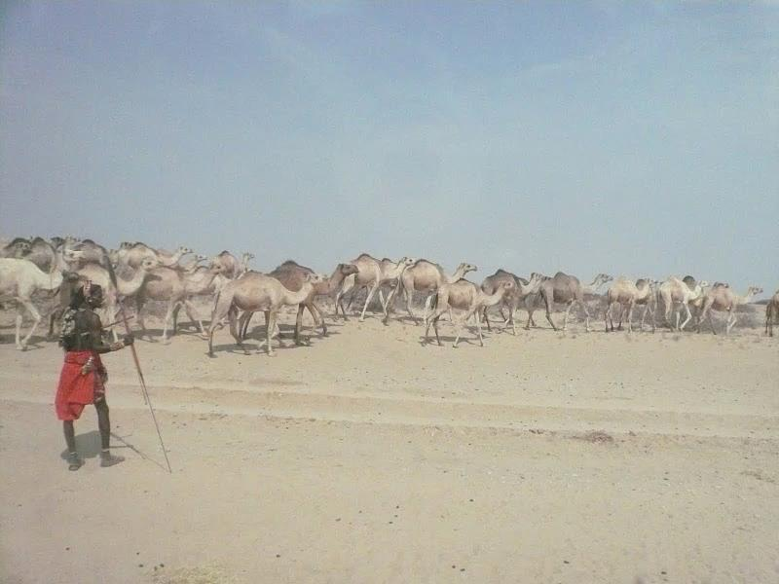
Evaluating Options
Private-public partnerships central to many options to build resilience. Must evaluate the many options carefully!
Example: Index insurance for herders in East Africa (e.g., Index-Based Livestock Insurance) vs. HSNP
See http://livestockinsurance.wordpress.com/ for videos/details

Slide 6
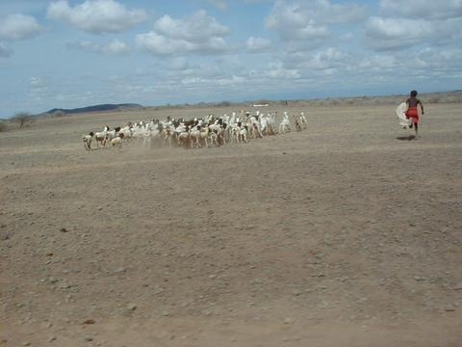
Thank you
Forward progress is possible with carefully evaluated interventions to build resilience.
Thank you for your time, interest and comments!

