Slide 1
The System of Rice Intensification and Its Impacts on Household Income and Child Schooling: Evidence from Rural Indonesia
Kazushi Takahashi, Institute of Developing Economies (Japan)
and
Christopher B. Barrett, Cornell University (USA)
  Australian National University seminar
  June 4, 2013

Slide 2
Motivation
SRI as pro-poor, environmentally friendly innovation:
  Nontraditional origins (developed by missionary priest in Madagascar, not in the labs/fields of a research institute)
  No purchased or new external inputs needed, less H₂0 use
  Intensive use of labor; the poor commonly have surplus
Controversy within rice community
  Repeated observations of large yields gains (50-200%) on farmers’ fields in multiple countries across Africa and Asia, while some experimental trials show little impact on yield (McDonald et al., 2006, 2008).
  Weak theoretical foundation: Science behind SRI’s yield effects remains unknown; SRI not accepted by some crop scientists (“Scientific Unconfirmed Field Observations”).

Slide 3



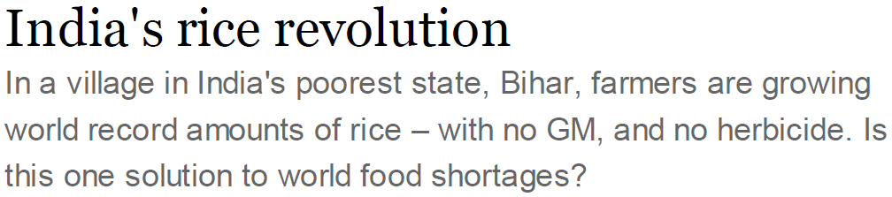

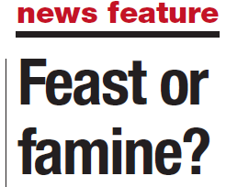
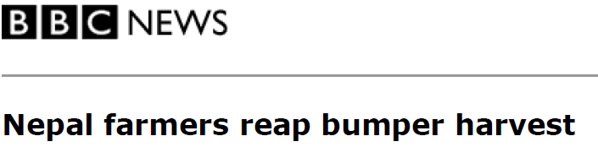
Motivation
SRI has gained international media/donor attention:

Slide 4
A big knowledge gap
What are the welfare impacts of SRI?
Amid the scientific disputes about the biology of SRI, the impacts (if any) on farmer welfare and broader economic impacts have been largely ignored.
Widespread adoption but in some places also much disadoption too … are users really better off?
On-station experimental trials may not reflect farmers’ realities, while simple with-without comparisons among farmers or over time ignore selection effects and spurious correlation with background trends.
Especially if it requires more labor, must look beyond just partial productivity of land (yield) impacts.

Slide 5
Our contribution
Our core (as-yet-unanswered) question:
What impact does SRI have on household income, including off-farm income generation, and on children’s education?
Use original primary data collected in rural Indonesia to:
Identify the factors associated with SRI use
Use those results to match on observables using propensity score matching (PSM) (w/tests sensitivity to unobservables)
Estimate the impacts of SRI adoption on:
  yield and rice income/HA at plot level
  Farm/off-farm/total incomes, child school enrollment at hh level

Slide 6
Our contribution
Core findings:
SRI indeed generates big (~64%) yield and plot-level rice income (107%) gains but also demands more labor, consistent with prior findings.
SRI users have lower off-farm earnings, especially women’s self-employed earnings and as a result have no significant total household income gains
SRI users’ children show no difference in school enrollment patterns

Slide 7
What is SRI?
SRI is a systems-based rice production approach/ technology characterized by a suite of agronomic practices and principles:
  Early transplanting of young seedlings (8-12 days old)
  Shallow planting (1-2 cm) of one or two seedlings
  sparse planting density (more than 20 × 20 cm)
  intermittent irrigation (alternate wetting and drying)
No new seed, agrochemicals, etc. – and less water – required
  It is commonly held that SRI is complex and careful/ timely water management and weed control are required. Thus both higher yields and higher yield risk (Barrett et al. AJAE 2004).

Slide 8
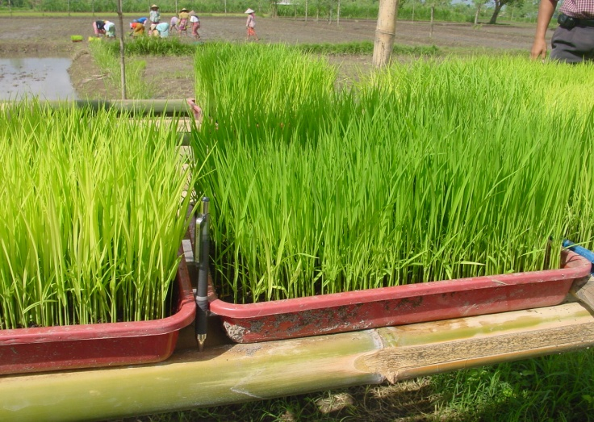
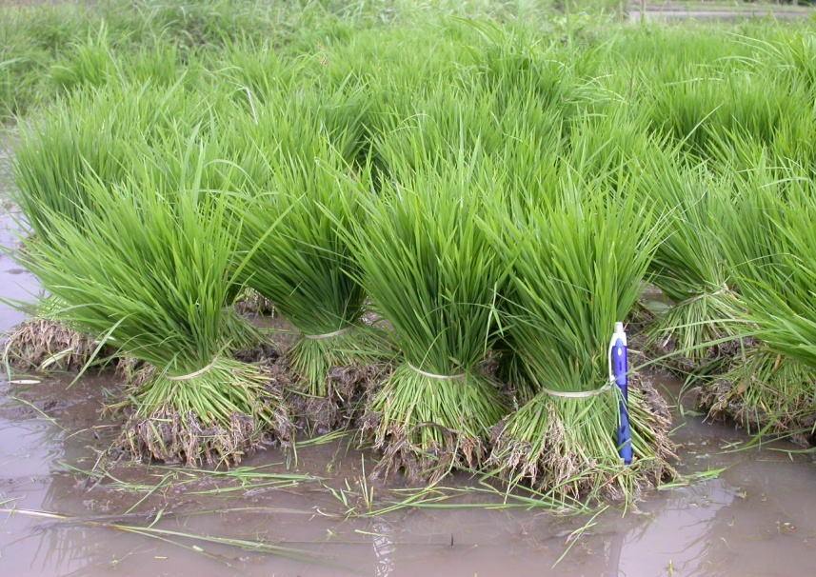
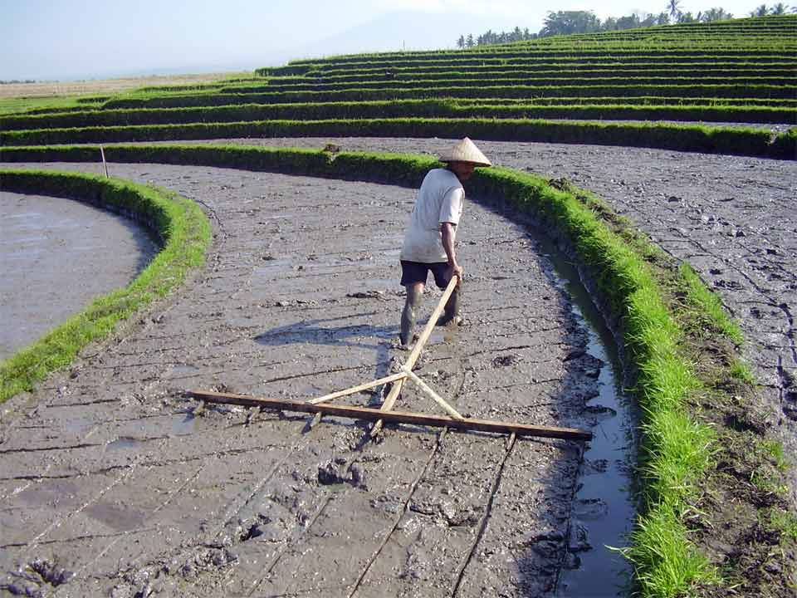
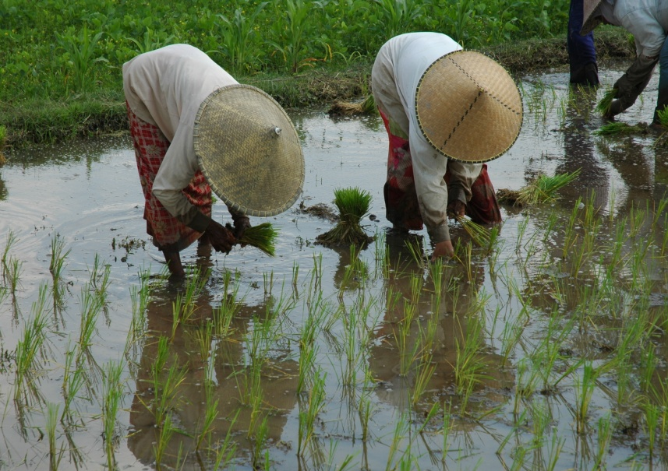
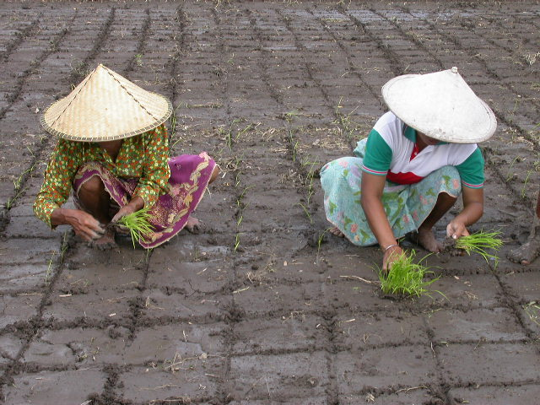
What is SRI?
SRI Seedling
(10 days after Seeding)
Non-SRI
Seedlings
(30 days after seeding)
Photos by Nippon Koei

Slide 9
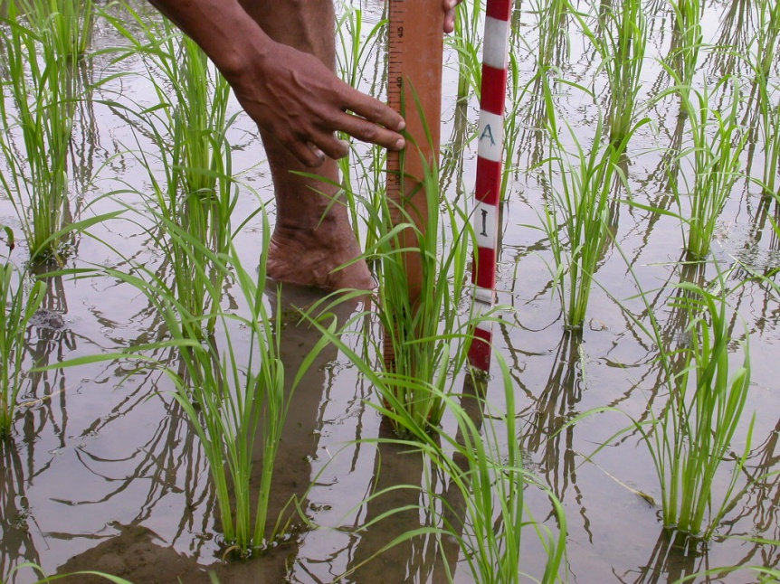
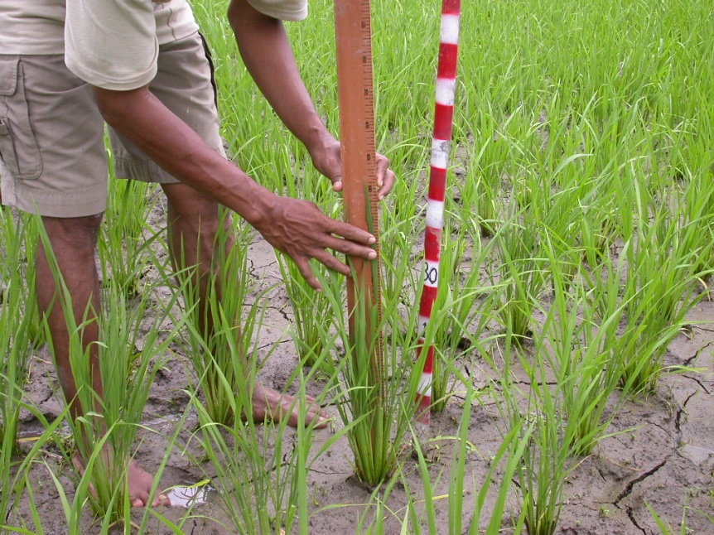
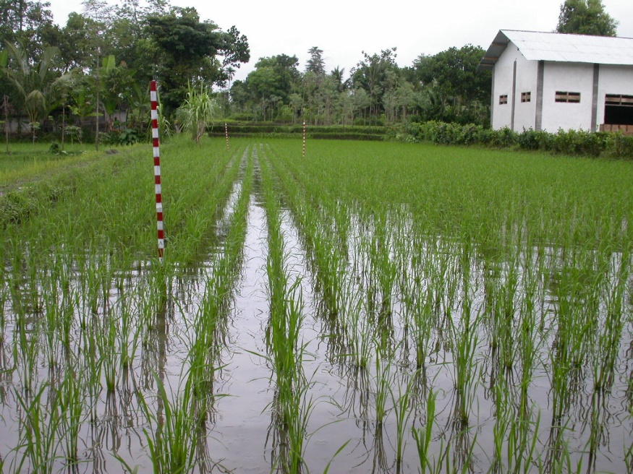
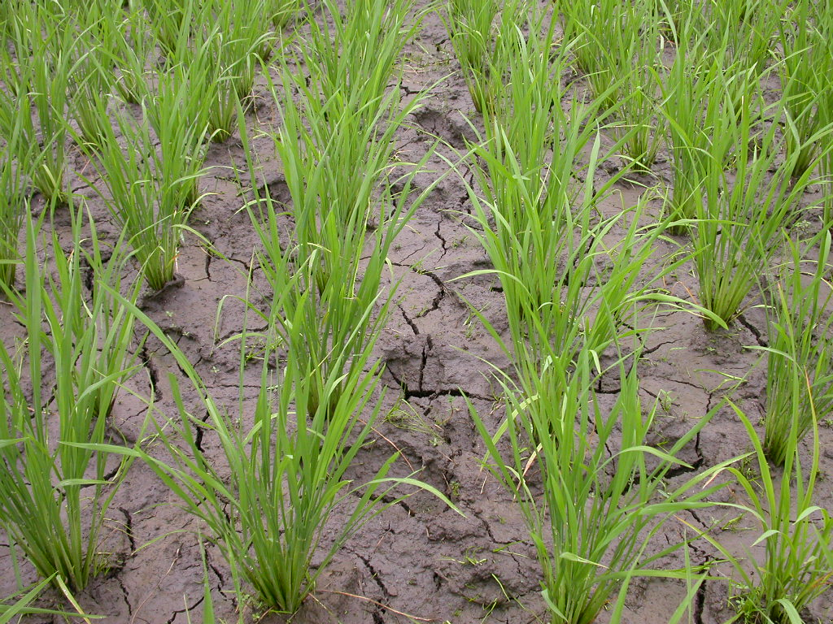
What is SRI?
Wet
Dry
Photos by Nippon Koei

Slide 10
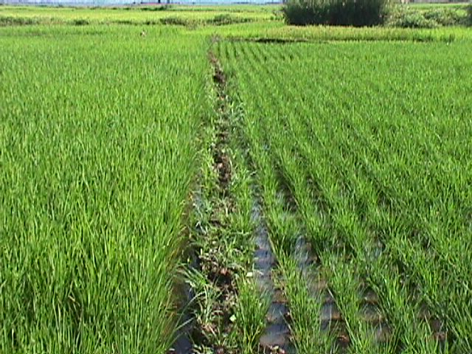
What is SRI?
Non-SRI
SRI
Photo by Christine Moser (Madagascar)

Slide 11
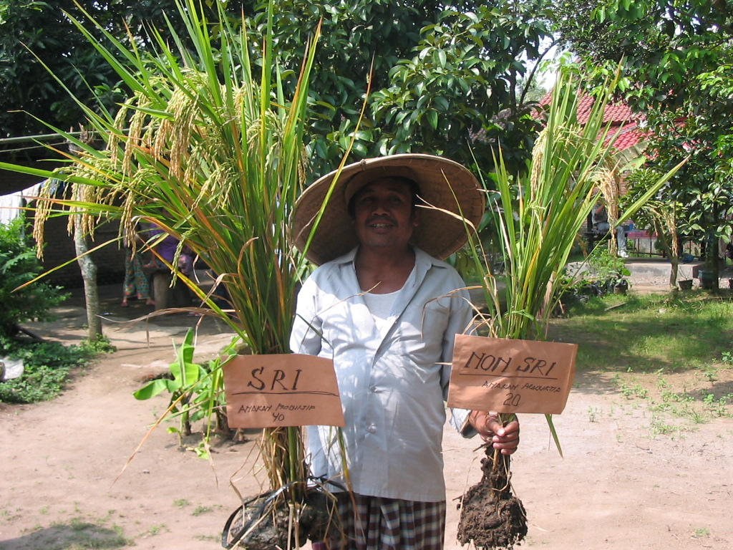
What is SRI?
Photos by Nippon Koei

Slide 12
Impact Evaluation
We want to know avg treatment effect on the treated (ATT), but it is impossible to observe the outcome of SRI-adopters had they not adopted SRI. So use PSM to match conditional on probability of SRI use, as estimable based on plot- and household-level observable characteristics.
But we know that SRI uptake is highly non-random, with >½ of yields gains due to farmer- or plot-specific observables/unobservables (Barrett et al. AJAE 2004).
So (i) try to elicit/control for some unobservables, (ii) do sensitivity testing using Rosenbaum (2002) bounds and Ichino et al. (2008) methods.

Slide 13
Data
Jeneponto District, South Sulawesi, Indonesia
Poor, agriculture-dependent region
Annual rainfall is limited (1,000 mm-1,500 mm/year)
Irrigation project funded by JICA
SRI promoted under the scheme since 2002
Sample: 864 rice farmers (122 SRI adopters/742 non-adopters), with 1202 rice plots after 2009 wet season

Slide 14
Descriptive Stats 1
 |  | Mean | sd
Household Characteristics
# of Cultivated Plots |  | 1.43 | 0.8
Total Land Size | (ha) | 0.64 | 0.6
Adopt SRI | (%) | 14.12 | 34.8
SRI Experience | (years) | 0.71 | 1.9
SRI Experience conditional on SRI uptake | (years) | 4.31 | 2.8
Plot Characteristics
Adopt SRI | (%) | 13.98 | 34.69
Young Seedling | (%) | 13.64 | 34.34
Shallow Planting | (%) | 13.14 | 33.80
Parse Planting | (%) | 13.56 | 34.25
Intermittent Irrigation | (%) | 11.15 | 31.49
Full Adoption of SRI | (%) | 9.98 | 29.99

Slide 15
Descriptive Stats 2
 |  | SRI | Non-SRI | Diff
Plot level outcomes ( n=168 SRI, 1,034 non-SRI)
Yield | (ton/ha) | 5.50 | 2.95 | 2.54***
Rice income per ha | (Mn Rp) | 6.67 | 2.46 | 4.21***
Household level outcomes ( n=122 SRI, 742 non-SRI)
Monthly Total Farm income | (000 RP) | 732.50 | 238.80 | 493.7***
Monthly Total off-farm labor income | (000 RP) | 543.90 | 503.90 | 40.06
o/w Off-farm wage earnings | (000 RP) | 398.10 | 272.30 | 125.80
o/w Self-employed non-farm income | (000 RP) | 145.90 | 231.60 | -85.69
Monthly Total labor income | (000 RP) | 1276.50 | 742.70 | 533.7***
SRI yields +86%, rice income +171%, hh income +72% … are these gains attributable to SRI?

Slide 16
Probit SRI Use Estimates
Table 4. Selected Probit Results of SRI Use at Plot Level
VARIABLES | Estimate | (SE)
Plot upstream | 0.802*** | (0.238)
Plot midstream | 0.488** | (0.199)
Plot receives water directly from canal | 0.947*** | (0.222)
Size of plot (ha) | 0.243* | (0.141)
Number of plots a household operates | -0.121** | (0.052)
Dummy equal to 1 if a household head is female | -0.823*** | (0.294)
Number of HH members age 6 and below | -0.330*** | (0.070)
Number of HH members age 15 and above | 0.071** | (0.032)
Number of HH members age between 6-14 | 0.026 | (0.073)
At least one technology advisor ever adopted SRI | 1.843*** | (0.133)
Risk averse | -0.425* | (0.228)
Pseudo R² | 0.379
Sensible results, although the purpose of this step isn’t causal inference, esp. given prospective endogeneity of some covariates.

Slide 17
Common support check
Distributions of SRI and non-SRI plots are each skewed, so use kernel matching, drop (12) off-support observations.
Post-match, all covariates pass balancing test at 10% level

Slide 18
Plot-Level ATT Estimates of SRI Use
PSM Impact Estimates
Large yield and rice profit gains, even with added labor use (added cost only ~10% of profit gains at prevailing wage rates).
Even allowing for the possibility of selection-on-unobservables, the impacts of SRI use on rice yields, rice income per hectare are clear. But gains in terms of labor use less convincing.

Slide 19
PSM Impact Estimates
Household-Level Impacts of SRI Use
Farm income gains from SRI use are completely offset by lower off-farm earnings, especially women’s self-employed non-farm income. No household income gains, on average, from SRI.

Slide 20
PSM Impact Estimates
Household-Level Impacts of SRI Use
Despite the increased labor demands of SRI use, children in SRI households are no less likely to attend school and no more likely to be delayed in school progress.
Offsetting income effects of productivity gains and substitution effects on labor demand?

Slide 21
Conclusions
We corroborate claims of SRI’s tremendous plot level productivity gains, but also of increased labor demand.
But we find that these productivity gains vanish at household level. SRI seems to induce reallocation of (women’s) time from off-farm self-employment, wiping out income gains at the household level.
Some of those are perhaps invested in keeping children in school in spite of higher returns to family labor on-farm.
Puzzle: where do the productivity gains go? Why only modest (18%) disadoption? Adopters capture gains in non-monetary form (esp. locational preferences for work).

Slide 22
Thank you!
Thank you for your time, interest and insights

