Slide 1

Index-based Livestock Insurance (IBLI) for Northern Kenya Pastoralists
Christopher B. Barrett
October 7, 2009
Institute for African Development, Cornell University

Slide 2
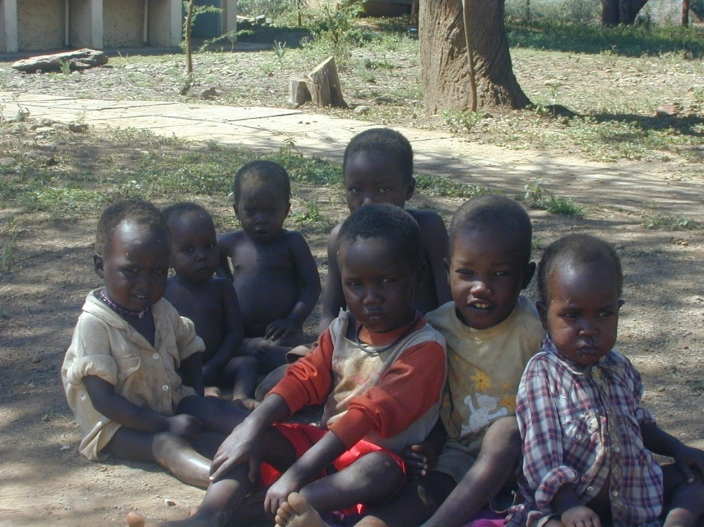
Getting Smart About Risk and Poverty Traps
Strong evidence of poverty traps in the arid and semi-arid lands (ASAL) of east Africa
Usual humanitarian response to shocks: food aid
Pay attention to the risk and dynamics that cause destitution … else beware an aid trap!
Notes:
2

Slide 3
Insurance and Development
Economic costs of uninsured risk, esp. w/poverty traps
Sustainable insurance can:
  Prevent downward slide of vulnerable populations
  Stabilize expectations & crowd-in investment and accumulation by poor populations
  Induce financial deepening by crowding-in credit supply and demand
But can insurance be sustainably offered in the ASAL?
Conventional (individual) insurance unlikely to work, especially in small scale pastoral/agro-pastoral sector:
  Transactions costs
  Moral hazard/adverse selection

Slide 4
Index Insurance: Advantages
Index insurance provides insurance based on events collectively – rather than individually – experienced. Can avoid problems that make individual insurance infeasible:
  No transactions costs of measuring individual losses
  Preserves effort incentives (no moral hazard) as no single individual can influence index.
  Adverse selection does not matter as payouts do not depend on the riskiness of those who buy the insurance
  Available on near real-time basis: faster response than conventional humanitarian aid
Index insurance can, in principle, be used to create a productive safety net needed to alter poverty dynamics

Slide 5
Index Insurance: Challenges
‘Big 5’ Challenges of Sustainable Index Insurance:
  High quality data (reliable, timely, non-manipulable, long-term) to calculate premium and to determine payouts
  Minimize uncovered basis risk through product design
  Innovation incentives for insurance companies to design and market a new product
  Establish informed effective demand, especially among a clientele with little experience with any insurance, much less a complex index insurance product
  Low cost mechanism for making insurance available for numerous small and medium scale producers

Slide 6
Index Insurance: Solutions to the Challenges
Solutions to the ‘Big 5’ Challenges:
  High quality data
    Satellite data (remotely sensed vegetation: NDVI)
  Minimize uncovered basis risk
    Analysis of household panel data on herd loss
  Innovation incentives for insurers
    Researchers do product design work, develop awareness materials, help facilitate reinsurance
  Establish informed effective demand
    Simulation games with real information & incentives
  Low cost mechanism
    Delivery through partners
Notes:
6

Slide 7
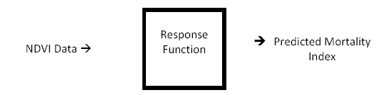

Livestock Mortality Index
One possible index is based on area average livestock mortality predicted by remotely-sensed (satellite) information on vegetative cover (NDVI):
Notes:
7

Slide 8
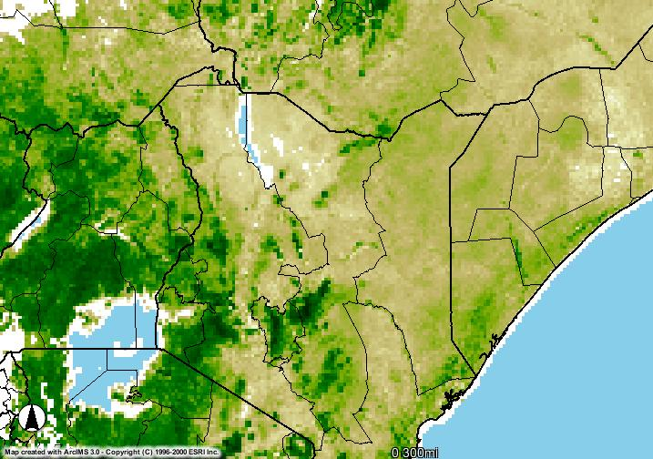
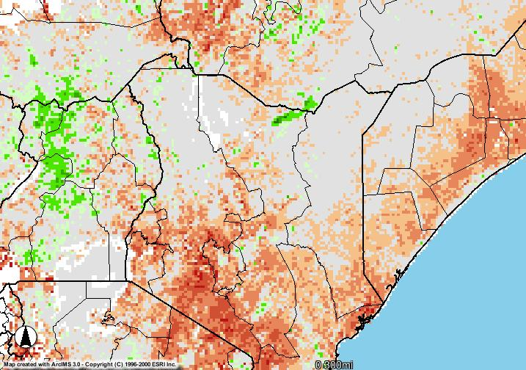
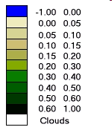
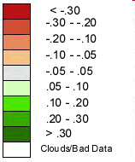
High Quality Data
NDVI Data
  Real-time available in 8×8 km² resolution
  27 years available since late 1981
NDVI February 2009, Dekad 3
Deviation of NDVI from long-term average
February 2009, Dekad 3
NASA NDVI Image Produced By: USGS-EROS Data Center. Source: Famine Early Warning System Network (FEWS-NET)
Laisamis Cluster, zndvi (1982-2008)
Historical droughts
Notes:
8

Slide 9
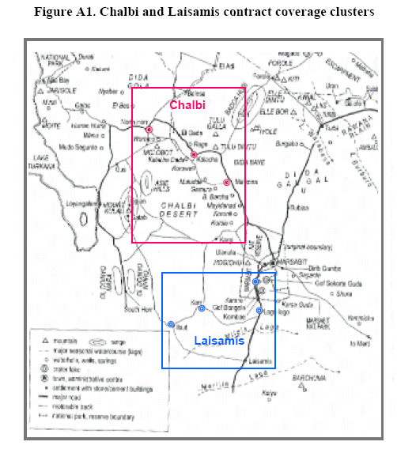
Estimate separate response functions for distinct geographic clusters due to differences in herd composition, grazing ranges, water access, etc.
Geographic Clusters
Notes:
9

Slide 10
Temporal structure of IBLI contract
Product Design
Notes:
10

Slide 11
How will IBLI work?
Consider 1-year contract for a pastoralist in the Chalbi cluster who would like to insure 1 cattle worth KSh10,000.
During the sale period at the beginning of the coverage year, he pays an annual premium (Ksh) = % × insured value
At the end of each of the two covered season, he receives indemnity payment (KSh) = (predicted mortality rate - M*)% × insured value
9%
Notes:
11

Slide 12
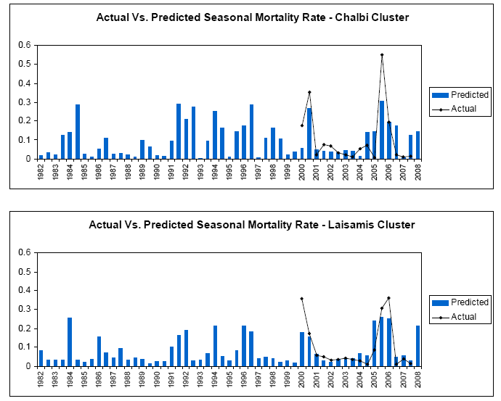
Performance of NDVI-based Mortality Index
Notes:
12

Slide 13
Performance of NDVI-based Mortality Index
Index predicts large-scale losses well
Notes:
13

Slide 14
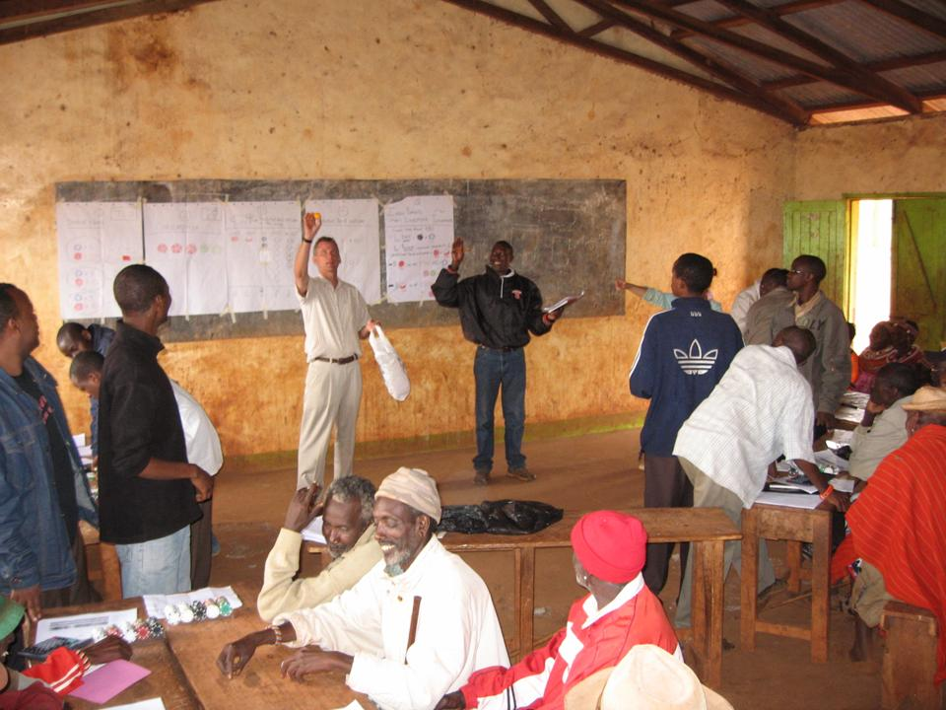
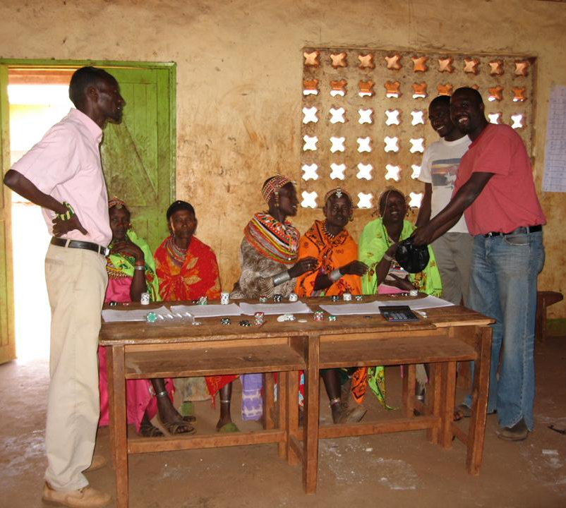
Establishing Informed, Effective Demand
Experimental IBLI Game
(i) Teach how IBLI works and how IBLI can affect herd dynamics
(ii) Game with real monetary stakes. Pretested in 2008.
Notes:
14

Slide 15
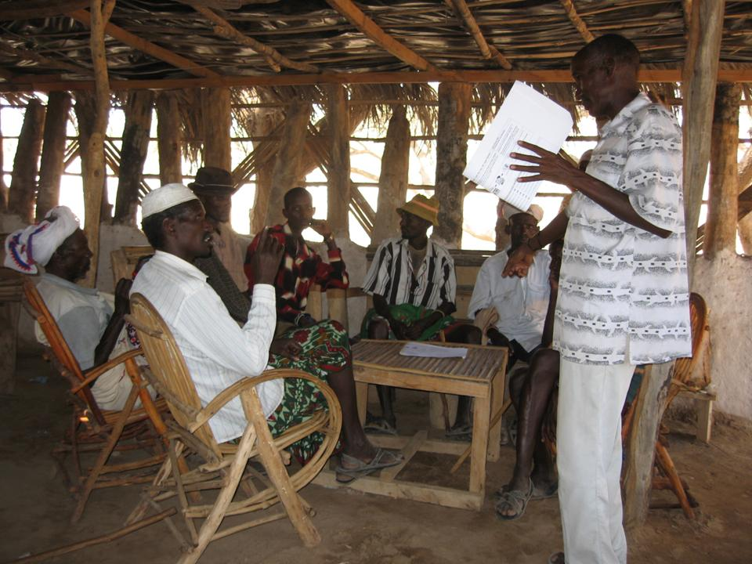
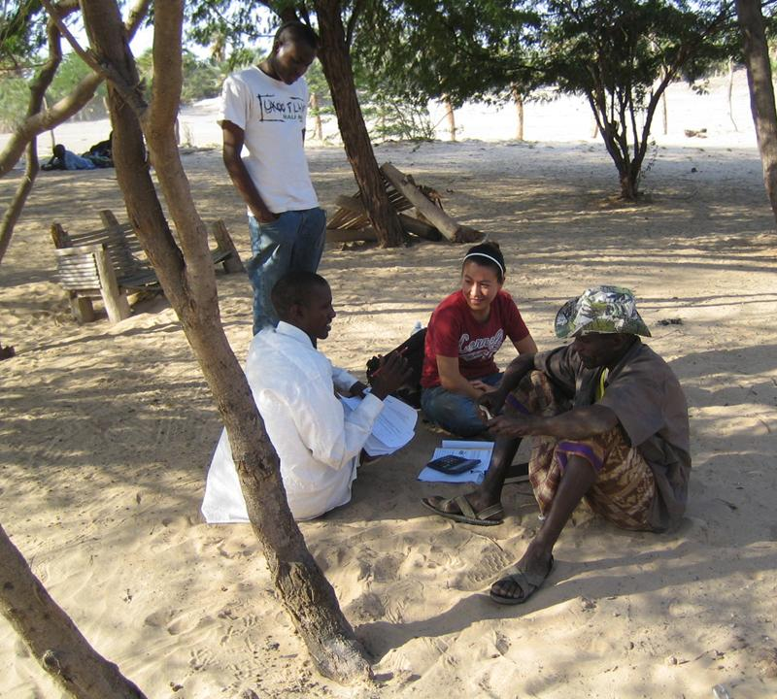
Establishing Informed, Effective Demand
Willingness to pay (WTP) experiments using contingent valuation methods
Notes:
15

Slide 16
Establishing Informed, Effective Demand
Estimated WTP for 10% strike contract
(Fair premium rate = 6.8% of total insured herd value)
IBLI demand appears
very price elastic.
Notes:
16

Slide 17
The Ways Forward
Pilot plan for Marsabit District (northern Kenya) in early 2010 by Equity Bank and UAP with international reinsurance, leveraging point of sale devices used for Hunger Safety Net Program.
Integrated survey design to study impact and design of IBLI
  HH survey of targeted population in pilot and control locations
  Discount coupons randomly allocated to eligible subpopulations to encourage uptake and generate variation in premiums.
World Bank has funded replication of this work in Tanzania

Slide 18
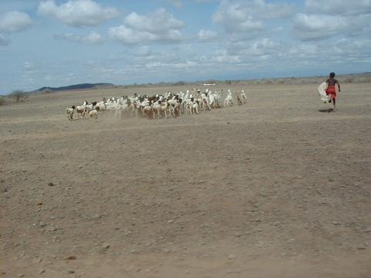
IBLI is a promising option for putting risk-based poverty traps behind us
For more information visit www.ilri.org/livestockinsurance
Thank you for your time, interest and comments!
Notes:
18

