Slide 1
The Perils of Panel IV Estimation:
Revisiting the Causes of Conflict
Paul Christian
Christopher B. Barrett
1/5/2021

Slide 2
Causes of conflict
Zurcher 2017 systematic review finds that much/most evidence about aid and conflict comes from:
  Country cases studies
  Cross country panel regressions
Nunn and Qian 2017 instrument for food aid deliveries by US wheat production interacted with regularity of aid receipt
  Find that increasing food aid 1,000 MT increases conflict by 0.3 percentage points
Hull and Imai 2018 instrument for economic growth using interest rates
  Find that 4% negative growth shock increases conflict risk by 30%

Slide 3
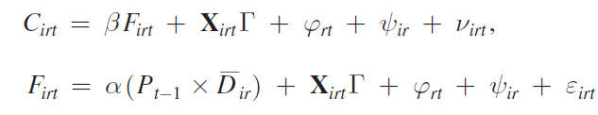
NQ Estimation Strategy
Estimate conflict as function of (endogenous) food aid receipts, given controls, incl. region-year and country fixed effects.
Policy generates random variation: “USDA accumulates wheat in high production years as part of its price stabilization policies. The accumulated wheat is stored and then shipped as food aid to poor countries.”
→Exogenous shocks to wheat production change availability of food aid at margin. →Primarily among regular food aid recipients?
Identification:
“US wheat production is associated with more conflict among regular US food aid recipients but not among irregular recipients.”

Slide 4
Talk Outline
Outline for rest of talk:
Panel IV w/o interacted instruments
  Correlations ignoring the time series
  Trends in sequenced observations
  Monte Carlo demonstration of inference problems with co-trending variables
  Cointegration and reverse causation
  First differencing to address nonstationarity
Do interacted instruments fix the problem?
Practical diagnostic steps for panel IV efforts

Slide 5
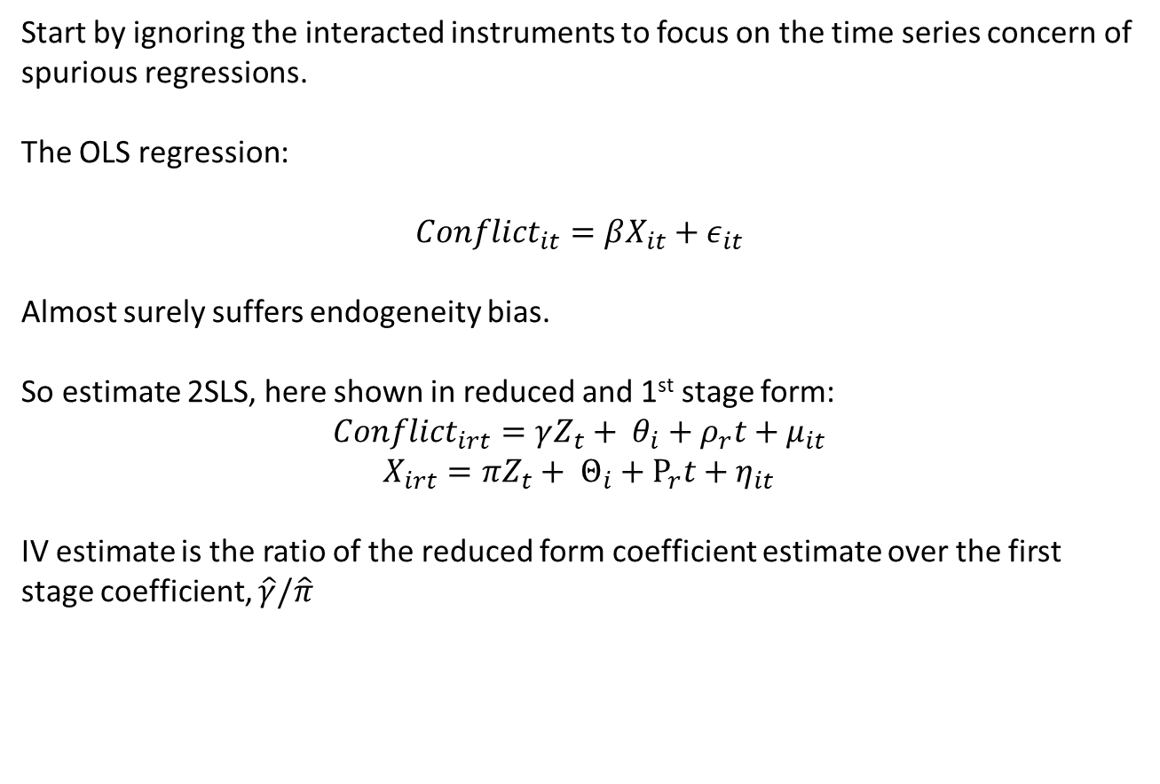
Estimation w/o shift-share instrument
Start by ignoring the interacted instruments to focus on the time series concern of spurious regressions.
The OLS regression:
$$Conflict_{it}=βX_{it}+ε_{it}$$
Almost surely suffers endogeneity bias.
So estimate 2SLS, here shown in reduced and 1st stage form:
$$Conflict_{irt}=γZ_{t}+ θ_{i}+ρ_{r}t+μ_{it}$$
$$X_{irt}=πZ_{t}+ Θ_{i}+Ρ_{r}t+η_{it}$$
IV estimate is the ratio of the reduced form coefficient estimate over the first stage coefficient, $\hat{γ}/\hat{π}$

Slide 6
Scatter Plots
If we ignore sequencing of observations, this works for growth and interest rates:
Conflict and real interest rates GDP growth and real interest rates
Positive reduced form/Negative 1st stage → negative IV

Slide 7
Scatter Plots
If we ignore sequencing of observations, this works for aid and conflict too:
Conflict and lagged US wheat output Food aid shipments and lagged US wheat output
Positive reduced form/Positive 1st stage → positive IV

Slide 8
Does IV establish causality?
Argument is usually that it is “hard to think of” a reason (after partialing out included controls) why civil wars would be affected by interest rates or US wheat yields except through endogenous variable (exclusion restriction)
As long as first stage regression significant and passes weak IV tests, this is taken as evidence of the policy channel establishing the IV (valid first stage)
BUT, we show (using old insights and methods) that ignoring time series properties means that reduced form coefficient estimates are large and significant more often than conventional tests indicate
When this happens, the first stage is also significant, because the endogeneity we were worried about in the first place spuriously correlates the outcome and endogenous X variables
→ lots of bad instruments can look like good instruments

Slide 9
Trends
And the endogenous regressors of interest likewise exhibit similar (or opposite) strong trends:
US wheat food aid shipments real GDP growth rates
The NQ (HI) endogenous regressor exhibits the same inverted-U (or its opposite, U) shape over the sample period.

Slide 10
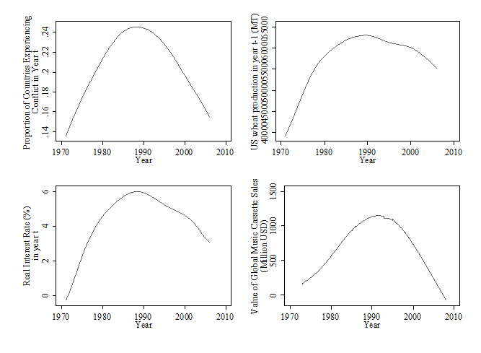
Trends
When we sequence the observations and estimate trends nonparametrically, a common pattern emerges:
The dependent variable, HI and NQ instruments, and an obviously spurious variable (global audio cassette tape sales) exhibit the same inverted-U shape over the sample period.

Slide 11
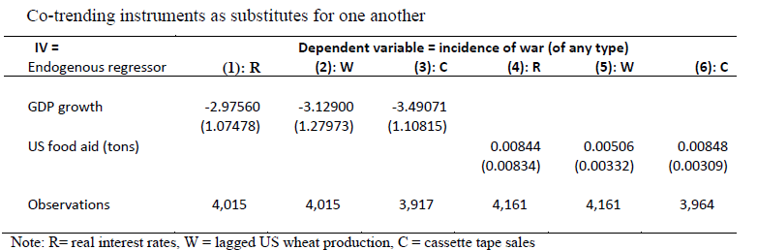
Trends in IV
Co-trending variables indeed serve as good substitutes for one another. No matter which variable we use as the IV, we get statistically indistinguishable 2SLS estimates.
How do we know which are spurious vs. truly causal?

Slide 12
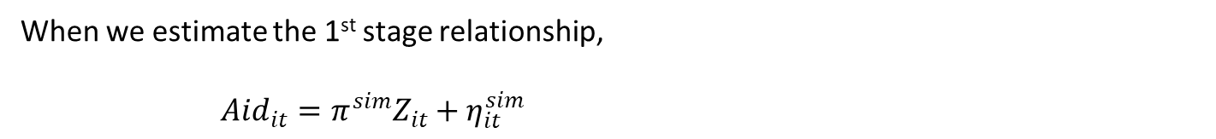
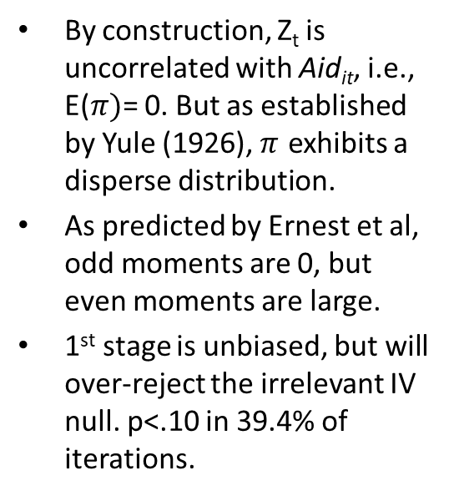
First stage with placebo random walk instrument
When we estimate the 1st stage relationship,
$Aid_{it}=π^{sim}Z_{it}+η_{it}^{sim}$
By construction, Z_{t} is uncorrelated with Aid_{it}, i.e., E($π)$= 0. But as established by Yule (1926), $π$ exhibits a disperse distribution.
As predicted by Ernest et al, odd moments are 0, but even moments are large.
1st stage is unbiased, but will over-reject the irrelevant IV null. p<.10 in 39.4% of iterations.

Slide 13
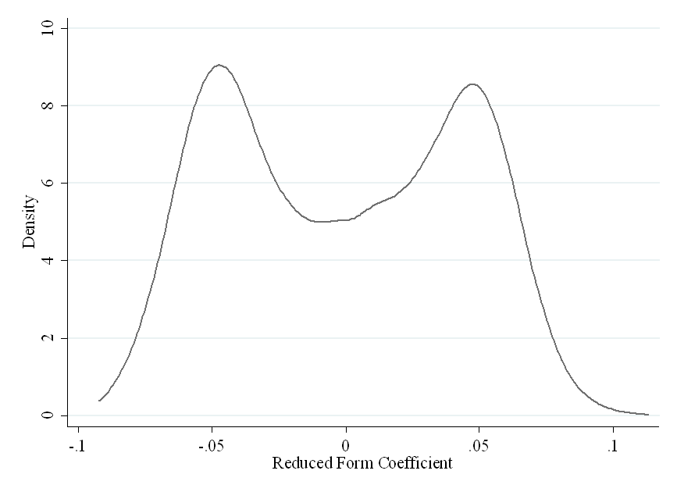
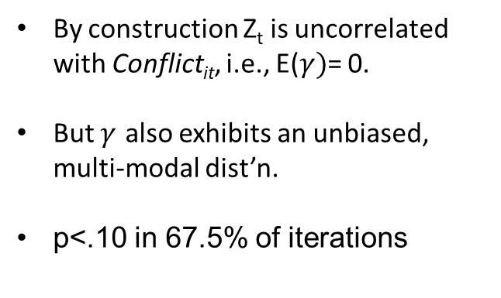
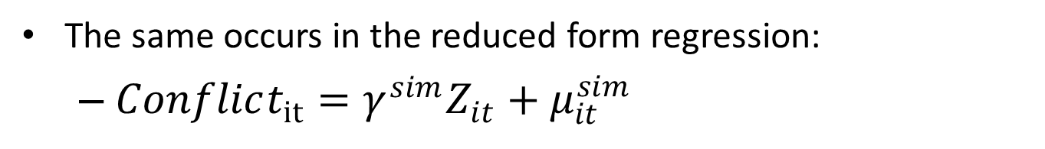
Reduced form with placebo random walk instrument
The same occurs in the reduced form regression:
  $Conflict_{it}=γ^{sim}Z_{it}+μ_{it}^{sim}$
By construction Z_{t} is uncorrelated with Conflict_{it}, i.e., E($γ)$= 0.
But $γ$ also exhibits an unbiased, multi-modal dist’n.
p<.10 in 67.5% of iterations

Slide 14
IV Coefficient
The unbiasedness of the single regressions does not carry over to the IV estimate because the common cycling leads to positive correlation in the 1st stage and reduced form parameter estimates.
2SLS coefficient estimate distribution Reduced form vs. 1st stage estimates

Slide 15
IV Coeff for GDP Growth
We get the exact same result for the MC simulation of the HI estimates, with the important difference that the countercyclical pattern in real GDP growth rates leads to a negative correlation of the 1st stage and reduced form estimates.
2SLS coefficient estimate distribution Reduced form vs. 1st stage estimates

Slide 16
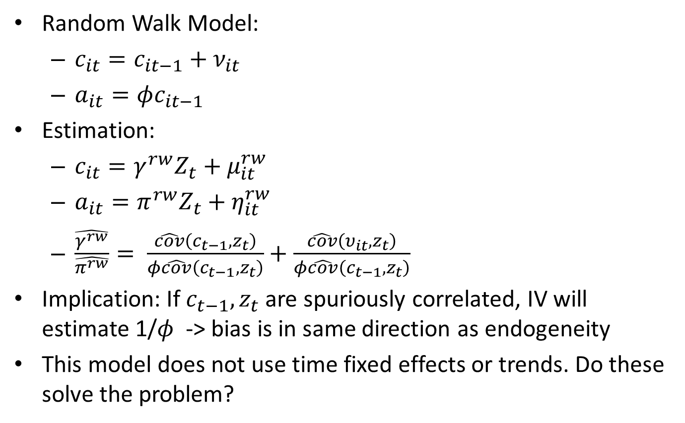
Why are over-rejections one-directional?
Random Walk Model:
  $c_{it}=c_{it−1}+ν_{it}$
  $a_{it}=φc_{it−1}$
Estimation:
  $c_{it}=γ^{rw}Z_{t}+μ_{it}^{rw}$
  $a_{it}=π^{rw}Z_{t}+η_{it}^{rw}$
  $\frac{\hat{γ^{rw}}}{\hat{π^{rw}}}= \frac{\hat{cov}\left(c_{t−1},z_{t}\right)}{φ\hat{cov}\left(c_{t−1},z_{t}\right)}+\frac{\hat{cov}\left(υ_{it},z_{t}\right)}{φ\hat{cov}\left(c_{t−1},z_{t}\right)}$
Implication: If $c_{t−1},z_{t}$ are spuriously correlated, IV will estimate 1/$φ$ -> bias is in same direction as endogeneity
This model does not use time fixed effects or trends. Do these solve the problem?

Slide 17
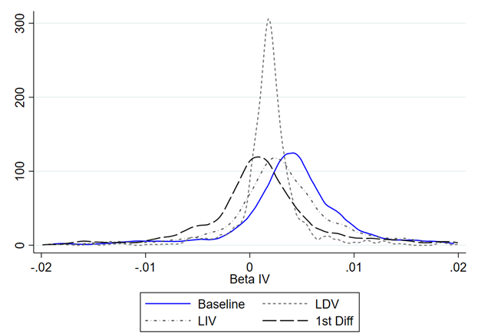
Does controlling for lags solve the problem?
Now expand the Monte Carlo 2SLS simulation to test 3 more variants: (i) LDV, (ii) LIV, (iii) first differences. LDV/LIV only work if they match the true ARIMA process. Only 1st diff works in the I(1) case we simulate.

Slide 18
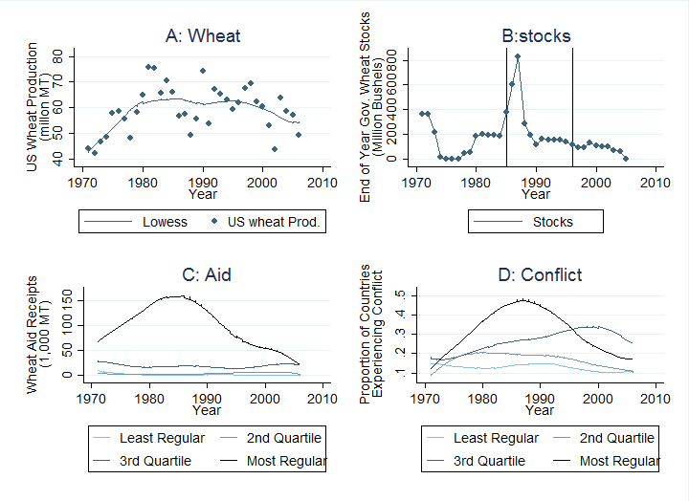
Decomposing Trends in NQ

Slide 19
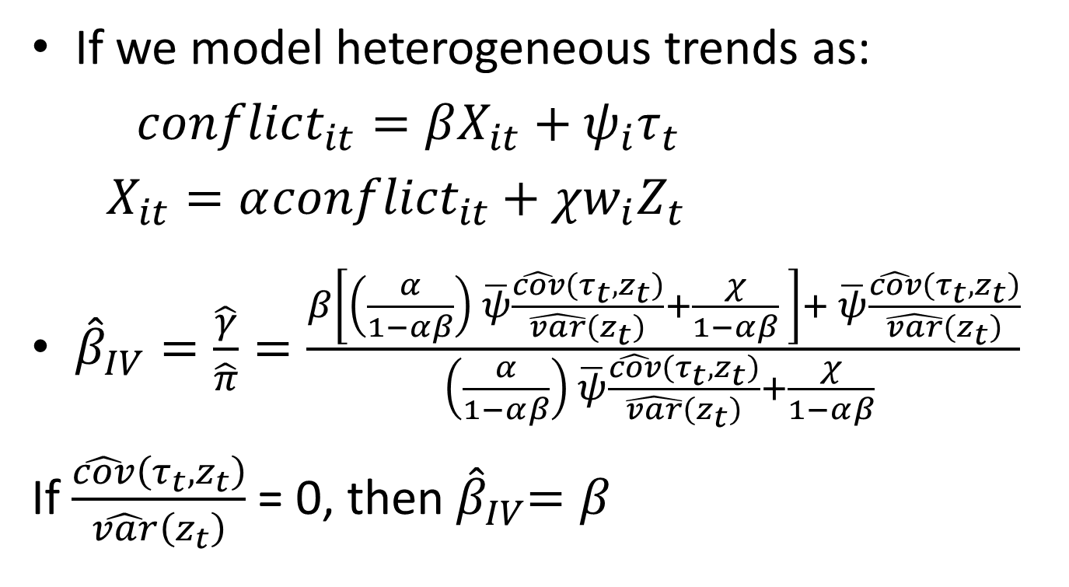
Solutions
If we model heterogeneous trends as:
$conflict_{it}=βX_{it}+ψ_{i}τ_{t}$
$X_{it}=α{conflict}_{it}+χw_{i}Z_{t}$
${\hat{β}}_{IV}=\frac{\hat{γ}}{\hat{π}}=\frac{β\left[\left(\frac{α}{1−αβ}\right) \overline{ψ}\frac{\hat{cov}\left(τ_{t},z_{t}\right)}{\hat{var}\left(z_{t}\right)}+\frac{χ}{1−αβ} \right]+ \overline{ψ}\frac{\hat{cov}\left(τ_{t},z_{t}\right)}{\hat{var}\left(z_{t}\right)}}{\left(\frac{α}{1−αβ}\right) \overline{ψ}\frac{\hat{cov}\left(τ_{t},z_{t}\right)}{\hat{var}\left(z_{t}\right)}+\frac{χ}{1−αβ} }$
If $\frac{\hat{cov}\left(τ_{t},z_{t}\right)}{\hat{var}\left(z_{t}\right)}$ = 0, then${ \hat{β}}_{IV}=β$

Slide 20
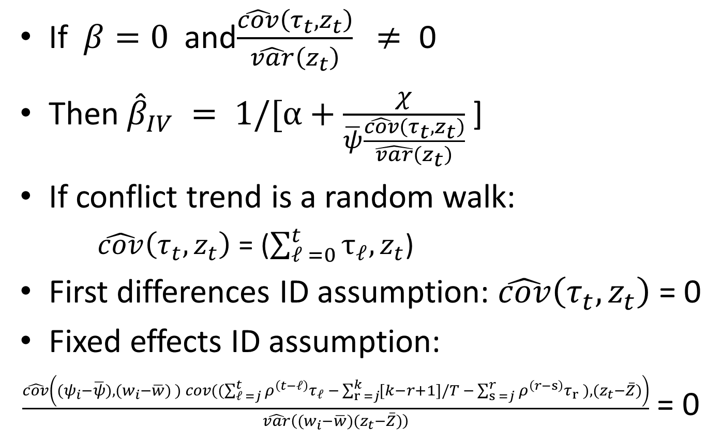
Solutions
If $β=0$and$\frac{\hat{cov}\left(τ_{t},z_{t}\right)}{\hat{var}\left(z_{t}\right)} ≠\text{ 0}$
Then ${\hat{β}}_{IV} = 1/[α+\frac{χ}{\overline{ψ}\frac{\hat{cov}\left(τ_{t},z_{t}\right)}{\hat{var}\left(z_{t}\right)}}$ ]
If conflict trend is a random walk:
  $\hat{cov}\left(τ_{t},z_{t}\right)$ = ($\sum_{𝓁 =0}^{t}{τ_{𝓁},z_{t}}$)
First differences ID assumption: $\hat{cov}\left(τ_{t},z_{t}\right)$ = 0
Fixed effects ID assumption:
$\frac{\hat{cov}\left({(ψ}_{i}−\overline{ψ}), (w_{i}−\overline{w}) ) cov((\sum_{𝓁 =j}^{t}{ρ^{\left(t−𝓁\right)}τ_{𝓁} −}\sum_{r =j}^{k}{[k−r+1]/T −}\sum_{s =j}^{r}{ρ^{\left(r−s\right)}τ_{r} }),(z_{t}−\overline{Z})\right)}{\hat{var}\left((w_{i}−\overline{w})(z_{t}−\overline{Z})\right)}$ = 0

Slide 21
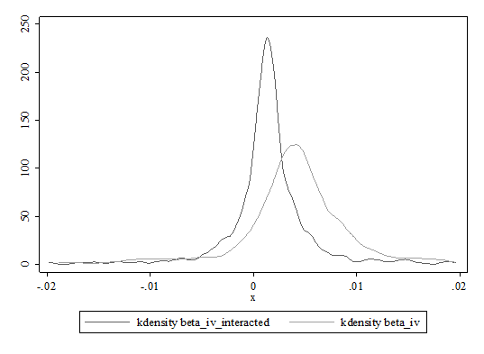

Shift-shares in Monte Carlo
When we repeat the Monte Carlo exercise, now using the actual interaction variables but still with a random walk time series instrument independent of both food aid flows and conflict, we find the same pattern. Interaction term merely rescales the bias from the uninteracted case. Because $D_{i}∈[0,1]$, this rescaling boosts power.

Slide 22
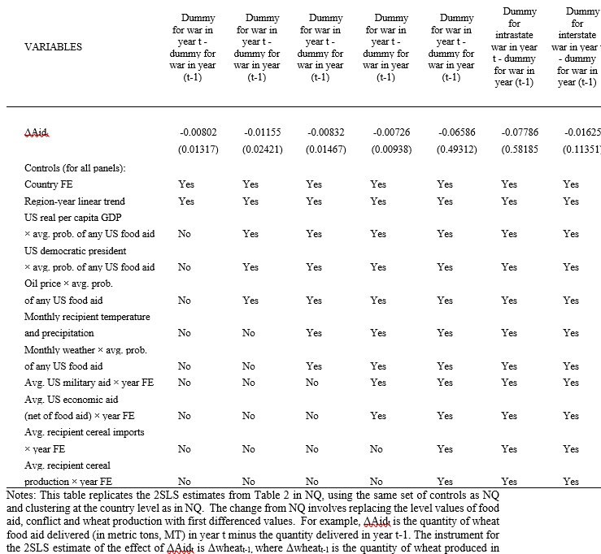
Estimating in first differences, (year to year changes only), NQ estimate flips signs (was positive) and not significant

Slide 23
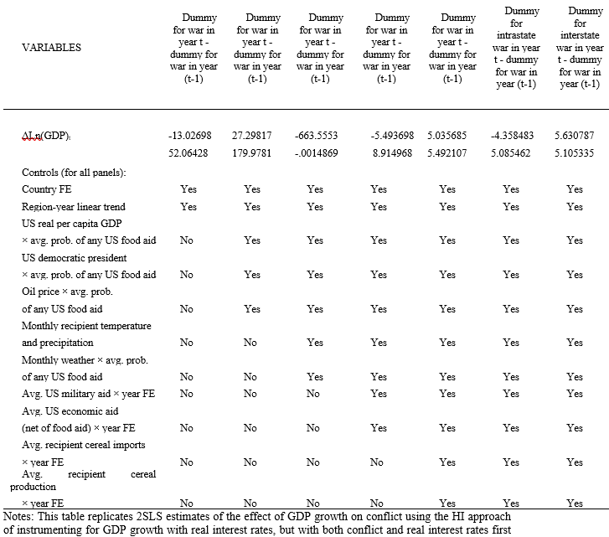
Estimating in first differences, (year to year changes only), HI estimate mostly keeps its sign, but now never significant

Slide 24
Weak IV tests
Publication bias is important here
The distribution of coefficients estimated by the placebo instruments that have F>10 is shifted upward from the overall distribution.
If we see only the results where the interacted instrument has F >10, we get more bias
If finite sample bias is uncorrelated across interaction variables, authors can pick the one that “works”

Slide 25
Recommendations
Plot variation as trends, i.e., don’t ignore sequencing
Report alternative trend specifications
Use first differences in the IV
Use policy changes to find placebo tests (pre-period tests)
Compare OLS and IV: does direction of change make sense?
Report auto-correlation and nonstationarity tests (ADF, Fisher)
Young (2018) bootstrap test for leverage
Monte Carlo of DGP under presumed endogeneity
Randomization tests (Borusyak et al, 2020)

Slide 26
Thank you for your interest and comments!
pchristian@worldbank.org
cbb2@cornell.edu

