Slide 1
The System of Rice Intensification and Its Puzzling Impacts on Household Welfare: Evidence from Rural Indonesia
Kazushi Takahashi and Christopher B. Barrett
  Presentation at workshop on
  The Economics of Global Poverty
  Calvin College
  July 12, 2012

Slide 2
Motivation
“SRI is pro-poor technology”:
  Nontraditional origins (developed by missionary priest in Madagascar, not in the labs/fields of a research institute)
  No additional or new external inputs needed
  Intensive use of labor, which the poor commonly have
Controversy within rice community
  Repeated observations of large yields gains (50-200%) on farmers’ fields while some trials show little impact on yield in experimental fields (McDonald et al., 2006, 2008).
  Weak theoretical foundation: Science behind SRI is “mysterious” and is not well accepted by some crop scientists. (“Scientific Unconfirmed Field Observations”)

Slide 3
Knowledge gap
What are the welfare impacts of SRI?
Widespread adoption but in some places also much disadoption … are users really better off?
Experimental fields may not reflect realities faced by farmers, while simple with-without comparisons among farmers or over time ignore selection effects.
Especially because of its labor use implications, must look beyond just partial productivity of land (yield) impacts
Our core (as-yet-unanswered) question:
What are the consequence of SRI use for household income, including off-farm income generation, and on children’s education?

Slide 4
Our contribution
Use original primary data collected in rural Indonesia to:
Identify the factors associated with SRI use
Use those results to match on observables using propensity score matching (PSM) (w/Rosenbaum bounds for unobservables sensitivity)
Estimate the impacts of SRI adoption on:
  yield and rice income/HA at plot level
  Farm/off-farm/total incomes, and child school enrollment at hh level
Core findings:
SRI indeed generates big (~64%) yield and plot-level rice income (107%) gains but also demands more labor.
SRI users have lower off-farm earnings, especially women’s self-employed earnings and as a result have no significant total income gains
SRI users’ children show no difference in school enrollment patterns
Puzzle: where do the productivity gains go?

Slide 5
What is SRI?
System of Rice Intensification is a systems-based rice production approach/technology characterized by:
  young seedlings of 8-12 days old
  shallow planting (1-2 cm) of one or two seedlings
  sparse planting density (more than 20 × 20 cm)
  intermittent irrigation (alternate wetting and drying)
  It is commonly held that SRI is complex and careful/ timely water management and weed control are required. Thus both higher yields and higher yield risk.

Slide 6
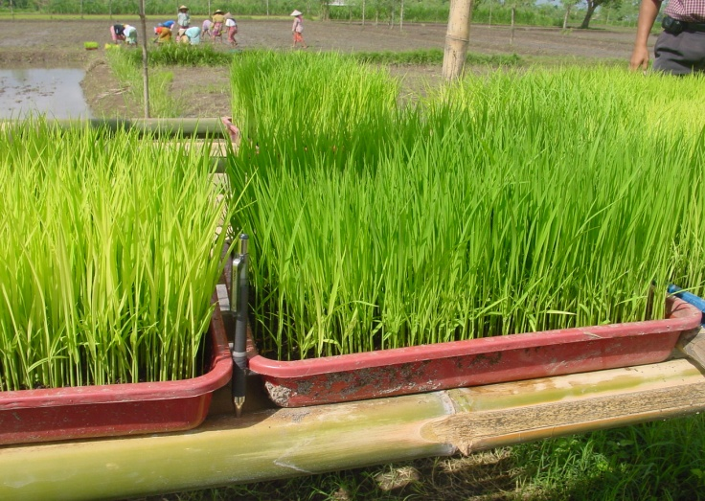
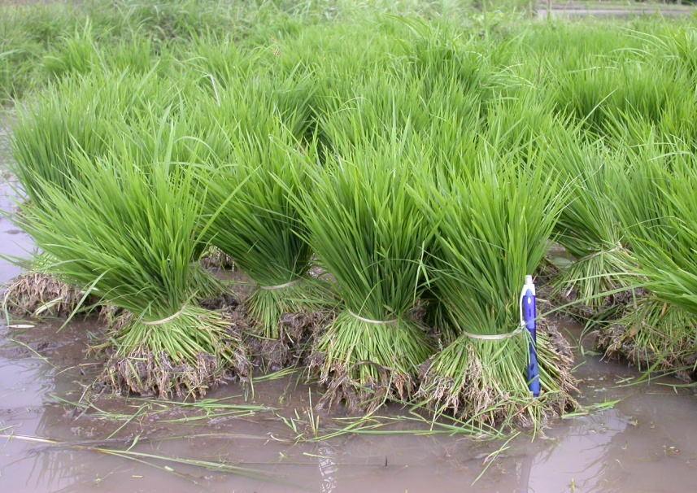
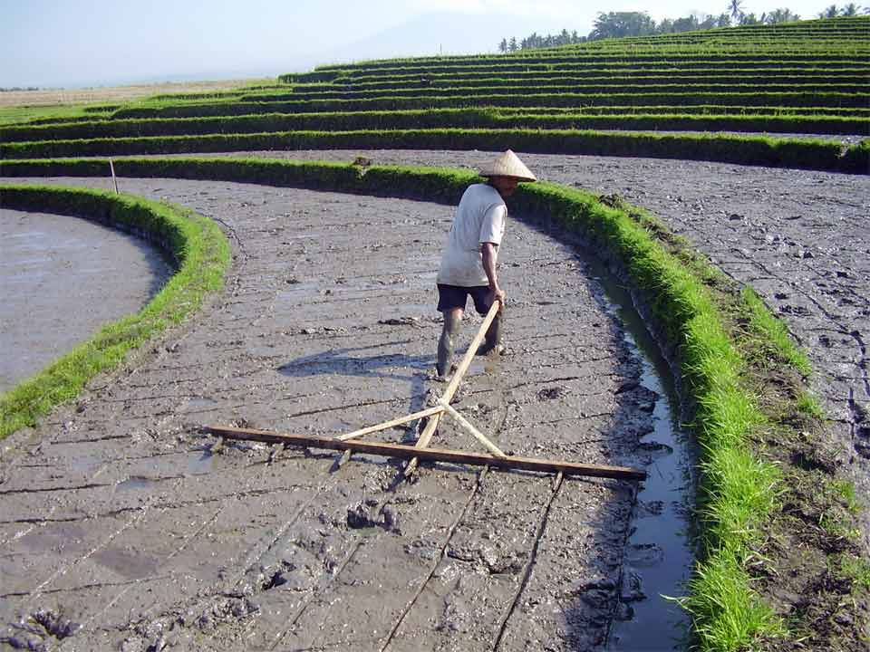
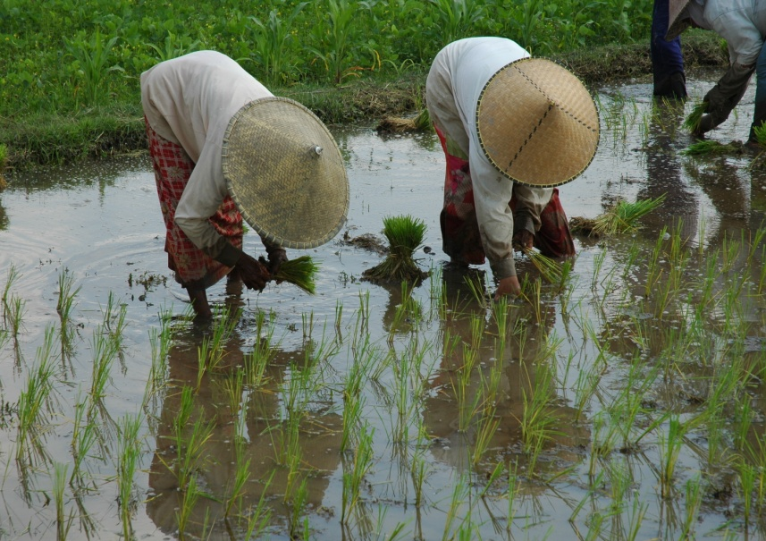
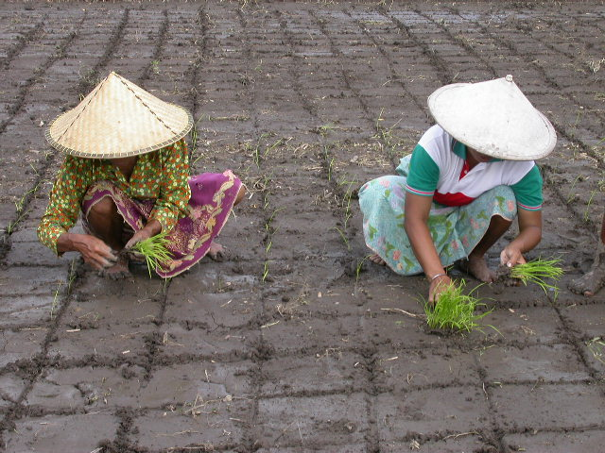
What is SRI?
SRI Seedling
(10 days after Seeding)
Non-SRI
Seedlings
(30 days after seeding)
Photos by Nippon Koei

Slide 7
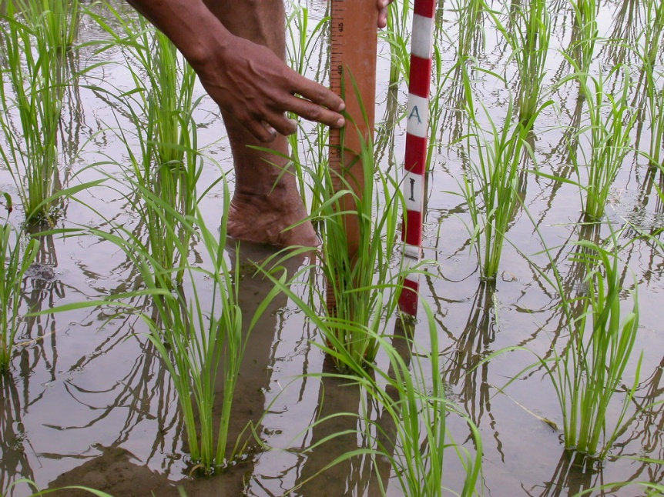
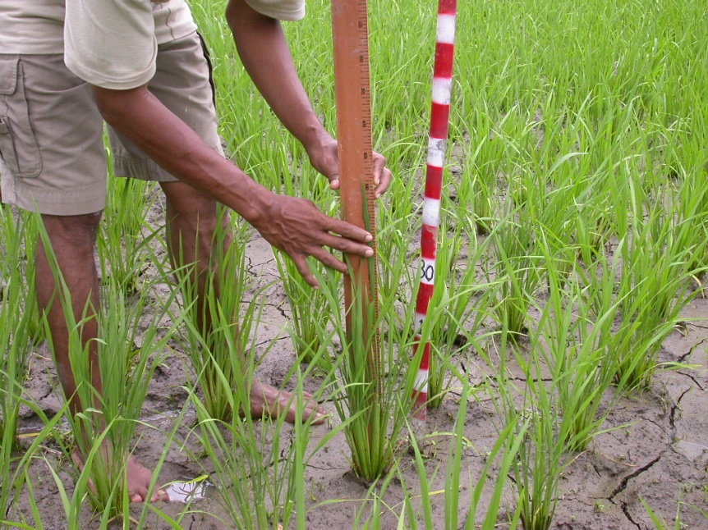
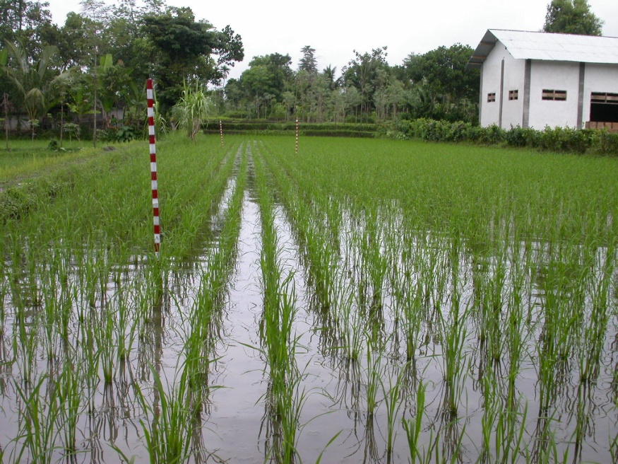
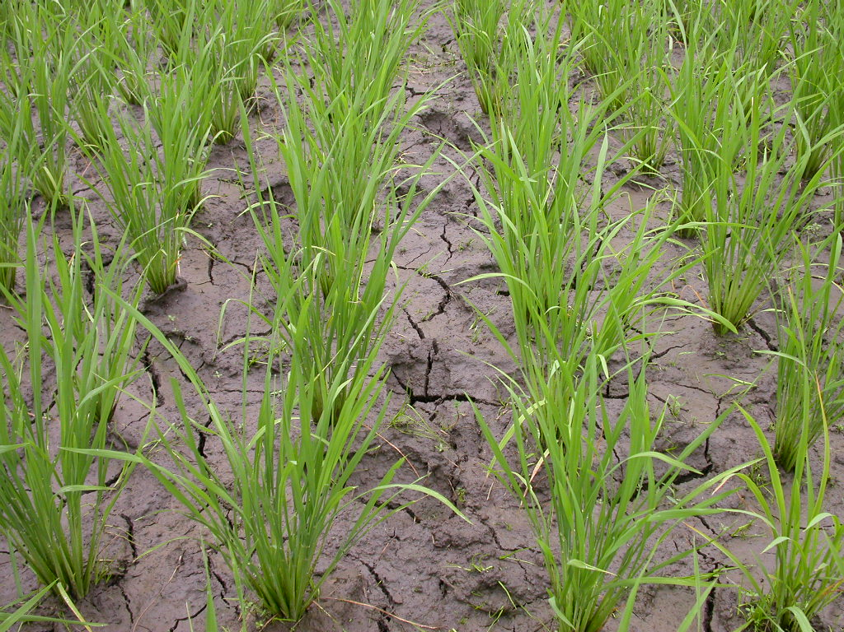
What is SRI?
Wet
Dry
Photos by Nippon Koei

Slide 8
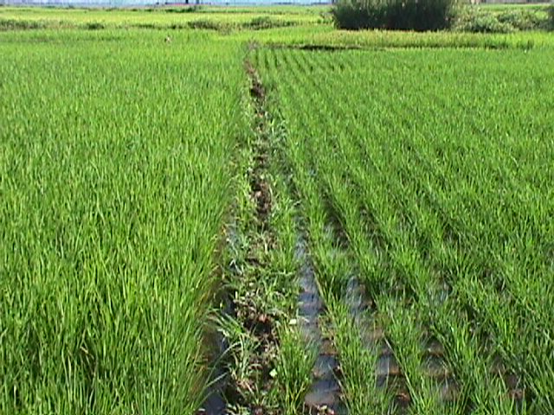
What is SRI?
Non-SRI
SRI
Photo by Christine Moser (Madagascar)

Slide 9
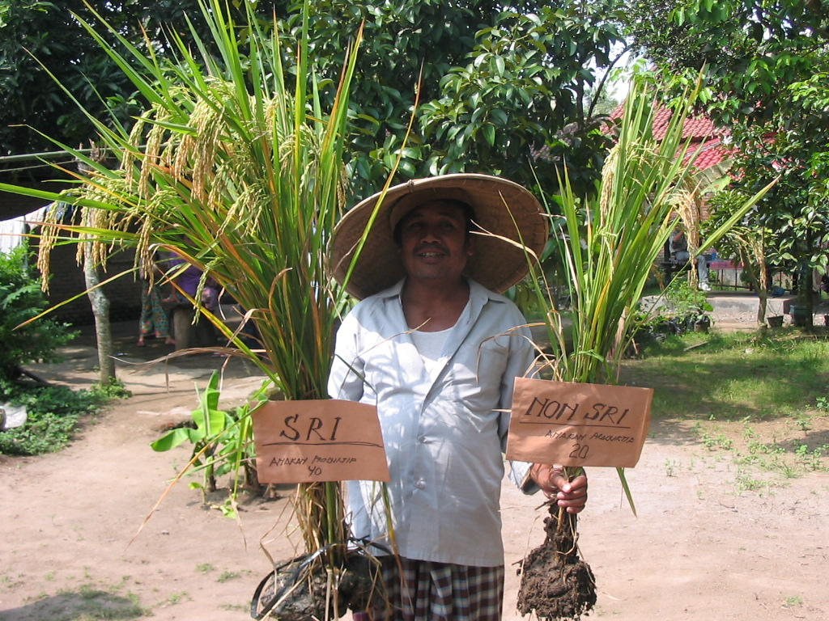
What is SRI?
Photos by Nippon Koei

Slide 10
Impact Evaluation
Want to know avg treatment effect on the treated (ATT):
But it is never possible to observe the outcome of SRI-adopters had they not adopted SRI, . So use PSM to match conditional on probability of SRI use, as estimable based on plot- and household-level observable characteristics.
Vulnerable to selection-on-unobservables, so (i) try to elicit/control for key unobservables, (ii) do sensitivity testing using Rosenbaum bounds.

Slide 11
Data
Indonesia, South Sulawesi, Jeneponto District
Poor, agriculture-dependent region
Annual rainfall is limited (1,000 mm-1,500 mm/year)
Irrigation project funded by JICA
SRI promoted under the scheme since 2002
Sample of 864 rice farmers (122 SRI adopters/742 non-adopters), operating 1202 rice plots
Wet season, cross-sectional data collected in 2009

Slide 12
Descriptive Stats 1
 |  | Mean | sd
Household Characteristics
# of Cultivated Plots |  | 1.43 | 0.8
Total Land Size | (ha) | 0.64 | 0.6
Adopt SRI | (%) | 14.12 | 34.8
SRI Experience | (years) | 0.71 | 1.9
# Agricultural Advisors |  | 0.77 | 1.0
Advisors Ever Adopt SRI | (%) | 17.13 | 37.7
Plot Characteristics
Adopt SRI | (%) | 13.98 | 34.69
Young Seedling | (%) | 13.64 | 34.34
Shallow Planting | (%) | 13.14 | 33.80
Parse Planting | (%) | 13.56 | 34.25
Intermittent Irrigation | (%) | 11.15 | 31.49
Full Adoption of SRI | (%) | 9.98 | 29.99

Slide 13
Descriptive Stats 2
 |  | SRI | Non-SRI | Diff
Plot level outcomes
Yield | (ton/ha) | 5.50 | 2.95 | 2.54***
Rice income per ha | (Mill Rp) | 6.67 | 2.46 | 4.21***
N |  | 168 | 1034
Household level outcomes
Monthly Total Farm income | (000 RP) | 732.50 | 238.80 | 493.7***
Monthly Total off-farm labor income | (000 RP) | 543.90 | 503.90 | 40.06
Monthly Off-farm wage earnings | (000 RP) | 398.10 | 272.30 | 125.80
Monthly Self-employed non-farm income | (000 RP) | 145.90 | 231.60 | -85.69
Monthly Total labor income | (000 RP) | 1276.50 | 742.70 | 533.7***
N |  | 122 | 742

Slide 14
Elicited Risk Preferences
Conducted a simple/standard game in the field:
Game | A | B |  | EV Difference | Risk Aversion Class
1 | 50000 | 75000 | 50000 | 12500 | Inefficient
2 | 50000 | 75000 | 45000 | 10000 | Risk-averse
3 | 50000 | 75000 | 35000 | 5000 | Risk-averse
4 | 50000 | 75000 | 25000 | 0 | Risk-averse to Risk-neutral
5 | 50000 | 75000 | 15000 | -5000 | Risk-neutral to Risk-lover
6 | 50000 | 75000 | 5000 | -10000 | Risk-lover
 |  |  |  |  | No change=Risk-lover

Slide 15
Elicited Risk Preferences
No real risk preference differences b/n SRI users/non-users:
Risk Loving
Risk Neutral
Risk Averse

Slide 16
Probit SRI Use Estimates

Slide 17
Plot-Level Impacts of SRI Use
PSM Impact Estimates
Even allowing for the possibility of selection-on-unobservables, the impacts of SRI use on rice yields, rice income per hectare and family labor use per hectare all appear strongly positive.

Slide 18
PSM Impact Estimates
Household-Level Impacts of SRI Use
Farm income gains from SRI use are completely offset by lower off-farm earnings, especially women’s self-employed non-farm income. Puzzling result: no household income gains from SRI.

Slide 19
PSM Impact Estimates
Household-Level Impacts of SRI Use
Despite increased labor demands of SRI use, children in SRI using households are no less likely to attend school or no more likely to be delayed in school progress. Reflects offsetting income effects of productivity gains and substitution effects on labor demand?

Slide 20
Conclusions
We corroborate claims of SRI’s tremendous plot level productivity gains, but also of increased labor demand.
But we find that these productivity gains vanish at household level. SRI seems to induce reallocation of (women’s) time from off-farm (self-)employment, wiping out income gains.
Some of those are perhaps invested in keeping children in school in spite of higher returns to family labor on-farm.
Puzzle: where do the productivity gains go? Why no disadoption?

Slide 21
Thank you!
Thank you for your time, interest and insights

