Slide 1
Agricultural Factor Markets in Sub-Saharan Africa:
An Updated View with Formal Tests for Market Failure
Brian Dillon, University of Washington
Chris Barrett, Cornell University
November 11, 2014
STAARS Kick-off Workshop
AFDB Headquarters
Tunis
A part of the AfDB sponsored “Agriculture in Africa – Telling Facts from Myths” project of the World Bank

Slide 2
“Factor markets regularly fail African farmers, leading to allocative inefficiencies within and between households”
Myth or Fact?

Slide 3
“Factor markets regularly fail African farmers, leading to allocative inefficiencies within and between households”
Myth or Fact?
The international development community takes factor market failure in SSA as given

Slide 4
“In Africa, the efficient functioning of markets is constrained among others by inappropriate policies, low volumes, limited competitiveness, lack of information, inadequate infrastructure, weak institutions and market power asymmetries.”
- FAO RSF for Africa 2010-2015

Slide 5
“In Africa, the efficient functioning of markets is constrained among others by inappropriate policies, low volumes, limited competitiveness, lack of information, inadequate infrastructure, weak institutions and market power asymmetries.”
- FAO RSF for Africa 2010-2015
“Given the strategic importance of fertilizer in achieving the African Green Revolution to end hunger, the African Union Member States resolve to increase the level of use of fertilizer from…8 kg per hectare to an average of at least 50 kg per hectare by 2015.”
- Abuja Declaration 2010

Slide 6
“In Africa, the efficient functioning of markets is constrained among others by inappropriate policies, low volumes, limited competitiveness, lack of information, inadequate infrastructure, weak institutions and market power asymmetries.”
- FAO RSF for Africa 2010-2015
“Given the strategic importance of fertilizer in achieving the African Green Revolution to end hunger, the African Union Member States resolve to increase the level of use of fertilizer from…8 kg per hectare to an average of at least 50 kg per hectare by 2015.”
- Abuja Declaration 2010
“Especially for seed and fertilizer, market failures continue to be pervasive in Sub-Saharan Africa because of high transaction costs, risks, and economies of scale.”
- WDR 2008

Slide 7
What can cause a market to fail?
Non-competitive pricing
Distortionary regulation (price controls, quotas, etc.)
Failures in multiple related markets
Missing/incomplete markets

Slide 8
What can cause a market to fail?
Non-competitive pricing
Distortionary regulation (price controls, quotas, etc.)
Failures in multiple related markets
Missing/incomplete markets
High equilibrium prices
Low trading volumes
Poor welfare outcomes for large numbers of HHs
Not necessarily evidence of market failure

Slide 9
Why does it matter whether the problem is market failure, or something else?
Policy responses are very different

Slide 10
If markets are truly missing / failing:
  Increase competitiveness
  Allocate property rights
  Fix the contract enforcement system
  Maybe intervene to lower some prices (e.g. in information markets)

Slide 11
If markets are truly missing / failing:
  Increase competitiveness
  Allocate property rights
  Fix the contract enforcement system
  Maybe intervene to lower some prices (e.g. in information markets)
If markets are working but welfare outcomes remain sub-optimal:
  Taxes and transfers to address endowment inequalities
  Assistance capturing value chains
  Subsidies
  Training and education

Slide 12
What is the empirical evidence?
Against presence of market failures
Empirical evidence in support of credit market failures is surprisingly scant (Ray 2008)
Not clear that fertilizer application is sub-optimal for many farmers (Ricker-Gilbert et al. 2009, Sheahan 2011)
RCTs of information services seem to have no impact on cultivation practices (Camacho and Conover 2011, Fafchamps and Minten 2012, Cole and Xiong 2012)
In many ways, market participation by agrarian households in Africa is more robust than in wealthy countries (Fafchamps 2004)
In an RCT in Ghana, cash grants do not raise investment (Karlan et al. 2013)

Slide 13
What is the empirical evidence?
In support
Responses to anticipated income changes in S. Africa are consistent with credit market failures (Berg 2013)
Strong evidence of insurance market failure in Ghana (Karlan et al. 2013)
Evidence from household input choices: labor market failures in Kenya, financial market failures in Burkina Faso, and land market failures in both (Udry 1999)

Slide 14
What we do in this paper:
Provide a summary overview of land and labor market participation in Sub-Saharan Africa
Implement a simple test of market failures in data from five African countries (testing whether the separation hypothesis holds)

Slide 15
What we do in this paper:
Provide a summary overview of land and labor market participation in Sub-Saharan Africa
Implement a simple test of market failures in data from five African countries (testing whether the separation hypothesis holds)
Preview of findings: we strongly reject the null hypothesis of complete and competitive markets in all study countries, and market failure is widespread
(Ethiopia, Malawi, Niger, Tanzania, and Uganda)

Slide 16
Outline of the rest of the talk:
Model and empirical test
Data
Summary statistics and figures
Results

Slide 17
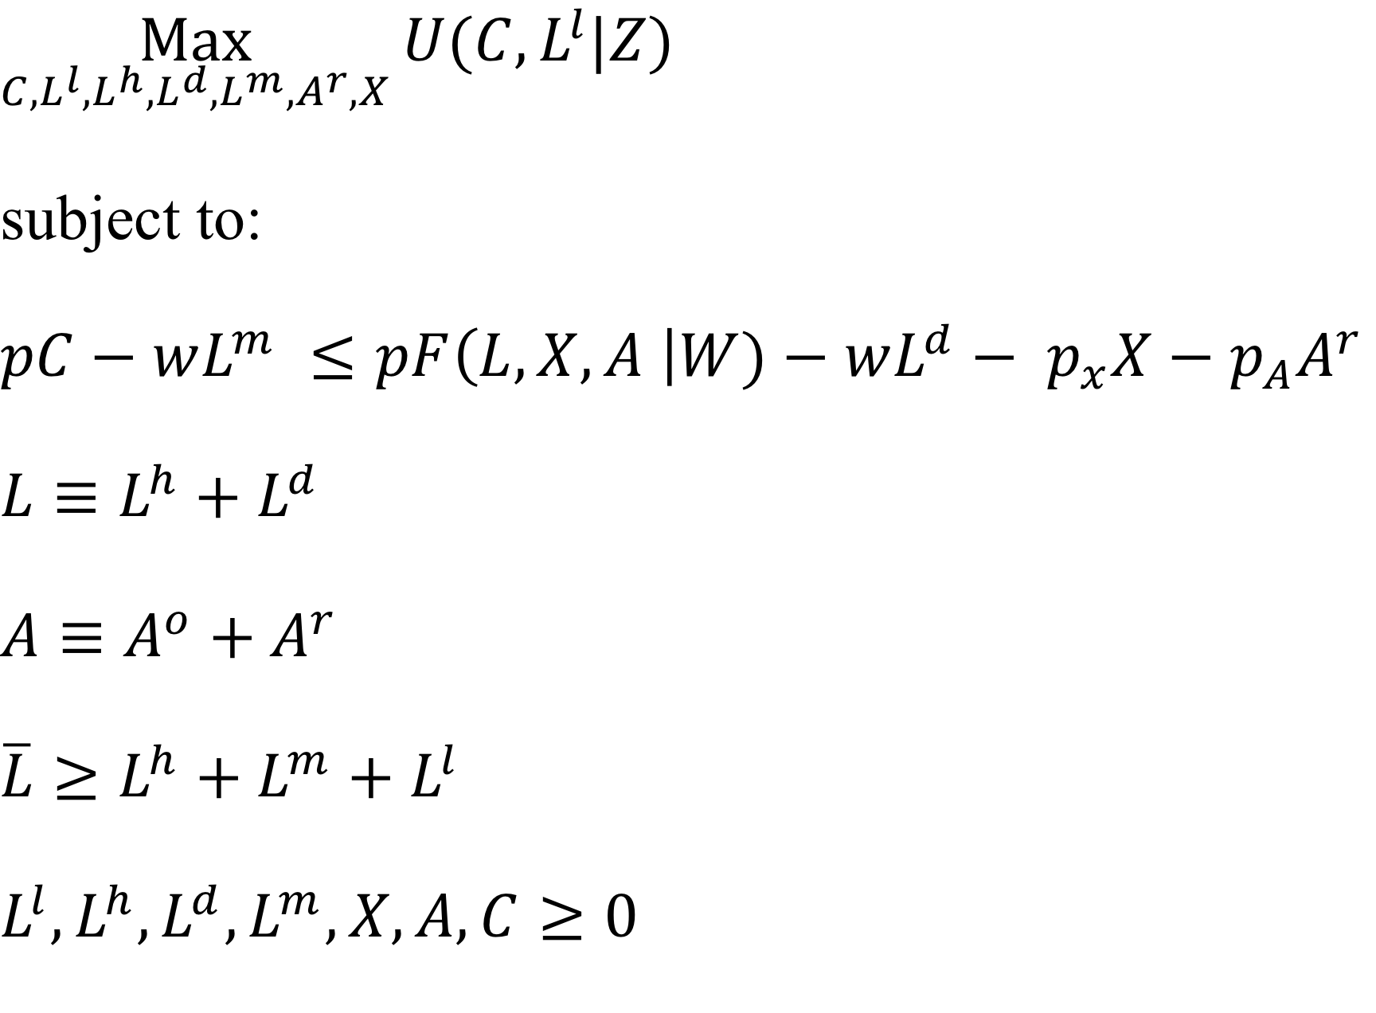
Simple version of the standard model (Singh et al. 1986)

Slide 18
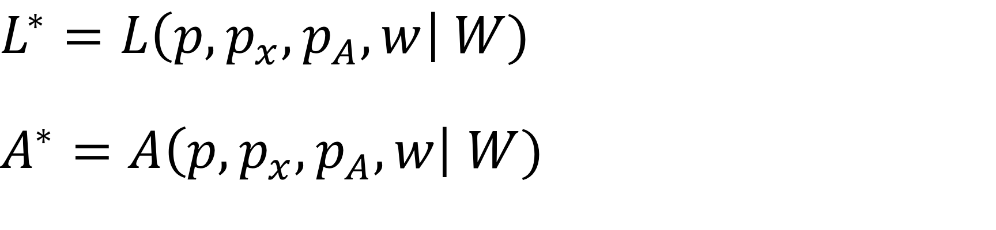
Key implication:
Input demands are independent of HH characteristics, if separation holds

Slide 19
Key implication:
Input demands are independent of HH characteristics, if separation holds
This suggests a natural test (Benjamin 1992, Udry 1999):

Slide 20
Data source
LSMS-ISA data for five countries: Ethiopia, Malawi, Niger, Tanzania, Uganda
Standard LSMS survey combined with a comprehensive plot-level agricultural survey
Nationally representative
Generally comparable across countries
Panel data planned or already collected (but here we work with only a single cross-section for each country)

Slide 21
Table 2. Participation in land rental markets
 | Ethiopia | Malawi | Niger | Tanzania | Uganda
N | 3094 | 2666 | 2339 | 2630 | 2135
Household rents land out | 6.10% | 0.90% | 1.20% | 3.40% | 0.40%
Household rents land in | 19.50% | 13.10% | 7.30% | 6.20% | 18.10%
Household rents or borrows land in | 30.30% | 28.40% | 27.70% | 23.20% | 36.60%

Slide 22
Table 3. Percent of agricultural households hiring labor
Country | Activity | Number of households | Percent hiring workers
Ethiopia | Cultivation | 3091 | 18.5%
 | Harvest | 2666 | 20.9%
 | Overall | 2666 | 30.2%
Malawi | Non-harvest | 2605 | 32.6%
 | Harvest | 2605 | 16.0%
 | Overall | 2605 | 42.0%
Niger | Preparation | 2339 | 19.5%
 | Cultivation | 2339 | 37.4%
 | Harvest | 2339 | 18.6%
 | Overall | 2339 | 47.8%
Tanzania | Planting | 2630 | 18.5%
 | Weeding | 2630 | 18.9%
 | Fertilizing | 2630 | 2.6%
 | Harvest | 2630 | 16.0%
 | Overall | 2630 | 30.8%
Uganda | Overall | 2109 | 46.8%

Slide 23
Table 4. Summary statistics of variables used in regressions
 | Ethiopia | Malawi | Niger | Tanzania | Uganda
Log labor demand (person-days) | 4.257 | 3.851 | 4.287 | 4.332 | 4.756
 | 1.302 | 0.989 | 0.982 | 0.974 | 0.776
Log area cultivated (acres) | 0.496 | 0.384 | 2.13 | 1.179 | 0.818
 | 1.332 | 0.82 | 1.124 | 1.05 | 1.001
Log median wage | 2.768 | 5.563 | 6.998 | 7.82 | 8.761
 | 1.083 | 0.539 | 0.443 | 0.489 | 0.649
Log HH size | 1.157 | 0.862 | 1.029 | 1.033 | 1.229
 | 0.457 | 0.454 | 0.46 | 0.498 | 0.571
Prime male share | 0.326 | 0.408 | 0.431 | 0.408 | 0.361
 | 0.207 | 0.229 | 0.185 | 0.233 | 0.223
Prime female share | 0.378 | 0.479 | 0.499 | 0.459 | 0.42
 | 0.21 | 0.238 | 0.167 | 0.229 | 0.226
Elderly female share | 0.136 | 0.071 | 0.027 | 0.078 | 0.124
 | 0.204 | 0.206 | 0.111 | 0.192 | 0.208
N | 2499 | 2556 | 2183 | 2346 | 2047
Notes: First row for each variable is the mean, second is the standard deviation

Slide 24
Table 5. Regression results from parsimonious OLS specification
 | Ethiopia | Malawi | Niger | Tanzania | Uganda
Log area (acres) | 0.489*** | 0.528*** | 0.343*** | 0.444*** | 0.379***
 | -0.04 | -0.048 | -0.026 | -0.027 | -0.033
Log median wage | 0.036 | -0.121** | -0.155 | -0.077 | 0.012
 | -0.051 | -0.052 | -0.107 | -0.065 | -0.043
Log HH size | 0.379*** | 0.399*** | 0.635*** | 0.399*** | 0.211***
 | -0.055 | -0.061 | -0.061 | -0.043 | -0.044
R-squared | 0.33 | 0.278 | 0.301 | 0.321 | 0.312
N | 2499 | 2556 | 2183 | 2346 | 2047

Slide 25
Table 5. Regression results from parsimonious OLS specification
 | Ethiopia | Malawi | Niger | Tanzania | Uganda
Log area (acres) | 0.489*** | 0.528*** | 0.343*** | 0.444*** | 0.379***
 | -0.04 | -0.048 | -0.026 | -0.027 | -0.033
Log median wage | 0.036 | -0.121** | -0.155 | -0.077 | 0.012
 | -0.051 | -0.052 | -0.107 | -0.065 | -0.043
Log HH size | 0.379*** | 0.399*** | 0.635*** | 0.399*** | 0.211***
 | -0.055 | -0.061 | -0.061 | -0.043 | -0.044
Prime male share | 0.446** | 0.036 | 0.008 | -0.085 | 0.223*
 | -0.186 | -0.14 | -0.198 | -0.136 | -0.128
Prime female share | 0.152 | -0.068 | -0.216 | -0.147 | 0.314**
 | -0.247 | -0.132 | -0.214 | -0.14 | -0.131
Elderly female share | -0.371** | 0.108 | -0.416 | -0.249 | 0.042
 | -0.171 | -0.165 | -0.286 | -0.187 | -0.166
Constant | 3.454*** | 3.993*** | 4.045*** | 4.056*** | 3.869***
 | -0.251 | -0.283 | -0.802 | -0.516 | -0.402
R-squared | 0.33 | 0.278 | 0.301 | 0.321 | 0.312
N | 2499 | 2556 | 2183 | 2346 | 2047
Notes: Standard errors in parentheses; standard errors clustered at the level of the zone (Ethiopia), TA (Malawi), grappe (Niger) or district (Tanzania and Uganda); sampling weights used for all regressions; dependent variable is the log of total labor demand, defined as total person-days employed on all plots; children under age 15 are counted as 0.5 adults; harvest labor is excluded for ET, MW, NG, and TZ, but included for UG because it cannot be separately distinguished; population shares defined with respect to adults > age 14

Slide 26
Table 6. Regression results from parsimonious OLS specification w/ district FE
 | Ethiopia | Malawi | Niger | Tanzania | Uganda
Log area (acres) | 0.530*** | 0.447*** | 0.324*** | 0.421*** | 0.380***
 | -0.045 | -0.045 | -0.029 | -0.029 | -0.032
Log HH size | 0.377*** | 0.515*** | 0.609*** | 0.488*** | 0.237***
 | -0.045 | -0.056 | -0.07 | -0.046 | -0.039
District/zone FE | Yes | Yes | Yes | Yes | Yes
R-squared | 0.47 | 0.415 | 0.5 | 0.44 | 0.42
N | 2765 | 2556 | 2183 | 2364 | 2047

Slide 27
Table 6. Regression results from parsimonious OLS specification w/ district FE
 | Ethiopia | Malawi | Niger | Tanzania | Uganda
Log area (acres) | 0.530*** | 0.447*** | 0.324*** | 0.421*** | 0.380***
 | -0.045 | -0.045 | -0.029 | -0.029 | -0.032
Log HH size | 0.377*** | 0.515*** | 0.609*** | 0.488*** | 0.237***
 | -0.045 | -0.056 | -0.07 | -0.046 | -0.039
Prime male share | 0.531*** | 0.061 | 0.141 | -0.078 | 0.238*
 | -0.138 | -0.128 | -0.195 | -0.134 | -0.137
Prime female share | 0.21 | -0.069 | -0.152 | -0.124 | 0.312**
 | -0.182 | -0.129 | -0.223 | -0.137 | -0.138
Elderly female share | -0.214 | 0.085 | -0.480* | -0.209 | 0.028
 | -0.139 | -0.166 | -0.288 | -0.192 | -0.166
Constant | 3.230*** | 3.295*** | 4.052*** | 3.634*** | 3.019***
 | -0.132 | -0.121 | -0.221 | -0.12 | -0.127
District/zone FE | Yes | Yes | Yes | Yes | Yes
R-squared | 0.47 | 0.415 | 0.5 | 0.44 | 0.42
N | 2765 | 2556 | 2183 | 2364 | 2047
Notes: Standard errors in parentheses; standard errors clustered at the level of the zone (Ethiopia), TA (Malawi), grappe (Niger) or district (Tanzania and Uganda); sampling weights used for all regressions; dependent variable is the log of total labor demand, defined as total person-days employed on all plots; children under age 15 are counted as 0.5 adults; harvest labor is excluded for ET, MW, NG, and TZ, but included for UG because it cannot be separately distinguished; population shares defined with respect to adults > age 14

Slide 28
Table 7. Regression results with district FE and both land and labor endowments
 | Ethiopia | Malawi | Niger | Tanzania | Uganda
Log acres cultivated | 0.529*** | 0.409*** | 0.298*** | 0.418*** | 0.362***
 | -0.048 | -0.049 | -0.035 | -0.034 | -0.041
Log HH size [A] | 0.377*** | 0.519*** | 0.602*** | 0.488*** | 0.233***
 | -0.045 | -0.056 | -0.071 | -0.046 | -0.039
Log acres owned [B] | 0.001 | 0.039*** | 0.024* | 0.002 | 0.016
 | -0.016 | -0.012 | -0.013 | -0.014 | -0.015
District/zone FE | Yes | Yes | Yes | Yes | Yes
F-test (joint sig of [A] & [B]) | 35.08 | 45.56 | 42.12 | 56.54 | 18.38
R-squared | 0.47 | 0.42 | 0.502 | 0.44 | 0.42
N | 2765 | 2556 | 2183 | 2364 | 2047

Slide 29
Table 7. Regression results with district FE and both land and labor endowments
 | Ethiopia | Malawi | Niger | Tanzania | Uganda
Log acres cultivated | 0.529*** | 0.409*** | 0.298*** | 0.418*** | 0.362***
 | -0.048 | -0.049 | -0.035 | -0.034 | -0.041
Log HH size [A] | 0.377*** | 0.519*** | 0.602*** | 0.488*** | 0.233***
 | -0.045 | -0.056 | -0.071 | -0.046 | -0.039
Log acres owned [B] | 0.001 | 0.039*** | 0.024* | 0.002 | 0.016
 | -0.016 | -0.012 | -0.013 | -0.014 | -0.015
Prime male share | 0.531*** | 0.021 | 0.165 | -0.077 | 0.241*
 | -0.138 | -0.13 | -0.193 | -0.134 | -0.136
Prime female share | 0.209 | -0.107 | -0.136 | -0.123 | 0.315**
 | -0.183 | -0.133 | -0.222 | -0.137 | -0.139
Elderly female share | -0.214 | 0.053 | -0.473 | -0.209 | 0.023
 | -0.139 | -0.168 | -0.29 | -0.192 | -0.168
Constant | 3.231*** | 3.393*** | 4.066*** | 3.636*** | 3.051***
 | -0.134 | -0.125 | -0.224 | -0.121 | -0.138
District/zone FE | Yes | Yes | Yes | Yes | Yes
F-test (joint sig of [A] & [B]) | 35.08 | 45.56 | 42.12 | 56.54 | 18.38
R-squared | 0.47 | 0.42 | 0.502 | 0.44 | 0.42
N | 2765 | 2556 | 2183 | 2364 | 2047
Notes: Standard errors in parentheses; standard errors clustered at the level of the zone (Ethiopia), TA (Malawi), grappe (Niger) or district (Tanzania and Uganda); sampling weights used for all regressions; dependent variable is the log of total labor demand, defined as total person-days employed on all plots; children under age 15 are counted as 0.5 adults; harvest labor is excluded for ET, MW, NG, and TZ, but included for UG because it cannot be separately distinguished; population shares defined with respect to adults > age 14; for households with zero acres owned, "Log acres owned" = ln(0.01); F-test statistic is for a test of the joint significance of "Log HH size" and "Log acres owned"; all F-stats are signficant at the 10e-8 level

Slide 30
Table 8. Regressions results with controls for gender of household head
 | Ethiopia | Malawi | Niger | Tanzania | Uganda
Log acres cultivated | 0.530*** | 0.446*** | 0.329*** | 0.422*** | 0.380***
 | (0.045) | (0.045) | (0.029) | (0.029) | (0.033)
Log HH size | 0.414*** | 0.508*** | 0.673*** | 0.470*** | 0.258***
 | (0.075) | (0.073) | (0.068) | (0.056) | (0.043)
Prime male share | 0.548*** | 0.068 | 0.147 | -0.081 | 0.246*
 | (0.140) | (0.130) | (0.199) | (0.139) | (0.140)
Prime female share | 0.211 | 0.005 | -0.374 | -0.114 | 0.278**
 | (0.176) | (0.157) | (0.242) | (0.171) | (0.134)
Elderly female share | -0.231 | 0.183 | -0.838*** | -0.193 | -0.018
 | (0.140) | (0.211) | (0.310) | (0.229) | (0.160)
Head is female | 0.117 | -0.067 | 0.455** | -0.047 | 0.086
 | (0.168) | (0.131) | (0.206) | (0.123) | (0.084)
Head is female x Log HH size | -0.225 | 0.001 | -0.408** | 0.067 | -0.061
 | (0.137) | (0.129) | (0.165) | (0.104) | (0.058)
Constant | 3.200*** | 3.269*** | 4.090*** | 3.645*** | 3.000***
 | (0.150) | (0.130) | (0.231) | (0.126) | (0.131)
District/zone FE | Yes | Yes | Yes | Yes | Yes
R-squared | 0.471 | 0.416 | 0.503 | 0.44 | 0.42
N | 2765 | 2556 | 2183 | 2364 | 2047
Standard errors clustered at EA level; sample weights used

Slide 31
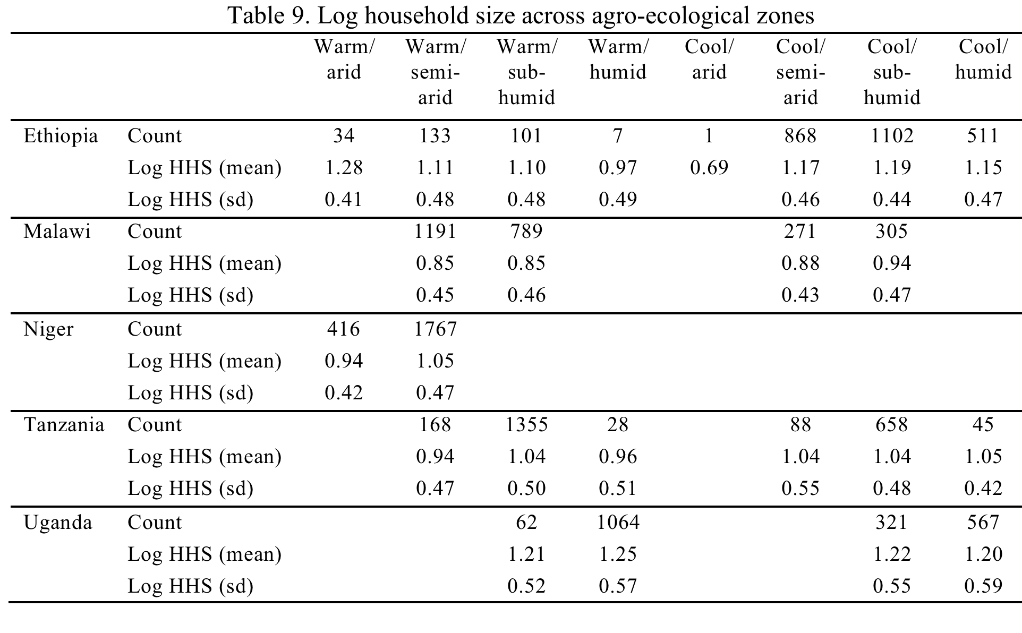

Slide 32
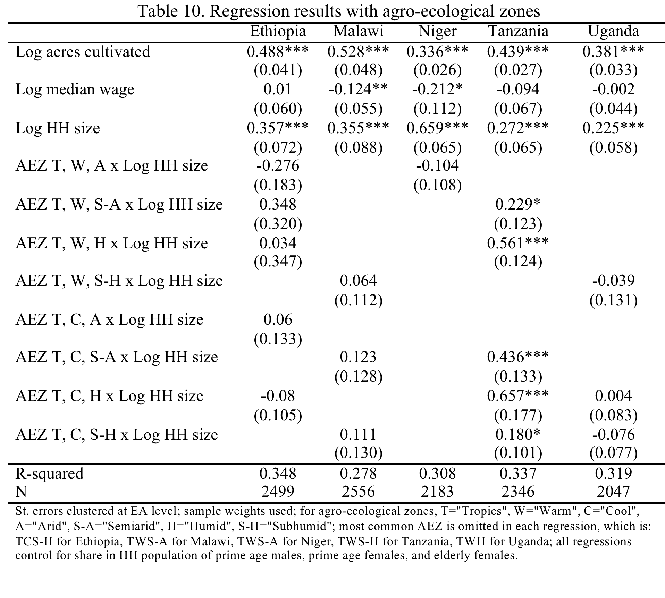

Slide 33
Conclusions:
Clear evidence of market failure in rural areas of five SSA countries
Failures are persistent across AEZs and gender of household head
Not clear which markets are failing (next step)
A caveat: high supervision costs or transaction costs could also generate the results in the paper
Clear that land/labor markets are not entirely missing, though they could be missing for some households

