Slide 1

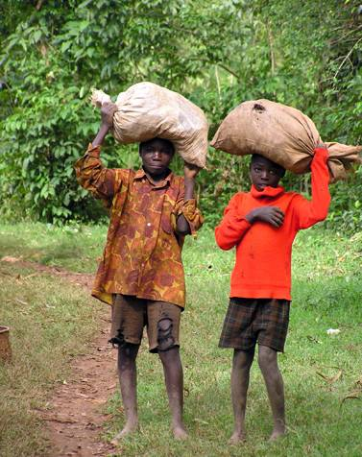
Smallholder Market Participation in Evolving Agricultural Value Chains: Comparative Evidence From Three Continents
Chris Barrett, Maren Bachke, Marc Bellemare, Hope Michelson, Sudha Narayanan, Tom Walker
June 3, 2010
FAO, Rome

Slide 2
Modernizing agricultural value chains are both cause and consequence of agricultural development.
Policymakers want poorer smallholders to tap into growth opportunities brought by value chains.
Top-down (SAP-style) approaches based on macro- and sectoral interventions largely failed to spark smallholder commercialization.
Now, heavy emphasis on joining commercial value chains.
Which farmers join evolving value chains and why?
Motivation

Slide 3
Our contribution
Based on field research in 5 countries – Ghana, India, Madagascar, Mozambique and Nicaragua – we:
Develop a simple conceptual model of smallholder participation in modern value chains.
We emphasize the contracting process, especially:
  Geographic selection effects (and associated spatial inequality concerns)
  Firm- and farmer-level selection effects, given uncertainty
  Imperfect contract performance and resulting churning in value chain participation.

Slide 4
Our contribution
Illustrate generalizable findings through the lens of that model, drawing on data from five countries and multiple commodities:
  Ghana – pineapple, mainly for export to Europe
  India – broilers, cotton, gherkins, marigold and papaya in Tamil Nadu
  Madagascar – variety of crops, mainly horticulture for export to Europe
  Mozambique – variety of crops
  Nicaragua – horticulture for domestic supermarkets

Slide 5
Our contribution
Key generalizable findings:
  Considerable geographic placement effects that appear to magnify spatial inequality
  Farmer selection on observables less pronounced once control for placement
  No clear size-participation relation, although irrigation and farmer group membership matter.
  Selection on unobservables matter due to problems of trust and social connections.
  Very high rate of exit from value chains.

Slide 6
Conceptual model
A firm selling to urban or foreign markets seeks lowest-cost source(s) that meet quality/volume requirements so as to maximize expected profits.
Has an importing option with fixed price and quality: this sets a reservation expected profit level, ∏.
Prospective domestic suppliers offer uncertain outcomes and have reservation expected welfare levels that constrain the contract terms the firm can successfully offer.

Slide 7
Conceptual model
Stylization of constrained firm contract offer choice:

Slide 8
Conceptual model
Stage 1: Firm geographic sourcing choice
Agroclimatic and (physical and institutional) infrastructure factors highly correlated across growers by region matter to expected firm profits. Largely observable. Large geographic subpopulations largely left out of value chains.

Slide 9
Conceptual model
Stage 2: Firm contract offer choice
Selection on farmer observables: land size, irrigation, education, ex ante wealth, gender, farmer group membership
Selection on unobservables: farming skill, reputation for honesty and reliability, social connections and opportunities for informal contract enforcement.
Choose contract terms to satisfy perceived farmer expected welfare reservation level. Gains from exchange arise from resolving some market failure –financing, inputs, extension, etc. – so (often only implicit) contract interlinkage common. But not in all cases. Sometimes gains arise purely from spatial arbitrage or from economies of scale/scope in marketing.

Slide 10
Conceptual model
Stage 3: Farmer contract acceptance choice
Because firms cannot perfectly observe w_{ij}, there is zero probability of contract acceptance with no surplus reaped by farmer. Some should decline offers, others benefit from them.
Benefits accrue from resolving some market failure, associated with i) spatial arbitrage, ii) financing, iii) inputs, iv) information/extension/certification, v) economies of scale/scope in marketing.
But nothing implies a) gains shared equally, nor b) contracts are efficient (i.e., Pareto optimal).
Declines may also be for reasons of strategic delay to learn.

Slide 11
Conceptual model
Stage 4: Firm/farmer contract performance choices
Breach of contract occurs frequently, from both sides, both due to shocks and malfeasance.
The relationship-specific investments each side makes create opportunities for contractual hold-up (hence vertical integration and selection on unobservables).
Farmers side-sell opportunistically. Firms likewise renege once retail demand and alternate supplier prices realized, or in the event of financing or logistical constraints.
Group membership preferred by both sides because it makes enforcement easier; o/w non-enforcement often equilibrium.

Slide 12
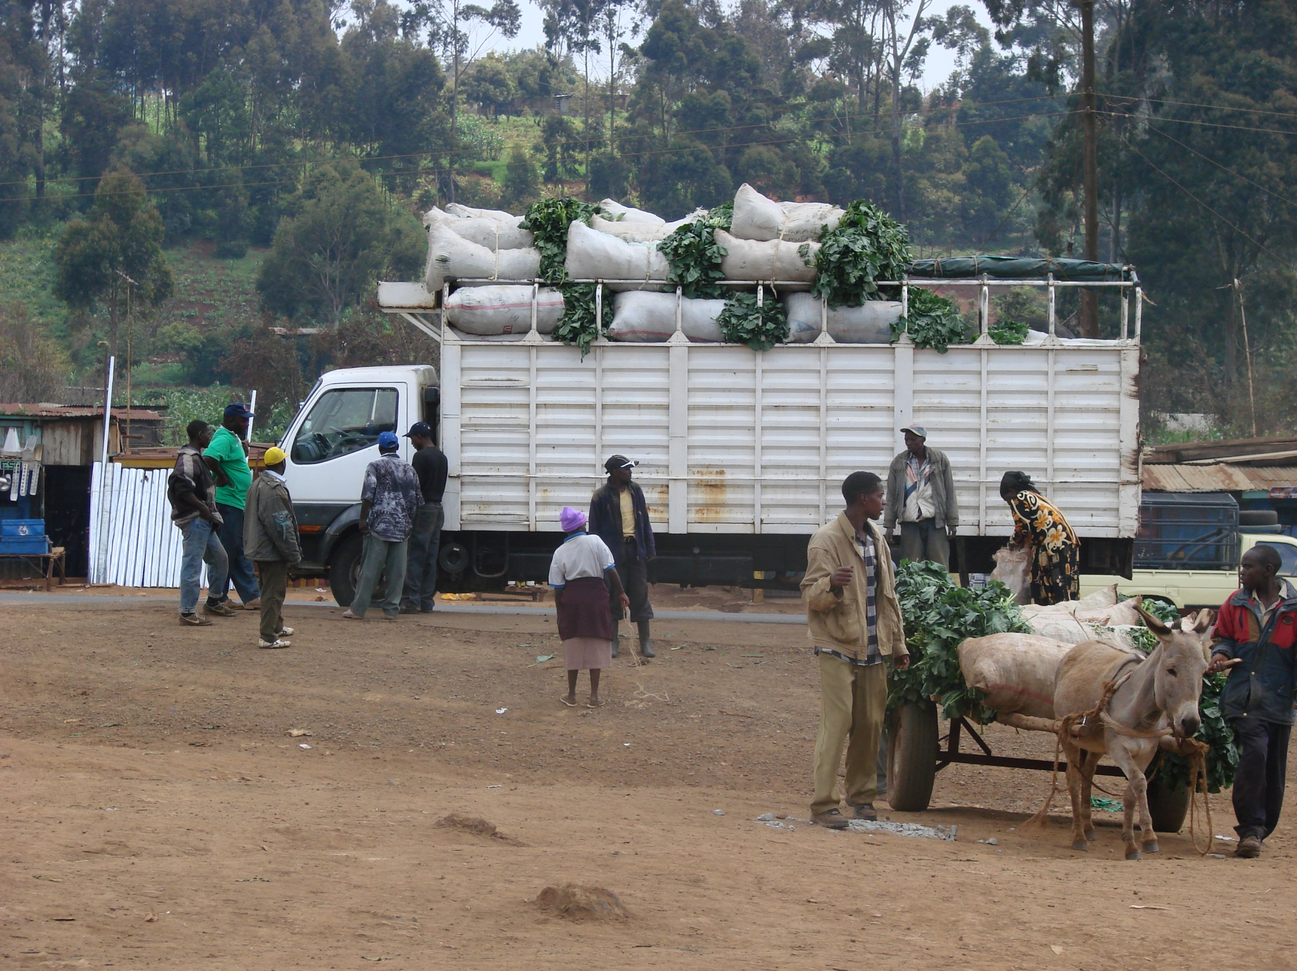
Empirical evidence
Pronounced geographic placement effects:
Access to appropriate soils, water and transport matters tremendously:
- irrigation in India, Nicaragua
- soils, winds, etc. for specific crops in India
- port access in Ghana, Madagascar
- urban market access in Madagascar, Nicaragua, Mozambique.
- NGO and farmer group activity … (implicitly) subsidize firms when interventions are channel-specific (e.g., extension) rather than general for smallholders (e.g., irrigation).
Note: placement does not always favor more accessible regions … firms balance cheaper access with higher risk of farmer side-selling in India.

Slide 13
Empirical evidence
Pronounced geographic placement effects:
A key implication: the geography of contracting often reinforces geographic poverty traps and increases spatial inequality.

Slide 14
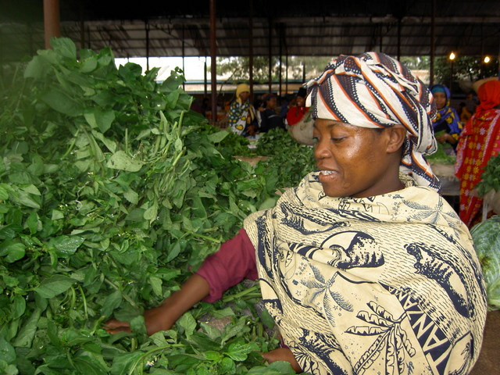
Empirical evidence
Farmer selection effects:
Contracting is clearly non-random among farmers.
But less pronounced and consistent selection on observables than anticipated.
- farm size, literacy/education, non-land wealth all have mild, positive effects in most (but not all) cases
- irrigation and farmer group membership most consistently positive and meaningful effects
Selection on unobservables appears significant in many cases, due to contract enforcement challenges.

Slide 15
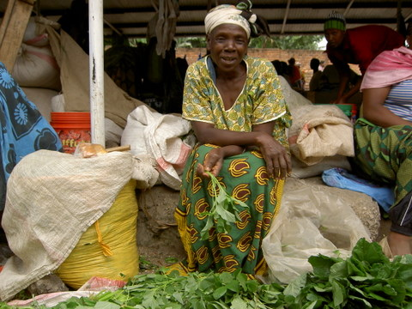
Empirical evidence
Contract compliance and churning within chains:
Breach of contract is widespread by both parties.
Unclear if use of written contracts improves performance. Group-based contracting seems to help.
Market saturation leads to significant problems with firm hold-up and malfeasance (Ghana, India, Nicaragua). Points to pecuniary externalities that offset learning incentives for strategic delay. Early market entrants reap greatest gains and prove most able to weather later market disruptions.

Slide 16
Empirical evidence
Figure 3: Pineapple Market Participation in Ghana, 1980-2009

Slide 17
Empirical evidence
Contract compliance and churning within chains:
Given widespread nonperformance, high rates of churning follow naturally:
- 38% in Nicaragua horticulture
- 56% in Ghana pineapple
- 64% in India gherkins
- 73% in India marigold
- 93% in India cotton
Evidence from Nicaragua suggests that many of the gains from value chain participation remain after exit.

Slide 18
Conclusions
Key points :
- Widespread concerns that smallholders are being left behind.
- Biggest sources of non-random participation appear to be geographic placement choices by firms, not farm-specific selection, although irrigation clearly matters (and probably helps farmers preserve the gains from value chain participation even upon exit) as do farmer groups.
- Breach of contract is widespread and leads to very high rates of churning within value chains, 38-93% in the chains where we measured exits.
- Welfare gains by participating smallholders are intuitive and appear real, although not universal and by no means a “fair share”.

Slide 19
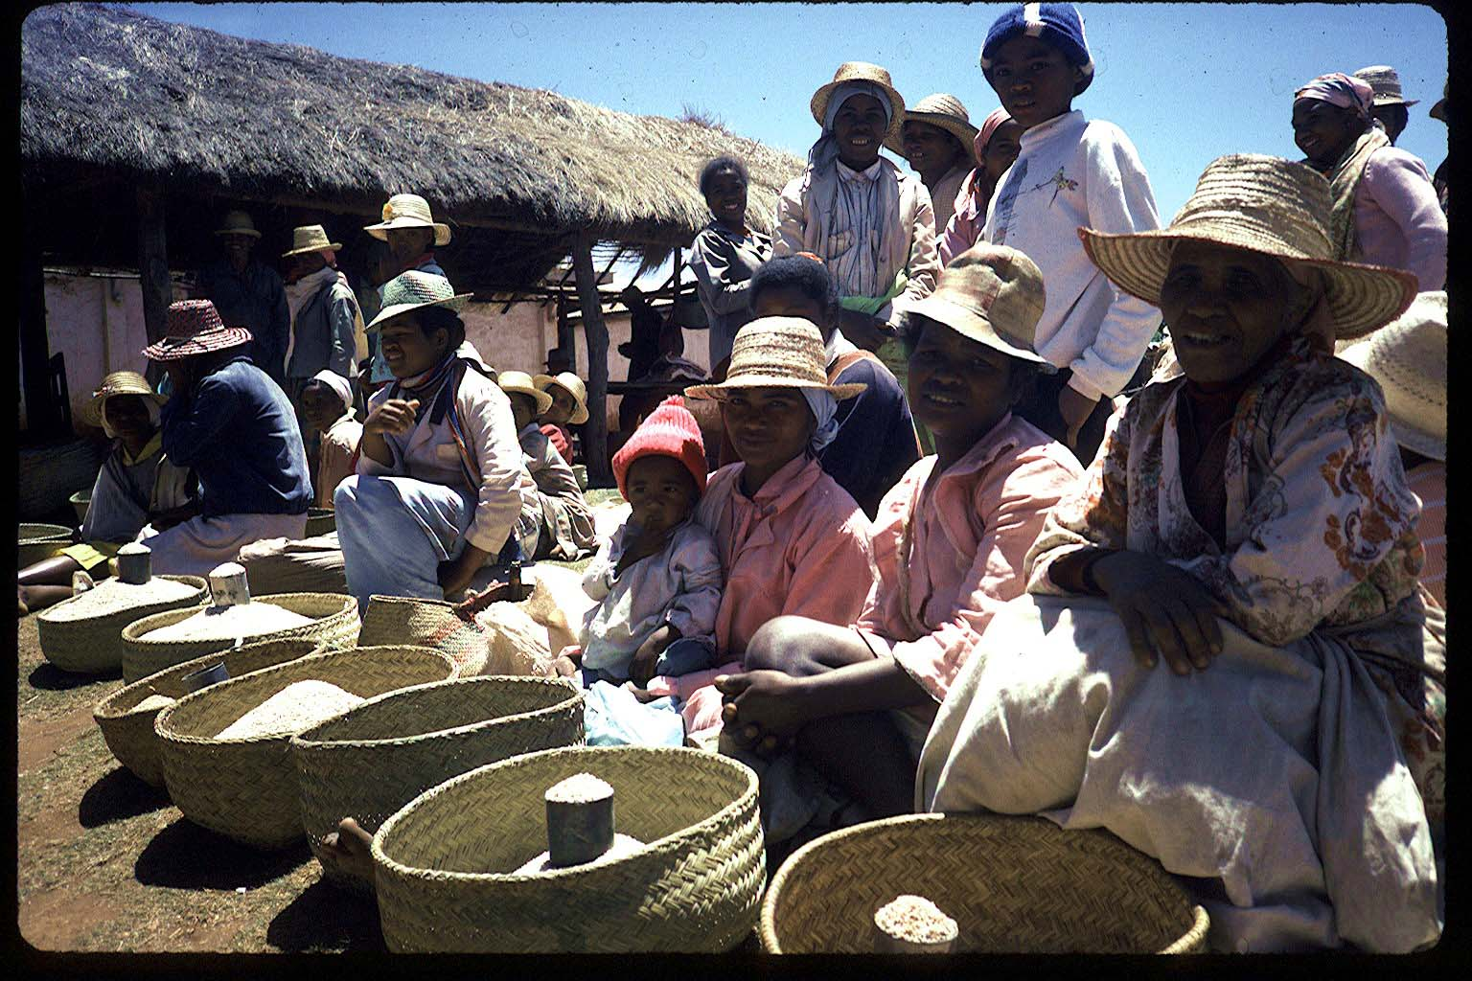
Thank you for your time and comments!

