Slide 1
No food security without good data or local analysts
Workshop Café, 1st Global Food Security Conference,
29Sept-2 Oct, Noordwijkerhout, Netherlands
Facilitators: Luc Christiaensen and Gero Carletto, World Bank,
and Christopher B. Barrett, Cornell University

Slide 2
Points of departure
The Grand Challenge
Statistics and capacity to measure and analyze food security remain wanting (especially in SSA)
Several initiatives …
LSMS-ISA – one attempt to address the void
Much more needed → brainstorm to prioritize

Slide 3
Africa’s statistical challenge
Of 44 SSA countries reviewed by FAO, only 2 have high standards in data collection
As of last year, 15 countries in SSA did not have a household expenditure survey within the last 5 yrss and a survey @ 5 yrs prior to that.
And if they do, poor comparability/inconsistent estimates
Slow to introduce best practices, new technologies
Insufficient documentation & dissemination when survey data do exist
Limited capacity to analyze data

Slide 4
Three questions
What data to collect?
How to improve data quality?
How to maximize its use and impact?

Slide 5
What data to collect (1)?
Issues in measuring and analyzing food security
Thematic: availability, access, utilization , stability
Spatial: global … national … individual
Temporal: acute … chronic
Evolving emphasis …
From availability (Borlaugh) to access (Sen), back to availability (&utilitization/nutrition)
From global to individual back to global/national

Slide 6
What data to collect (2)?
On the one hand, a plethora of data and instruments
Agricultural sample surveys, Censuses
Household consumption surveys (HBS, IES, LSMS, HIS)
Health/nutrition surveys (DHS, MICS)
Welfare Monitoring Surveys (WMS)
Nutrition surveys (24-hour)
Comprehensive Food Security Vulnerability Assessments (CFSVA)
In addition to:
Administrative price data
Georeferenced data (satellite/NDVI, roads, weather)
➔ Scope for re-purposing and “convergence”

Slide 7
What data to collect (3)?
On the other hand, some failure to …
integrate across
topics (within the instruments – lsms-isa)
time (areas/sentinels, households, individuals)
differentiate across
Individuals/groups
plots
provide sufficient periodicity
high frequency data
capture uncertainty/risk/resilience
Static versus dynamic indicators
address new data demands
climate change
post harvest loss
nutrition sensitive agriculture
…

Slide 8
What data to collect (4)?
And part of the solution lies in optimizing the use of existing data:
Integrate data across space
geo-referencing
concentrate on same sampling areas
Integrate across data instruments
poverty mapping (census and household surveys)
Integrate across time
Food security forecasting (HICS and WMS)
… but also new and better data necessary!

Slide 9
Improving the availability, relevance, and quality of household survey data
for policy and research in
Sub-Saharan Africa

Slide 10
Working on 4 fronts
Collecting household survey data with focus on agriculture in 8 SSA countries
Improving methodologies in data collection, producing best practice guidelines & research
Documenting & disseminating micro data, policy research
Building capacity in national institutions

Slide 11
Survey features
Nationally representative (rural and urban)
Multi-topic and disaggregated
Linked with ecosystems data
1-3 year panels of individuals
Data Entry: from centralized to field-based
Open data access policy
Collaborative: done with NSOs

Slide 12
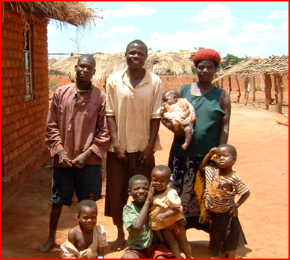
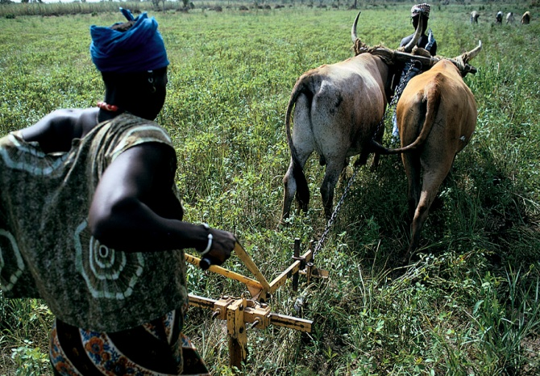
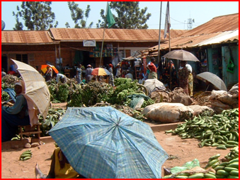
Survey instruments
Agriculture
Plot-level data on (i) Land Areas, (ii) Labor & non-labor inputs, (iii) Crop cultivation & production
Farm implements
Services
Facilities
Infrastructure
Market prices
Demographics
Governance
Organizations & groups
Livestock
Crop sales & utilization
Extension services
Fisheries
Subjective welfare
Non-Farm enterprises
Food security
Income
Food & non-food consumption
Housing, durable assets
Individual-level data on demographics, education, health, labor & anthro
Household
Community

Slide 13
Survey Schedule
Tanzania
Malawi
2010/11
Nigeria
2013
2011/12
2008/09
2010/11
2012/13
Uganda
2009/10
2010/11
2011/12
2013/14
2011/12
2013/14
2010/11
2012/13
Mali
2014/15
Ethiopia
Niger
Burkina
2011/12
2014/15
2014/15

Slide 14
Partnerships are key
In-country co-funding
USAID: Mali
WFP: Food security
IFAD: Community governance, gender
WFC: Fishery
FAO/ILRI/ARD: Livestock
FAO: Global Strategy
FAO/IFPRI: Analysis
CMAAE: Training

Slide 15
What data to collect (5)?
And many challenges remain
Periodicity
LSMS-ISA only every 1-3 years
Coverage
LSMS-ISA only in 8 countries and only in Africa
Harmonization versus customization
Local vs global use (different items, different importance )
Comparability over time and space
Inertia, acceptance, capacity building
Poor quality, low credibility

Slide 16
How to improve data quality
Methods matter! Importance of validation …
Consumption: Food (recall, diary, reference periods)
Production: Land area Measurement (GPS vs. self-reported)
Role of technology
CAPI, GPS, mobile phones, …
Institutional set up
Coordination/ harmonization over time and x-country, mandate, incentives, …

Slide 17
Lack of standards results in poor comparability!
Take Food Consumption …
Diary vs. recall
Household vs. individual
Reference period
Nomenclature (COICOP)
Bulk purchases
Non-standard units of measure
Food consumed away from home (FAFH)
Valuation of consumed own-production

Slide 18
Take the reference period of food consumption …
Source: “Assessment of the reliability and relevance of food data …”, Smith et al.

Slide 19
Implications for comparability overtime and x-country
What’s the “truth”?

Slide 20
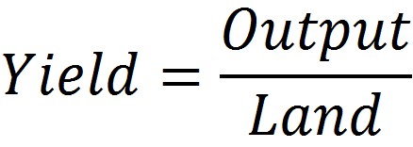
Measuring Farm Productivity
Many different measures, similar issues!
Take land productivity (yield)

Slide 21
Measuring production – the numerator
Farmers don’t keep records
Cassava harvested in small quantities over several months
Recall widely used, but does not always work
Measured in non-standard units of varying size
Different units along the value chain, different states
What are the alternatives? How to choose?
Need validation!

Slide 22
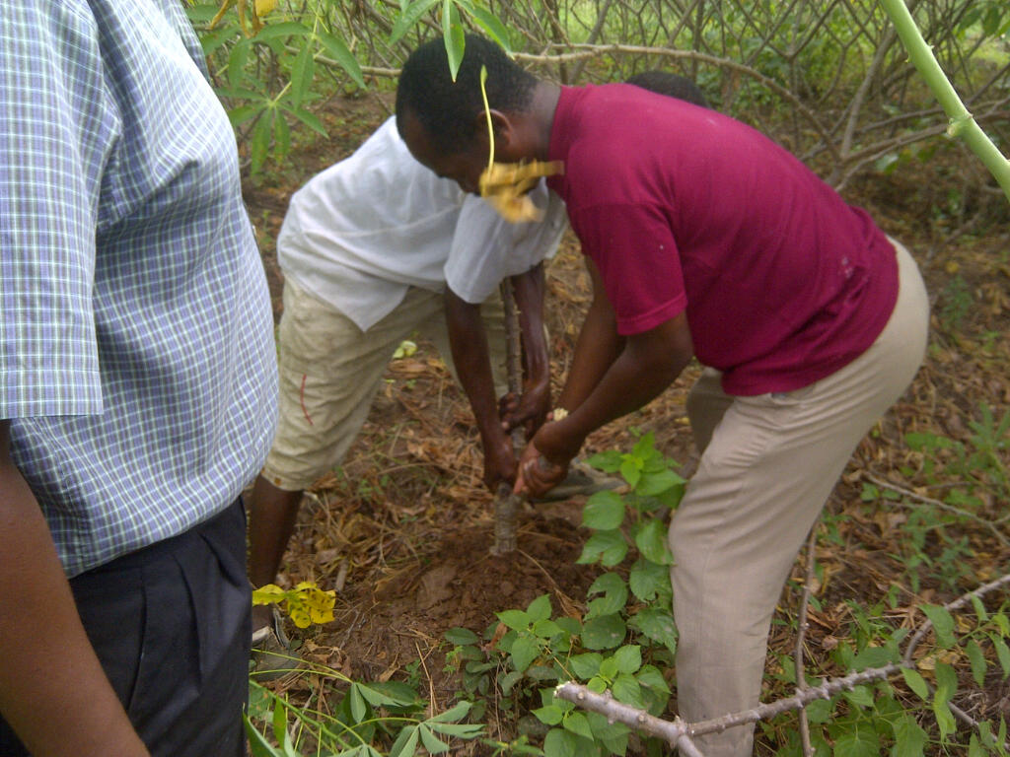
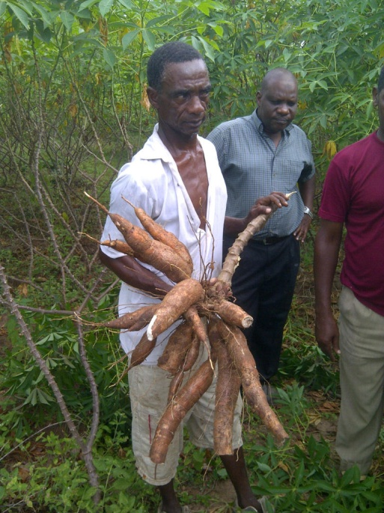
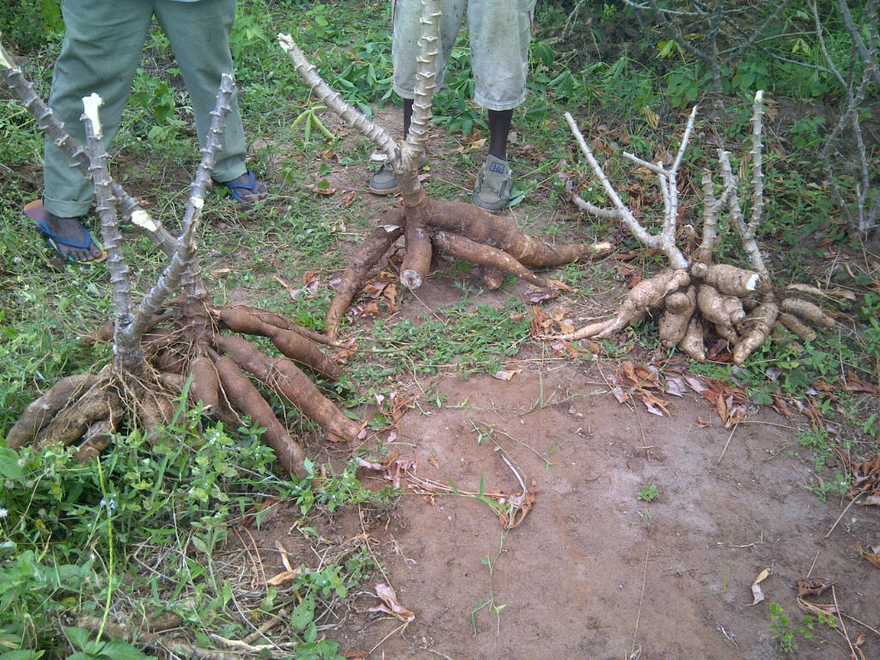
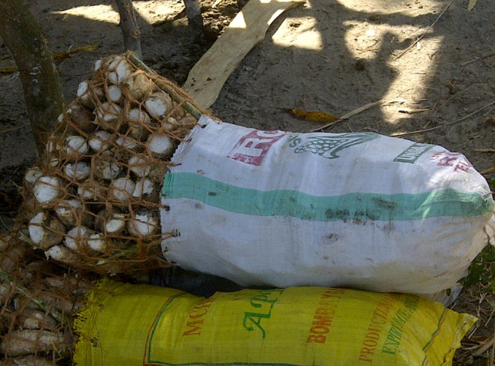
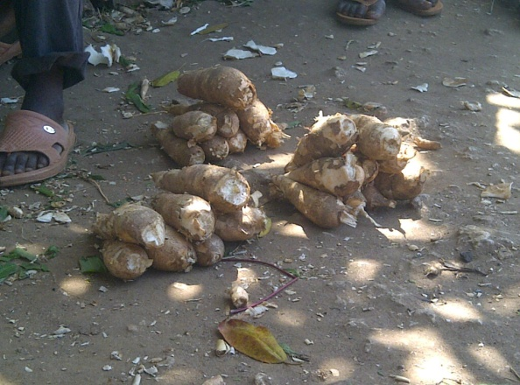
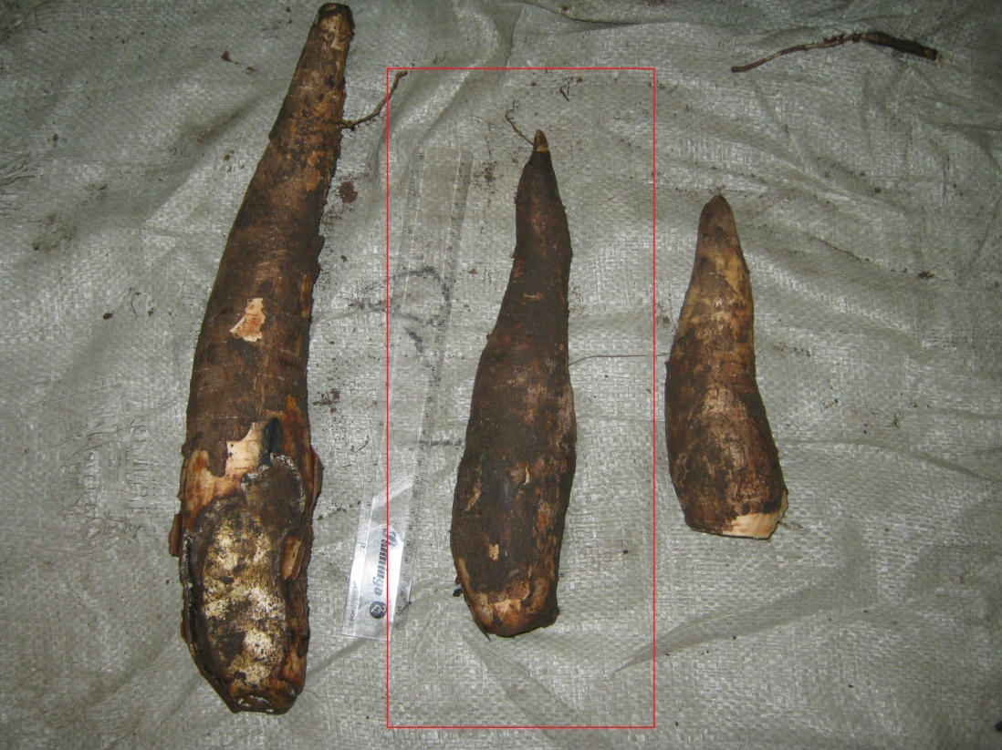
In pictures …

Slide 23
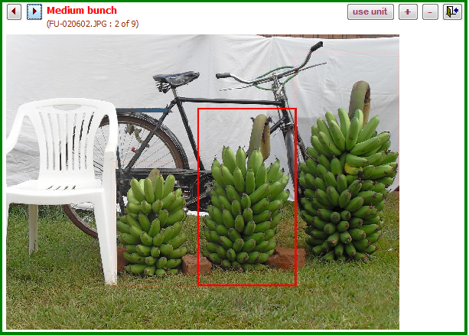
Quantifying non-standard units …

Slide 24
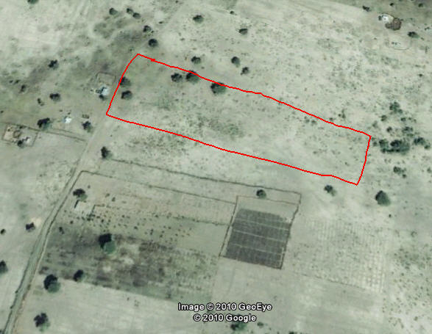
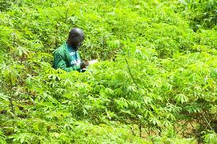
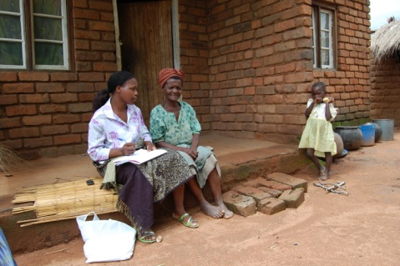
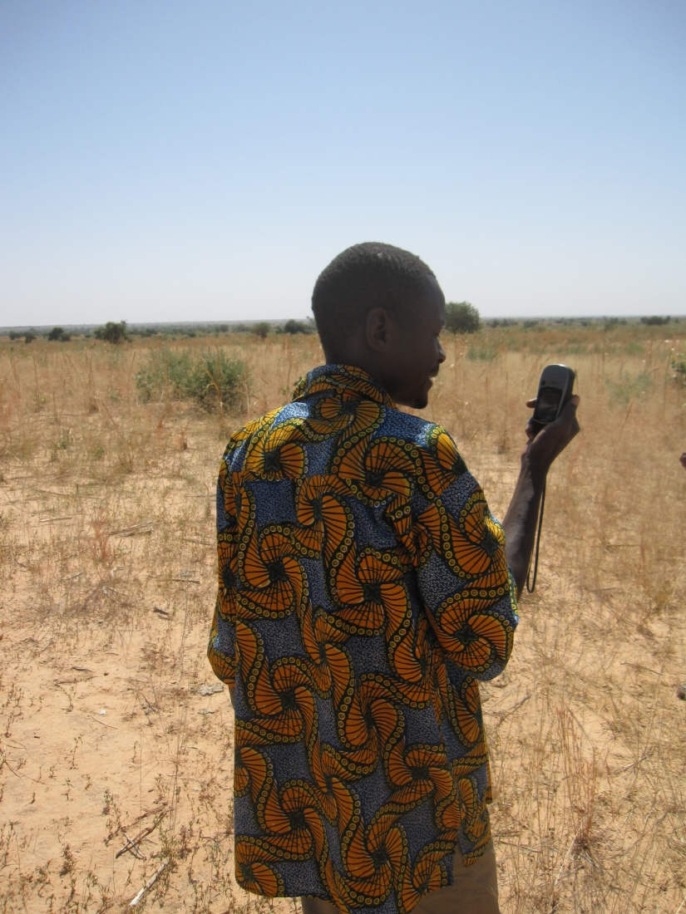
Now the denominator – land area
What are the different methods?
Satellite imagery
Lots of potential but . . .
“Eye estimate”
Surprisingly widespread but …
Traversing (compass and rope)
Gold standard but …
Farmer’s self-reporting
Widely used but …
GPS
Increasingly used but …

Slide 25
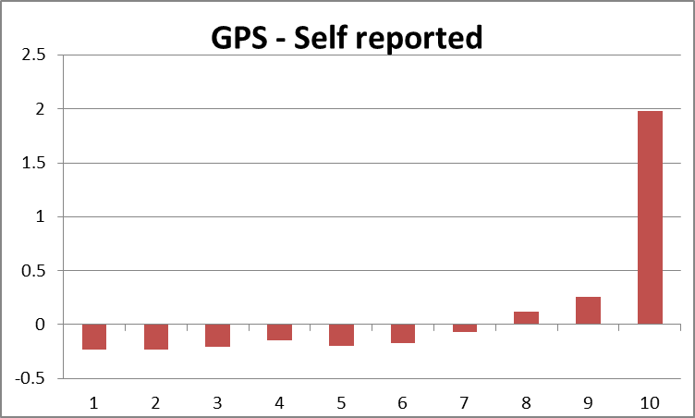
Does using GPS make a difference?
Source: 2005/06 UNHS
Source: Carletto, Savastano, Zezza (2013). “Facts or Artifacts: the Impact of Measurement Errors on the Farm size - Productivity Relationship”, Journal of Development Economics.

Slide 26
… which, in terms of yields ...
Farm Size (terciles) | Yields difference (GPS-SR)/GPS
Smaller | 28%
Medium | 7%
Larger | -30%
Cv cv
Cvc v
Source: 2005/06 UNHS

Slide 27
But, is Uganda a special case?
Yields differences: (GPS-SR)/GPS
FARM SIZE (terciles) | Pooled | Malawi | Uganda | Tanzania | Niger
Smaller | 19.4% | 18.0% | 17.4% | 32.2% | 19.1%
Medium | -4.3% | -5.7% | -4.1% | -0.1% | -3.3%
Larger | -19.1% | -13.9% | -34.0% | -28.5% | -89.6%

Slide 28
How to maximize its use and impact?
Awareness of and access to data – one stop shop portal?
Meta data
Raw data (LSMS-ISA)
Processed data (RIGA, CLSP, Myths and Facts)
Linked secondary data (LSMS-ISA)
Training versus learning by doing
Technical assistance (to LSMS-ISA statistical offices)
Mentorship program
AERC model (sponsor LSMS-ISA use by individual researchers)
CMAAE (regional M.S. training program)
Funding doctoral training (Centers of Excellence, OECD universities, regional universities)

Slide 29
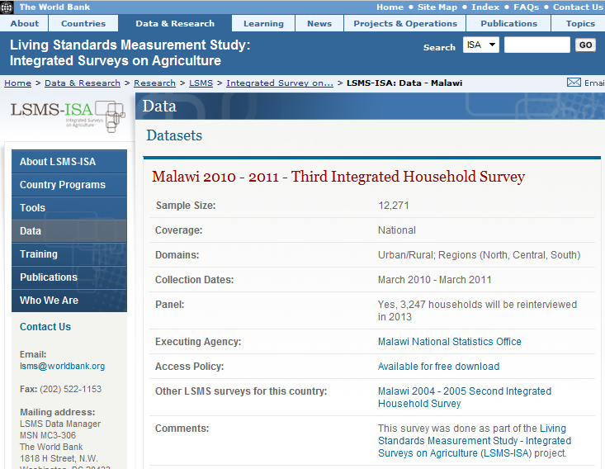
http://www.worldbank.org/lsms-isa

Slide 30
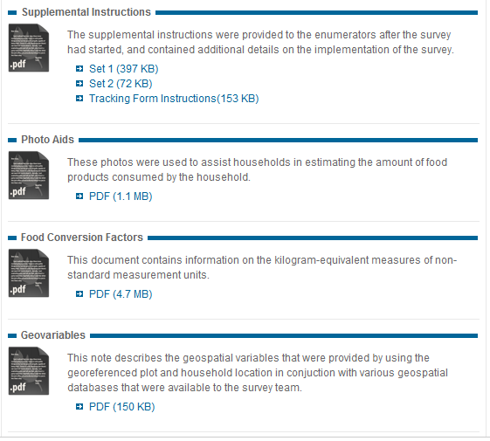
http://www.worldbank.org/lsms-isa

Slide 31
How to maximize its use and impact (2)?
A practical example
Agriculture in Africa – Telling Facts from Myths
Leading the way
Include other, similar data sets (Ghana, Zambia, Mozambique)
Inducing others to replicate LSMS-ISA (Central Africa, West Africa)
Disseminating results for impact
Publications
Briefs for media and policymakers

Slide 32
Objectives
Solid, updated, bottom up picture of Africa’s agriculture, food security and its farmers livelihoods
Harmonized, easy to use database of core agricultural and food security variables for tabulation and regional cross-country benchmarking
Community of practice.
AGRICULTURE IN AFRICA
TELLING FACTS FROM MYTHS

Slide 33
COMMON WISDOMS REVISITED
Use of modern inputs remains dismally low
Land, labor and capital markets remain largely incomplete
Agricultural labor productivity is low
Land is abundant and land markets are poorly developed
Access to credit remains low
Extension services are poor
Agroforestry is gaining traction
African agriculture is intensifying
9) Women perform the bulk of Africa’s agricultural tasks
10) Seasonality continues to permeate rural livelihoods
Smallholder market participation remains limited
Post harvest losses are large
Droughts dominate Africa’s risk environment
African farmers are increasingly diversifying their incomes
Agricultural commercialization and diversification improves nutritional outcomes

Slide 34
MENTORSHIP PROGRAM
Abidoye Babatunde (Nigeria)
Fuje Habtamu (Ethiopia)
Gandonou Esaie (Benin)
Kasirye Ibrahim (Uganda)
Kinuthia Bethuel (Kenya)
Liverpool-Tasie Lenis (Sierra Leone)
Ndiaye Moctar (Senegal)
Ngenzebuke Rama Lionel (Burundi)
Ogunyemi Oluwole (Nigeria)
Owoo Nkechi (Ghana)
AGRICULTURE IN AFRICA
TELLING FACTS FROM MYTHS

Slide 35
As a global community …
What data collection to promote? How to better integrate data?
What instruments to promote? How to foster the creation of standards?
What institutional set ups to promote? How to improve coordination?

