Slide 1
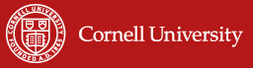
The Performance of Index Based Livestock Insurance (IBLI):
Ex Ante Assessment in the Presence
of a Poverty Trap
Chris Barrett
ISS Seminar, Cornell University
October 27, 2009

Slide 2
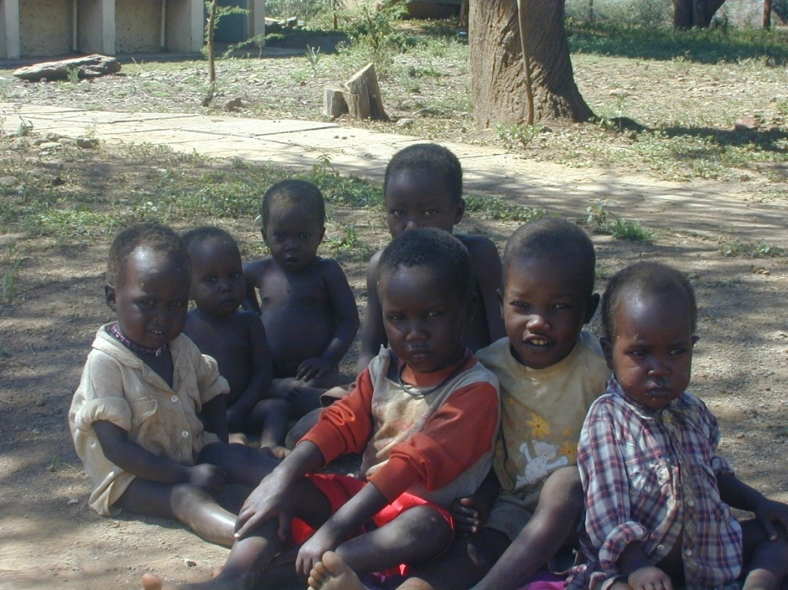
Motivation: Poverty Traps and Shocks
Strong prior evidence of poverty traps in the arid and semi-arid lands (ASAL) of east Africa
Standard humanitarian response to shocks/destitution: food aid
Pay attention to the risk and dynamics that cause destitution … else beware a relief trap!

Slide 3
Insurance and Development
Economic costs of uninsured risk, esp. w/poverty traps
Sustainable insurance can:
  Prevent downward slide of vulnerable populations
  Stabilize expectations & crowd-in investment and accumulation by poor populations
  Induce financial deepening by crowding-in credit supply and demand
But can insurance be sustainably offered in the ASAL?
Conventional (individual) insurance unlikely to work, especially in small scale agro-pastoral sector:
  Transactions costs
  Moral hazard/adverse selection

Slide 4
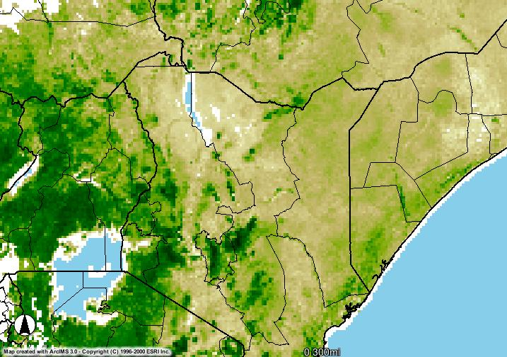
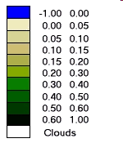
Index-based Livestock Insurance (IBLI)
Compensates area-averaged drought-related livestock losses
Indemnity paid based on predicted mortality index estimated based on satellite-based vegetation index (NDVI)
Advantages
- Low transaction costs
- Low incentive problems (e.g., moral hazard)
- Reduce covariate risk exposure
Disadvantages: Basis risk
Imperfect match of individual mortality
losses and the predicted mortality index
Given this tradeoff, the impact of index insurance becomes an empirical question … but no real evidence to date
NDVI February 2009, Dekad 3

Slide 5
This Paper’s Contribution
Simulation analysis of IBLI performance given a poverty trap
  IBLI as asset insurance
    Intertemporal impact assessment given underlying asset dynamics
  Household-level analysis
    Estimate household-level basis risk factors and risk preferences
  Explore WTP and aggregate demand for IBLI
Non-linear IBLI performance conditional on initial herd size
  IBLI valuation highest among the vulnerable non-poor
  Herd size impact dominates those of basis risk or risk preferences
Highly price elastic demand
Potential for targeted subsidies of IBLI as a productive safety net
Key Findings

Slide 6
The Study Area in Northern Kenya & Data
Four pastoral locations in Marsabit, where IBLI pilot launches in 2010
Two panel data sets available:
(1) USAID PARIMA project (~30 hh/location, quarterly 2000-2002)
(2) Household survey and experiment (42hh/location, pseudo quarterly 2007-2008)
Chalbi
Laisamis

Slide 7
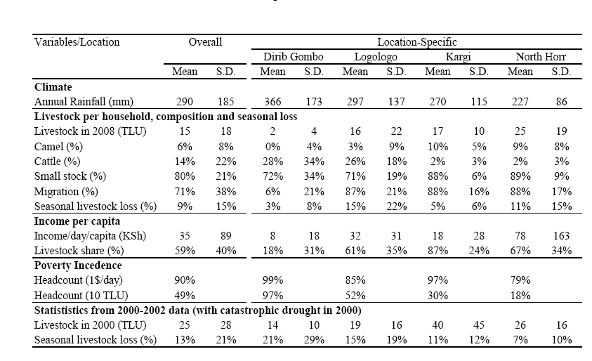
The Study Area in Northern Kenya & Data
Pastoral communities, livestock as main source of livelihood
Vulnerable to covariate livestock loss (e.g., drought in 2000)

Slide 8
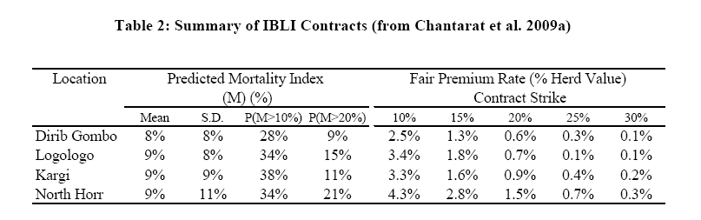
Index-based Livestock Insurance
Indemnity is made at the end of each season if NDVI-based predicted mortality rate is beyond strike M*

Slide 9
Analytical Framework: Bifurcated Herd Dynamics
(1) Nonlinear herd accumulation with subsistence consumption H^{c}
(2) This leads to bifurcation in herd accumulation with threshold H*(H^{c})
Intertemporal utility defined over livestock wealth with CRRA
(4) Certainty equivalent herd growth wrt. herd dynamics {H_{ilt}}_{t=1,…}

Slide 10
Analytical Framework: IBLI
(5) IBLI makes indemnity payments at the end of each season:
(6) Premium to be paid at the beginning of the season (loading a>0)
(7) Fully insured herd with IBLI (with g as non-mortality growth rates)
(8) Basis risk is estimated from PARIMA data as:
(9) IBLI performance in improving welfare dynamics:

Slide 11
Empirical Estimation and Simulation
Estimate seasonal non-mortality growth function:
H^{c} = 0.5 TLU /household /season
Pool 4 seasons of PARIMA (00-02), 2 seasons of (07-08) survey data
Two functions, 1 each conditional on good- or bad- vegetation conditions

Slide 12
Empirical Estimation and Simulation
Estimate seasonal non-mortality growth function:
If combined with mortality >> bifurcated herd dynamics at 15 TLU

Slide 13
Empirical Estimation and Simulation
Estimate household-specific basis risk factors:
Individual loss:
Unpredicted loss:
with
Random coefficient models with random effect on the slope
Use 4 seasons panel of PARIMA (2000-02)
Estimated household beta (mean=0.8,sd=0.5) Vs. unpredicted loss (0,0.12)

Slide 14
Empirical Estimation and Simulation
(3) Estimate best fit joint distributions of
  χ² goodness of fit criterion
Simulate herd dynamics of 500 hhs/area, 54 historical seasons
  Based on the estimated growth functions and parameters
  Use 54 seasons of historical NDVI since 1981, retaining sequencing
Cumulative distribution of simulated herd
Bifurcated herd threshold at 15 TLU

Slide 15
Empirical Estimation and Simulation
Simulate household’s CRRA based on wealth specific distributions
(6) Consider 5 fair IBLI with strikes of 10%, 15%, 20%, 25%, 30%
Simulate average performance
over 54 pseudo sets of 54-season herd dynamics

Slide 16
Effectiveness of IBLI in Managing Asset Risk
Varying patterns of IBLI performance emerge for different herd sizes
Bifurcated herd
H*=15 TLU
Negligible benefits for the poorest (herd<<H*)
Varying performance for vulnerable herd around H*: Highest gains if IBLI preserves herd dynamics from shock soon after initial purchase

Slide 17
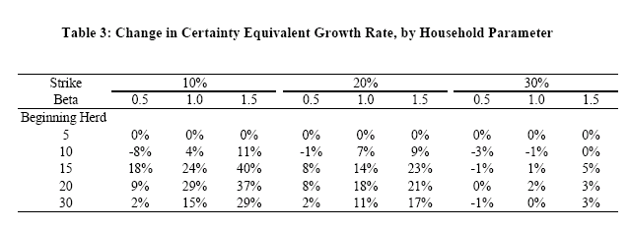
Effectiveness of IBLI in Managing Asset Risk
IBLI performance conditional on contract specifications and household’s basis risk factors
Non-linear impact based on initial herd size relative to the threshold
  Minimal role for H<15 TLU, greatest performance for H=15-20 TLU
IBLI performance increases with beta
10% contract provides best result, though the most expensive

Slide 18
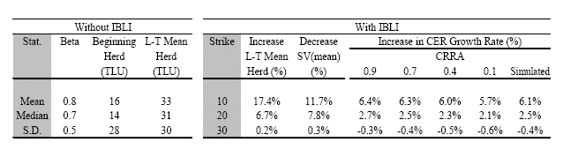
Effectiveness of IBLI in Managing Asset Risk
IBLI performance, 2000 simulated households
-- Effective demand exists for
fair IBLI at 10%,20% strike levels
-- Minimal change in performance
wrt risk preference
-- 10% contract provides best result
-- Variation in performance across
households with different
characteristics

Slide 19
Willingness to pay for IBLI
By herd size
WTP beyond fair rate is only attained at herd size beyond H*=15 TLU
Most of the population has no effective demand for IBLI

Slide 20
District level-Aggregate Demand for IBLI
Larger herd owners are clientele for commercially loaded IBLI
Highly price elastic demand >> significant pricing implications
Very price elastic demand and lower than commercial rates among the vulnerable group (10-30 TLU) >>> premium subsidies desirable???

Slide 21
Dynamic Outcome of Targeted IBLI Subsidies
Optimally targeted subsidized IBLI maximizes poverty reduction outcomes:
Free provision to 10-20 TLU & subsidized at actuarily fair rate for 20-50 TLU
  Lower and stabilize asset poverty about 10% lower than w/o IBLI
  Most cost effective: at $20 per capita cost per 1% reduction in poverty HC
  ( in contrast to the $38 per capita for the need-based transfers scheme)
Potential for IBLI as productive safety net

Slide 22
Conclusions
Initial herd size is the key determinant of IBLI performance in the presence of threshold-based poverty trap
  Greater effect than basis risk or risk preference
  IBLI works least well with the poorest
  IBLI is most valuable for the vulnerable non-poor
10% strike contract outperforms others
Highly price elastic aggregate demand and limited demand at the commercially viable rates
  Especially significant among the vulnerable group
  Targeted IBLI subsidies may work as a productive safety net

Slide 23
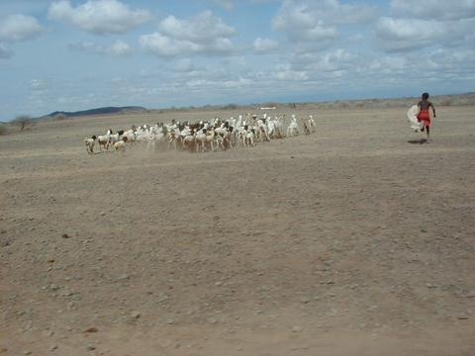
IBLI appears a promising option for addressing risk-based poverty traps
For more information visit www.ilri.org/livestockinsurance
Thank you for your time, interest and comments!
Notes:
23

