Slide 1
Innovations to Build Resilience in Low-Income Rural Communities: Some Research Reflections and Frontiers
Christopher B. Barrett, Cornell University
Keynote address at annual conference of the
International Consortium on Applied Bioeconomy Research
June 30, 2021

Slide 2
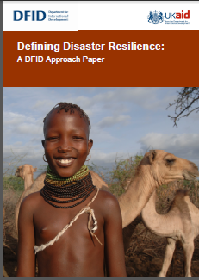
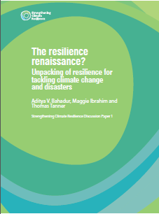
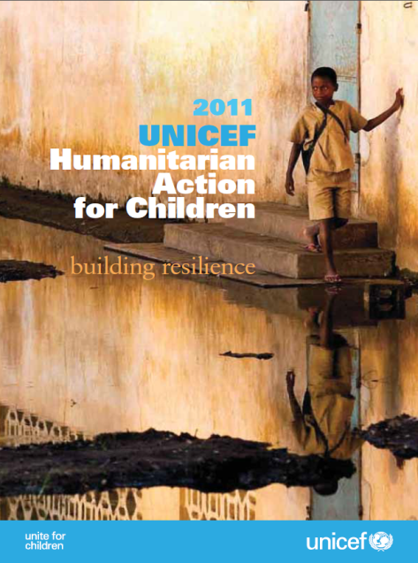
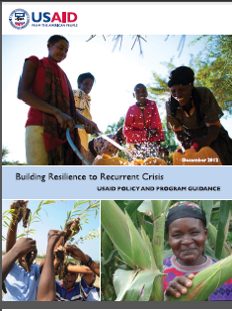
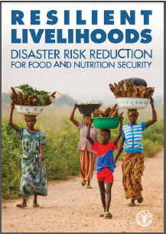
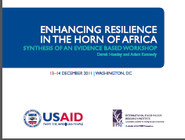
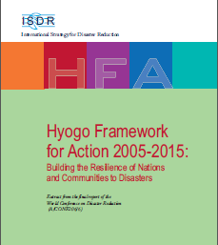
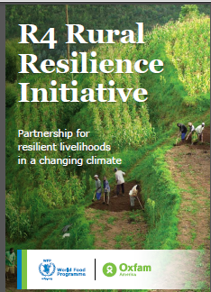
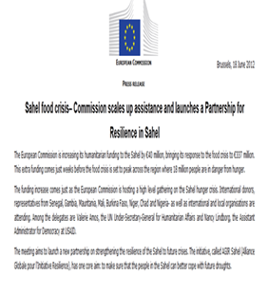
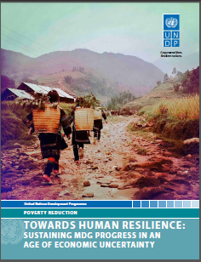
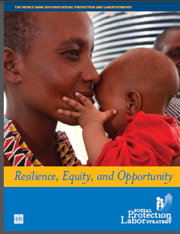
Motivation
“Resilience” has rapidly become a ubiquitous buzzword, but ill-defined and inconsistently measured concept within the development and humanitarian communities

Slide 3

Motivation
Why development and humanitarian communities’ current fascination with “resilience”?
Risk perceived as increasing in both frequency and intensity
Recurring crises (e.g., Somalia, eastern DRC) underscore the longstanding difficulty of reconciling humanitarian response to disasters with longer-term development efforts.
Increasingly recognize interdependent socio-biophysical systems. Learn from advances in ecological research.

Slide 4
Motivation
Core challenge: Like poverty and food security, resilience is an unobservable, normative concept, a latent variable. It is not directly measurable and requires longitudinal, ideally high frequency data plus exposure to shocks/stressors.

Slide 5

Challenge for researchers
Concept remains inconsistently used …
and measurement remains unsettled ...
so good research to guide innovation and investment quite underdeveloped.

Slide 6
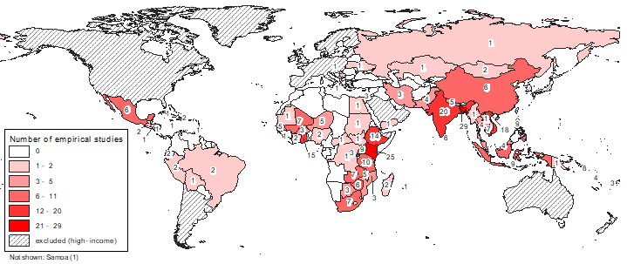
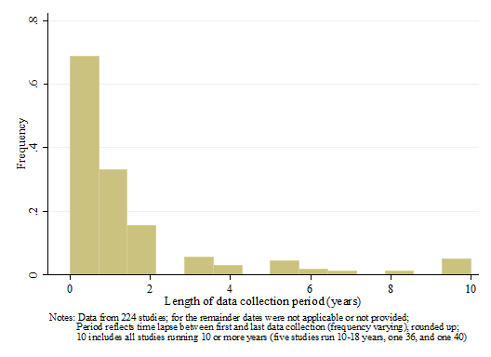
State of literature
Literature expanding very rapidly since 2008-11.
But most focused on a few areas and shocks, use just cross-sectional data and one scale of analysis.
Publication of empirical resilience studies
Source: Barrett et al. World Dev’t in press

Slide 7
State of literature
Quant lit on resilience especially weak
5 key ‘quality’ criteria:
1 – Clear definition of “resilience”
2 – Explicit attention to risk/stressor exposure and/or ex-post shocks
3 – Clear resilience measure
4 – Used longitudinal data
5 – N ≥ 200 / survey round
Google Scholar: 2.4 mn hits!
9,558 total records in SR
301 included studies
45 ‘5C’ studies
12 ‘5 C’ quant studies
Source: Barrett et al. World Dev’t in press

Slide 8
Conceptualizations
Lots of conceptual confusion about resilience
Focus on minimizing human experience of ill-being over time in a stochastic world.
Implies:
focus on individuals’ (and groups’) well-being within a system, not the state of a system itself.
consider the stochastic dynamics of well-being
Focus less on specific sources of risk b/c problem is uninsured exposure to many stressors (ex ante risk) and shocks (ex post, adverse outcomes). Resilience implies adaptability while preserving/achieving an adequate standard of living.

Slide 9
Conceptualizations
and measures
3 broad conceptualizations in literature:
Concept 1: Resilience as capacity
Resilience = “the capacity that ensures stressors and shocks do not have long-lasting adverse development consequences” (Constas et al. 2014)
Commonly operationalized as indices constructed by factor analysis of a vector of indicators (FAO RIMA, USAID/TANGO)
Resilience as capacity aims to explain variation in well-being.
Hard to use to study ‘what builds resilience’ and hard to unpack a vector of endogenous indicators to identify causal effects.

Slide 10
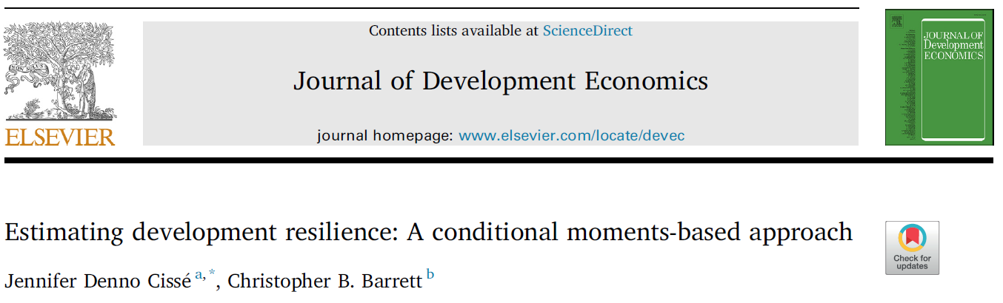
Conceptualizations
and measures
Concept 2: Resilience as a normative condition
Resilience = probability of attaining at least some minimum standard of wellbeing.
Commonly operationalized as conditional probability (Cissé & Barrett JDE 2018), an outcome measure. Applied to food security (Upton et al. Ag Econ 2016)

Slide 11
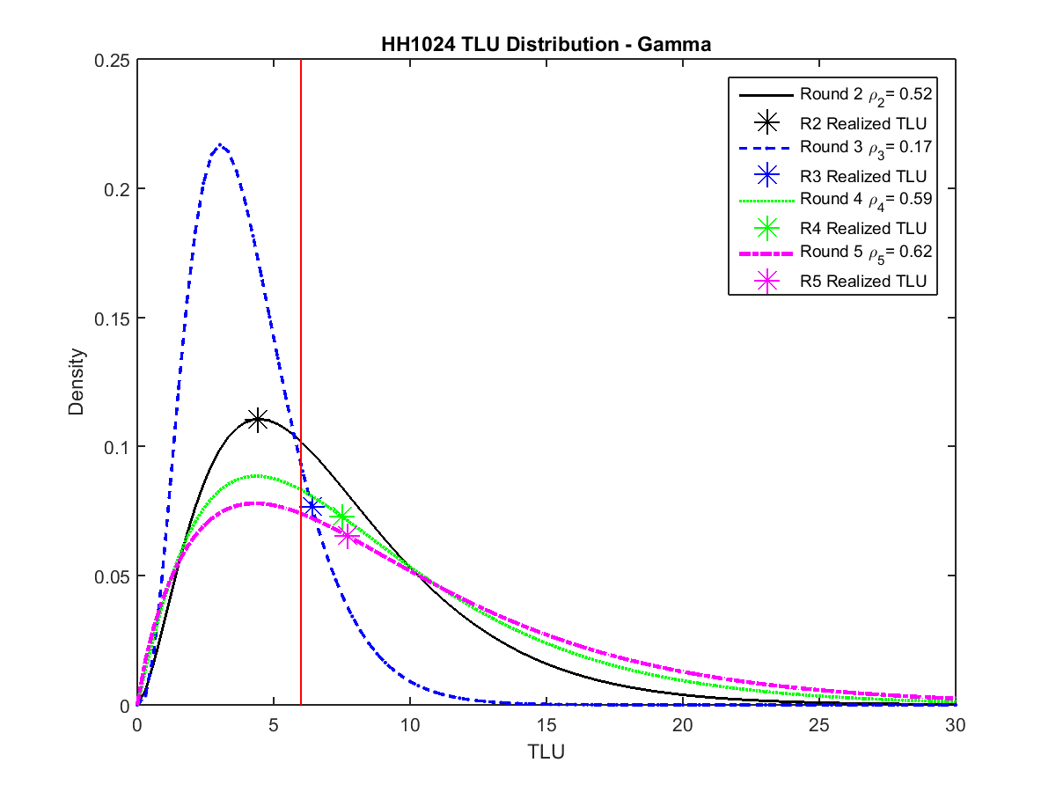
HH-period-specific CPDs: FGT-style population-level measures:
Conceptualizations
and measures
Example from northern Kenya pastoralists
Source: Cissé & Barrett JDE 2018

Slide 12
Conceptualizations
and measures
This approach lends itself naturally to impact evaluation
Example: Heifer Int’l project in Zambia.
Training and asset transfers significantly increase conditional mean and reduce conditional variance of household wealth over time. Total B/C ~ 7
[2.5,8.7] across hh wealth deciles
Source: Phadera et al. (JDE 2019)

Slide 13
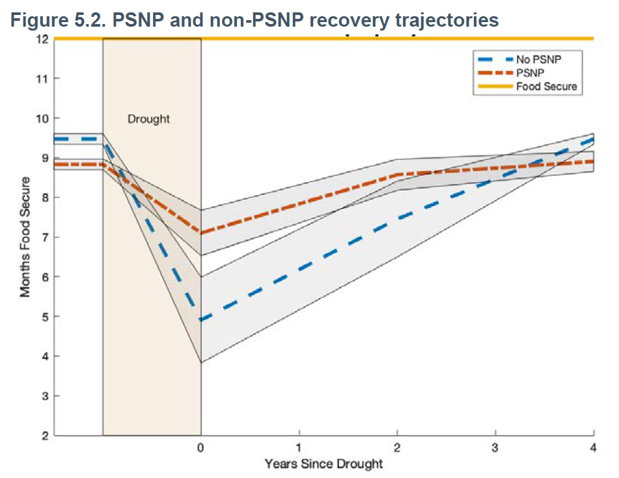
Conceptualizations
and measures
Concept 3: Resilience as return to equilibrium
Resilience = speed/magnitude/differences of/in return to pre-shock state
Example: Ethiopia PSNP
(Knippenberg & Hoddinott 2017)
Challenges: requires shocks,
many periods’ observations,
some normative anchor to measure

Slide 14
Measurement problems follow naturally
Main resilience measures (TANGO, RIMA, C&B) do not exhibit similar distributions, don’t identify the same households as resilient, and generally poor OOS predictive accuracy in same data sets.
Plus, RCI measures not internally consistent with the R measures they use for outcomes.
Source: Upton, Constenla & Barrett (in review)

Slide 15
What guidance?
Without conceptual and measurement clarity, the state of rigorous research to guide innovation and investment to build resilience is weak.
Conceptually, three general options exist:
Shift people’s current state. Ex: transfers of cash, education, land or other assets. (e.g., Heifer, PSNP)
Alter conditional transition dist’ns directly through risk reduction/transfer. Ex: social protection - EGS, insurance, improved policing, drought-resistant varieties (e.g., IBLI, flood-tolerant rice).
Tech/institutional change to alter underlying system structure (e.g., mobile phones)
But how evaluate specific interventions/innovations?

Slide 16
Summary
Resilience is a popular buzzword now. But little precision or consistency in its use, theoretically or methodologically.
We know relatively little about ‘building resilience’, based on rigorous, replicated studies. Operations are far out ahead of research. Risks of malpractice are distressingly high.
Must start with a firm theoretical foundation and measures/data that directly follow from theory. Rigorous but implementable.
A massive research agenda, especially w/agencies using resilience as a programming principle.

Slide 17
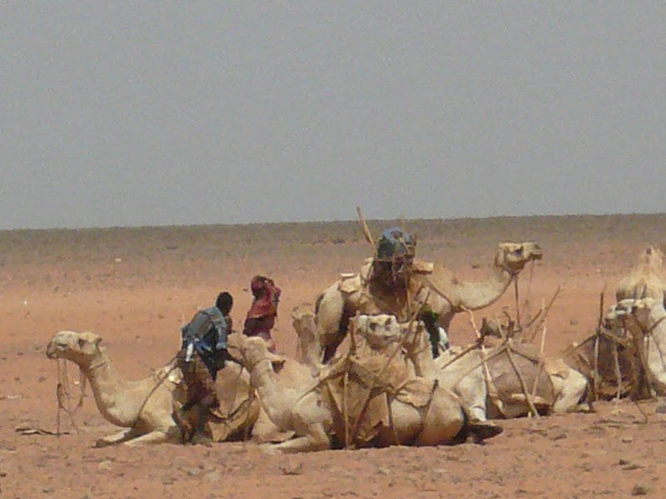
Thank you
Thank you for your time, interest and comments!

