Slide 1


If I Could Start Anew:
Some Reflections of
An Applied Economist
Chris Barrett
February 26, 2024
University of Illinois – Urbana/Champaign

Slide 2
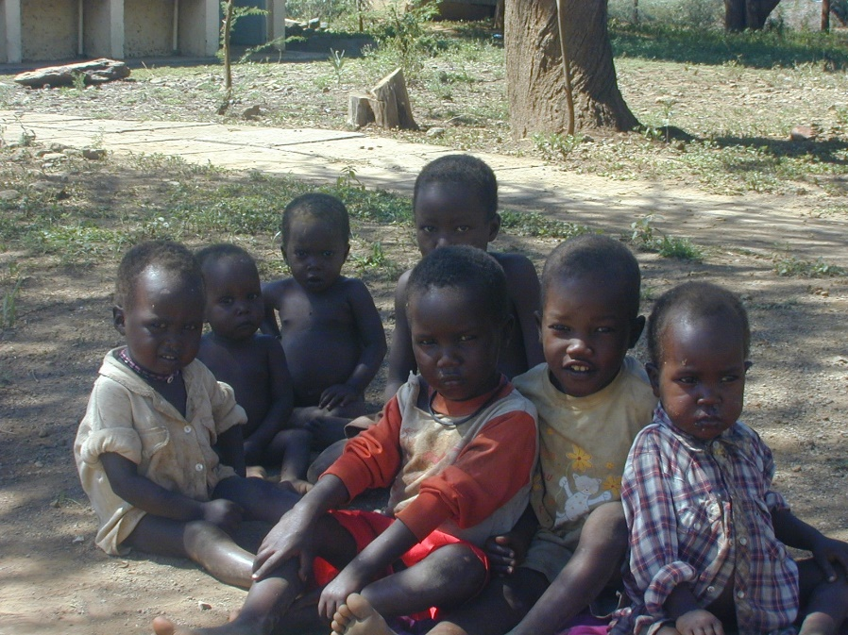
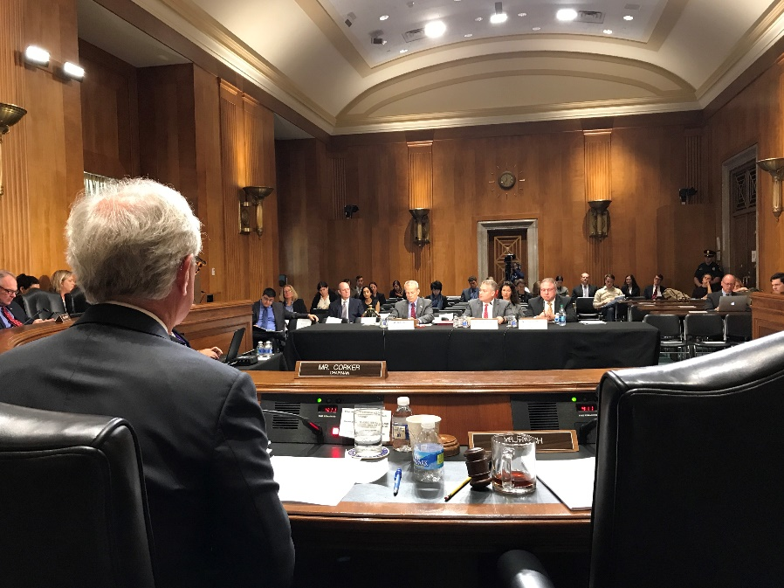
Why do we become applied economists?
- Fame? Power? Money? Exotic travel?
Probably not!
Probably more:
- intellectual stimulation (i.e., tackle interesting problems)
- impact opportunity (i.e., help solve important problems)
Aim for Impact

Slide 3
Aim for Impact
How to enjoy intellectual stimulation and impact?
First identify/relax binding constraints:
Knowledge
Access
Time
(very rarely is it money!)

Slide 4
Knowledge
Applied Economics Today
Heavy emphasis on reduced form empirical work with ‘clean’ causal identification. Premium on survey and experimental design skills, econometrics
Rapidly increasing data availability / computing power. Rising premium on data science (ML, NLP, GIS) skills.
Growing appreciation of the whole human, drawing on other social sciences to embrace – rather than assume away – the richness of human behaviors.
Increased recognition of humans’ inextricability from natural systems (health, ag, etc.) – work w/the relevant (soil, climate, crop, fisheries, parasitology, etc.) science.

Slide 5
Knowledge
Applied Economics Tomorrow
Most impactful questions integrate description, prediction and inference problems. Need to learn how to do each well.
Likely implies increased
emphasis on structural work and computational methods to get at causal mechanisms.
attention to MSE not just bias.
effort to improve measurement and address non-classical measurement error problems.
Kleinberg et al. (2015 AER P&P)

Slide 6
Time
How to relax time constraints
Develop good time management skills … rocks, jar and cup of coffee parable
Make good use of students/pre-docs/post-docs … not just as RAs/TAs, but as the next generation who can convey your ideas to the world and improve them!
Our greatest impacts typically come not from our contributions of ideas but from our contributions to the development of others … our students, our children.
  So invest accordingly!

Slide 7
Access
Focus on communicating beyond journal articles … at least post-tenure: blogs, columns, policy outreach
  Focus on clear communication for bright laypeople.
Seek out opportunities to work (e.g., during sabbatical) with firms, NGOs or government agencies you believe in and find out what they feel they need to learn (not what you think they need to learn). Respect those who do (not just scholars).
Accept that most important questions are fundamentally normative and therefore heavily value-laden. Real world decision makers will listen if and only if it’s clear that you will learn their language too and that you respect them even if you disagree. Don’t be the ugly economist!

Slide 8
If I Could Start Anew
I would:
Remind myself daily why I chose applied economics
‘Tech up’ on structural estimation, data science, state-of-the-art measurement methods
Develop closer working relationships with students and w/colleagues in sister social and natural sciences
Spend more time on clear public communications and with real decision-makers
Spend less time trying to impress fellow economists

Slide 9
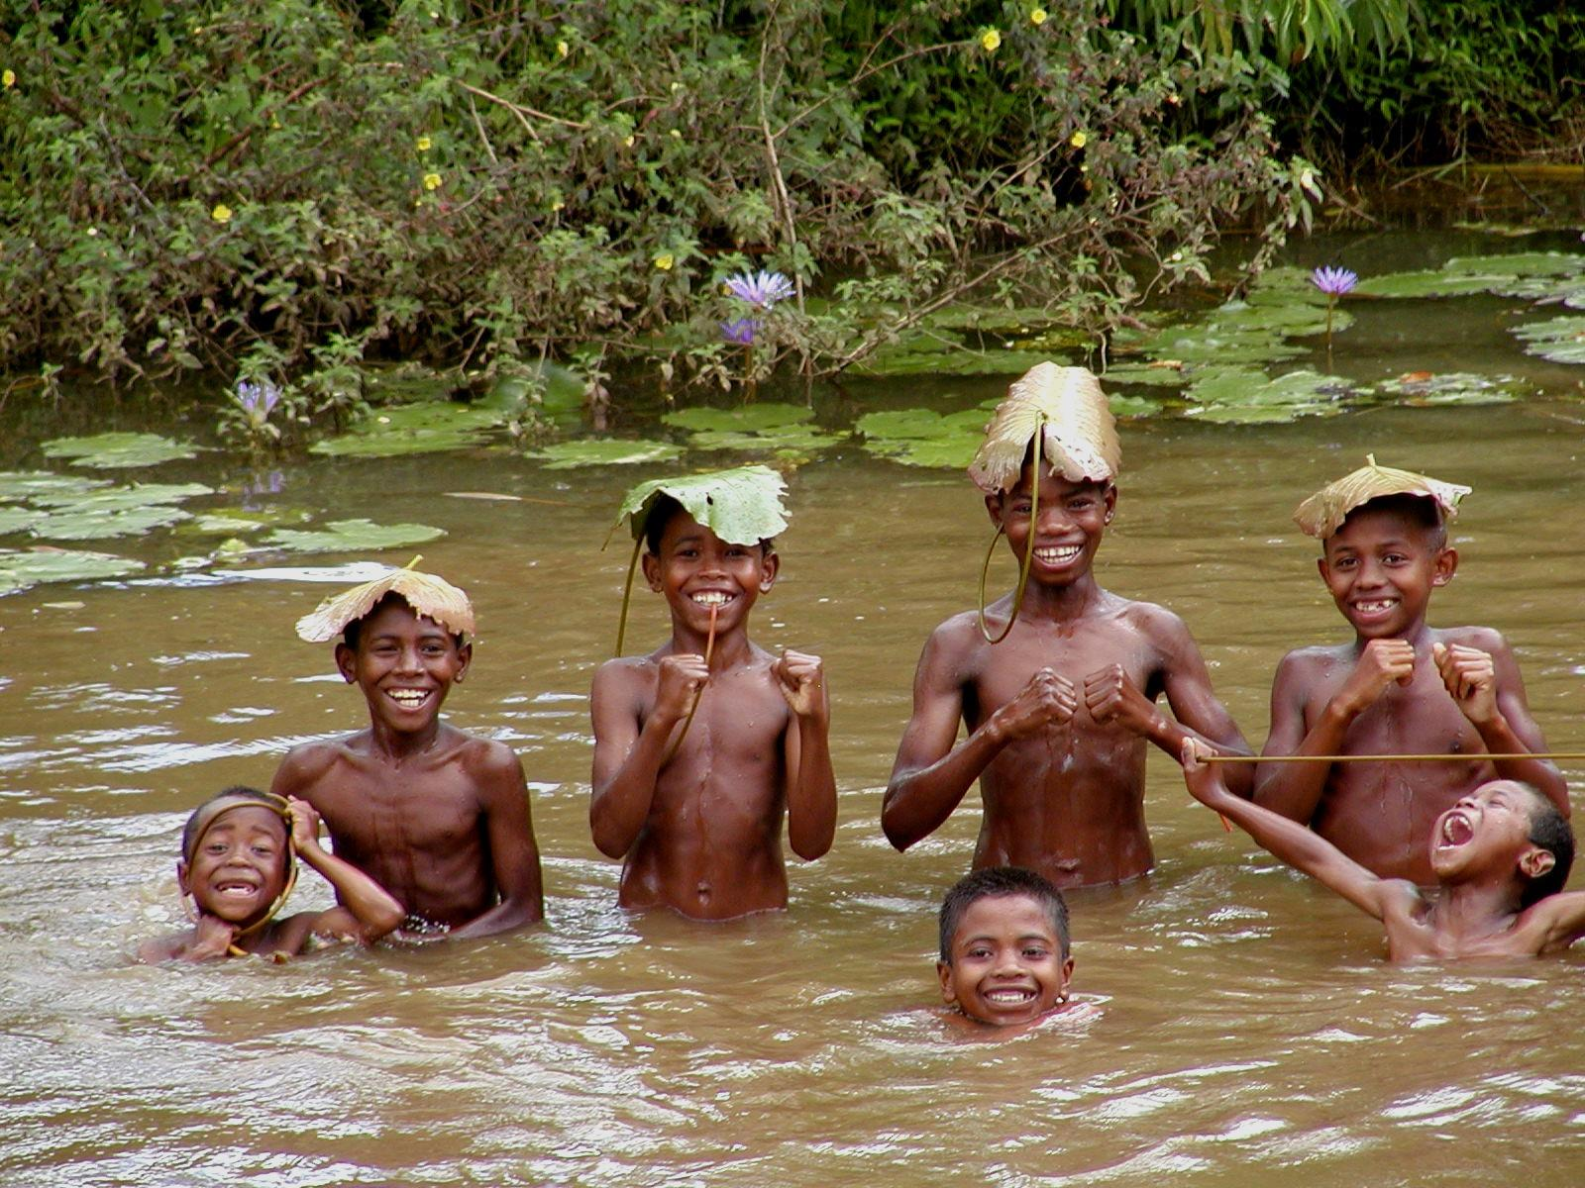
Good luck and Godspeed!

