Slide 1
Estimating value added from global agrifood systems
Kate Schneider Lecy, Jing Yi, Piero Conforti, Veronica Boero, Silvia Cerilli, Michele Vollaro, Shiyun Jiang, Jose Rosero Moncayo, and Christopher B. Barrett
workshop on Measuring Jobs in Agrifood Systems

Slide 2
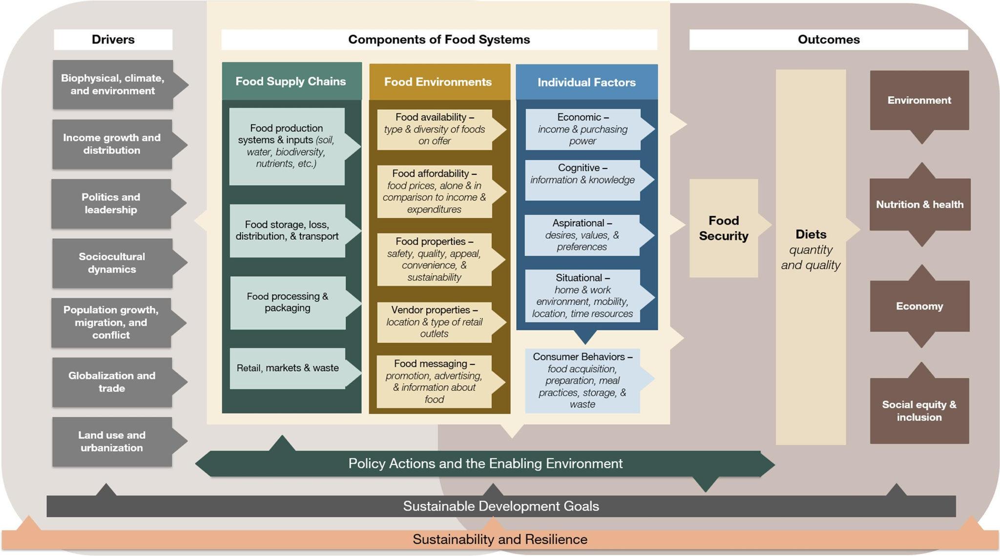
Agrifood systems are essential to every economy on earth
Notes:
Agrifood systems are an essential component of every economy on earth because they provide income, food, fibers, fuels, and medicine, among other goods and services.
Agrifood systems encompass all the actors and activities related to the production, processing, trade, consumption, and disposal of food and related non-food products and services. This includes and extends beyond primary production of agriculture, forestry, livestock production, and fishing

Slide 3
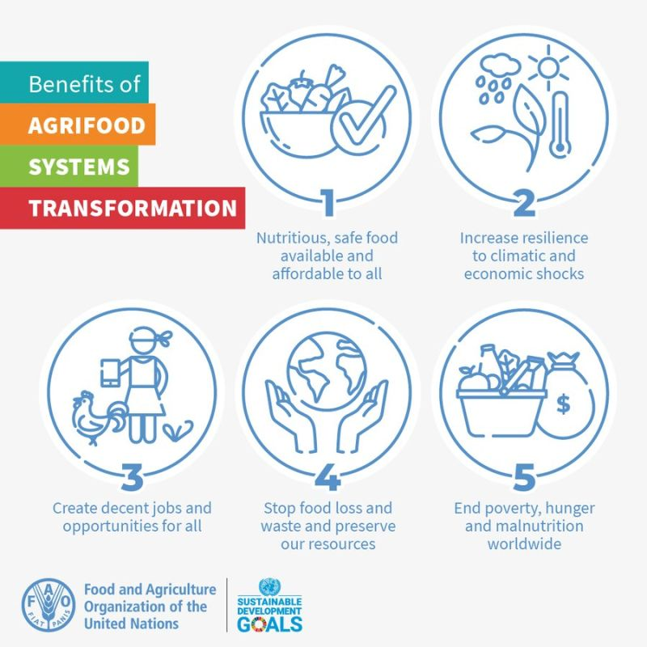
Agrifood systems transformation is increasingly at the center of national and global objectives.
Notes:
from meeting the Sustainable Development Goals (SDGs) and the Paris Agreement carbon emissions targets to ensuring supply chains are resilient to the next major war, pandemic, or other shocks

Slide 4
Agrifood systems and their transformation have been implicated in achieving wide ranging goals:
Economic development
Employment and youth employment
Climate change mitigation
Food security
Food safety
Better nutrition
Notes:
Are these expectations realistic? What are the most effective lever points for intervention?
It’s really hard to evaluate without knowing the the economic contribution of all parts of agrifood systems

Slide 5
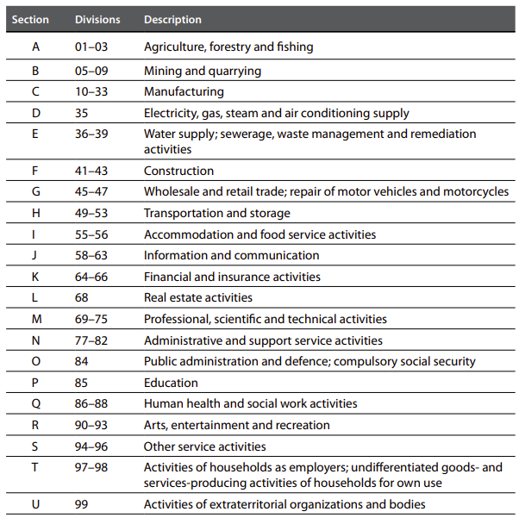
But official statistics follow traditional economic sectors.
So, existing data are not readily able to quantify the contribution of multisectoral agrifood systems to national economies and the world.
Notes:
ISIC classification is the standardized system for national accounting. You can see here the main aggregate categories (assigned letters) and the 2-digit level codes under each. It’s a hierarchical taxonomy.
Main aggregates and two digit codes shown
Goes down to 4-digit level --- but of course the data aren’t always available at this level of disaggregation

Slide 6
Research questions
How much value added is generated by agrifood systems?
How do the non-production parts of agrifood systems change with economic growth?
How do the patterns of consumer food expenditure accruals along the value chain relate to the rest of agrifood systems?

Slide 7
Approach
Start with official statistics from UNSD and UNIDO which are classified by ISIC codes
Different ISIC revisions available by country and year

Slide 8
Data
System of national accounts value added tables
Notes:
Take official statistics as our starting point
SNA – main aggregates --- the letter codes, highest level of aggregation --

Slide 9
Data
System of national accounts value added tables
Manufacturing sector detailed value added tables (ISIC 2-digit)
+
Notes:
Manufacturing sector – available at the 2 digit level

Slide 10
Approach
Start with official statistics from UNSD and UNIDO which are classified by ISIC codes
Different ISIC revisions available by country and year
Classify the ISIC codes for Revisions 3, 3.1, and 4 all the way down to the 4-digit level into an agrifood system classification:
Wholly agrifood
Partly agrifood
Not agrifood

Slide 11
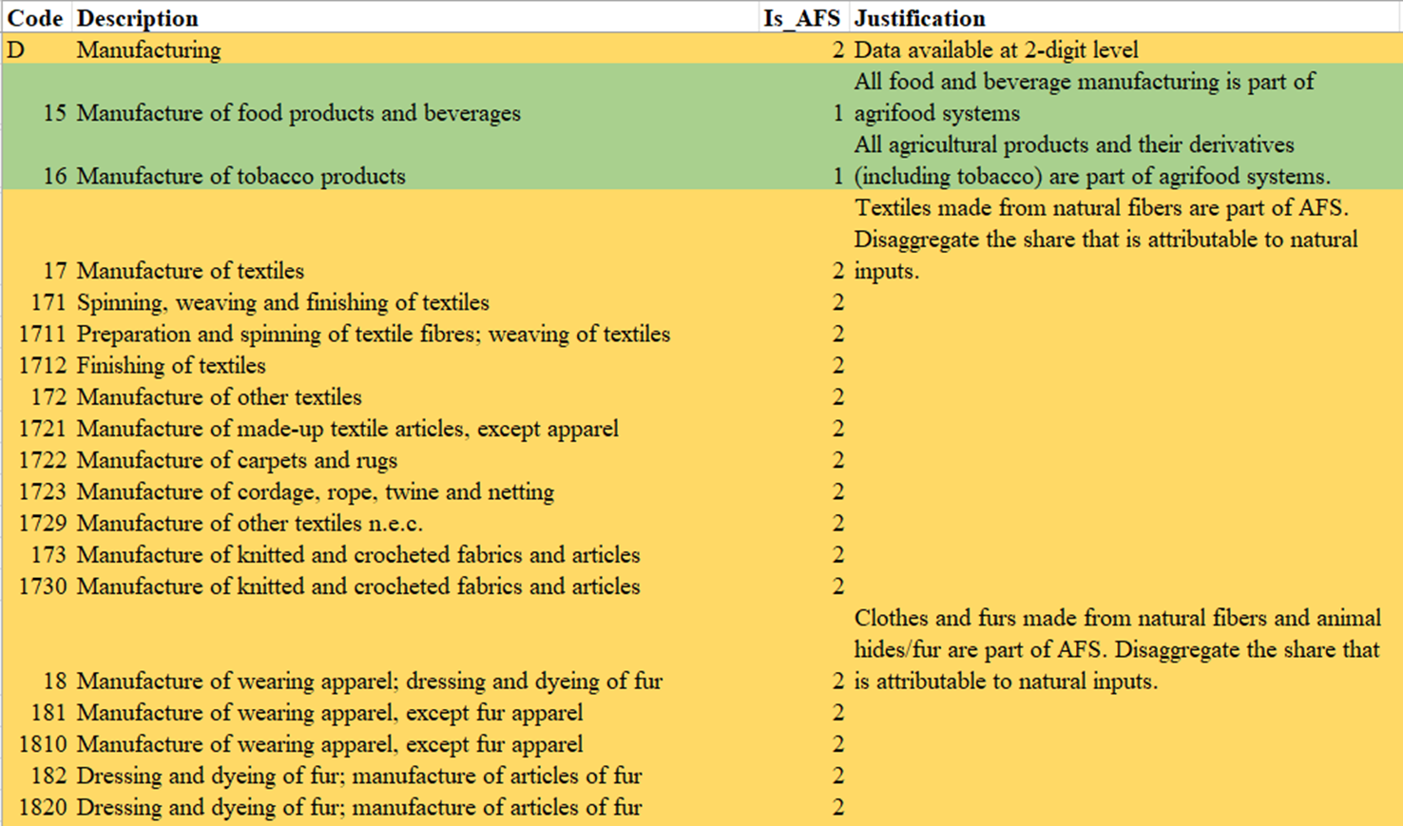
Example of ISIC classification to AFS (Rev 3) (completed for ISIC Rev 3, Rev 3.1, Rev 4)
Notes:
This classification takes the hierarchical structure such that any aggregate category is coded reflecting the lower-level codes it contains. Higher level codes with some wholly and/or partly AFS subordinates are assigned as partly AFS

Slide 12
Approach
Our approach starts by classifying the ISIC codes for Revisions 3 and 4 all the way down to the 4-digit level into an agrifood system classification
First step is to classify every ISIC code to the 4-digit level into:
Wholly agrifood
Partly agrifood
Not agrifood
Then we have to harmonize ISIC Revisions 3 and 4 to get the broadest country and time coverage
Take the latest ISIC Revision available for both UNSD and UNIDO data per country-year to form a time series

Slide 13
Harmonization table (excerpt)
ISIC Rev. 3 | ISIC Rev. 3 Description | AFS Rev. 3 | ISIC Rev. 4 | ISIC Rev. 4 Description | AFS Rev. 4 | Harmonization action for the AFS Value added database | Harmonized category name
A | Agriculture, hunting and forestry | Wholly | A | Agriculture, forestry and fishing | Wholly | Excluded in favor of aggregate A+B category. Combined into an A+B aggregate for country-years where it is not already in the data base. | Agriculture, forestry, fishing
01 | Agriculture, hunting and related service activities | Wholly | 01 | Crop and animal production, hunting and related service activities | Wholly | Excluded in favor of aggregate A+B category. Combined into an A+B aggregate for country-years where it is not already in the data base.
02 | Forestry, logging and related service activities | Wholly | 02 | Forestry and logging | Wholly | Excluded in favor of aggregate A+B category. Combined into an A+B aggregate for country-years where it is not already in the data base.
B | Fishing | Wholly | 03 | Fishing and aquaculture | Wholly | Excluded in favor of aggregate A+B category. Combined into an A+B aggregate for country-years where it is not already in the data base.
A+B | Agriculture, hunting and forestry; Fishing | Wholly |  |  | Wholly | Included as A+B from Rev 3, and A from Rev 4
C | Mining and quarrying | Partly | B | Mining and quarrying | Partly | Included as C from Rev 3 and B from Rev 4 | Mining and quarrying
D | Manufacturing | Partly | C | Manufacturing | Partly | Disaggregate by the fraction method (see below) for countries only reporting this aggregate, dropped for countries with UNIDO data. | Manufacturing
15 | Manufacture of food products and beverages | Wholly | 10 | Manufacture of food products | Wholly | Combined with beverages to harmonize with ISIC Rev 3. | Manufacture of food products and beverages
 |  |  | 11 | Manufacture of beverages | Wholly | Combined with food products to harmonize with ISIC Rev 3. | Manufacture of food products and beverages

Slide 14
Approach
Our approach starts by classifying the ISIC codes for Revisions 3 and 4 all the way down to the 4-digit level into an agrifood system classification
First step is to classify every ISIC code to the 4-digit level into:
Wholly agrifood
Partly agrifood
Not agrifood
Then we have to harmonize ISIC Revisions 3 and 4 to get the broadest country and time coverage
Take the latest ISIC Revision available for both UNSD and UNIDO data per country-year to form a time series
Finally, we disaggregate partially agrifood system categories using a fraction developed from inter-industry transaction matrix of harmonized multi-region input-output tables
Notes:
IO tables record where the output from each sector is consumed by other sectors in the economy, allowing us to track how goods emanating from agrifood production are used in the economy and vice versa

Slide 15
Data
System of national accounts value added tables
Manufacturing sector detailed value added tables (ISIC 2-digit)
+
Multi-region Input-Output tables: Eora26 harmonized 26-sector IO data
+
Notes:
Specifically, we use the Eora-26 MRIO which harmonizes IO data across countries into 26 consistent sectors and incorporates the role of trade

Slide 16
Goal:
Calculate total value added from agrifood systems as:
$VA_{AFS,y}=\sum_{i=1}^{j_{w}}{{VA}_{j_{w}y}}+\sum_{i=1}^{j_{p}}{{ω_{j_{p}y}∗VA}_{j_{p}y}}$ (1)
$VA=$ value added
$j_{w}=$ wholly agrifood sector
$j_{p}=$ partly agrifood sector
$y=$ year
$ω=$ share of partly agrifood sector attributable to agrifood systems

Slide 17
Goal:
Calculate total value added from agrifood systems as:
$VA_{AFS,y}=\sum_{i=1}^{j_{w}}{{VA}_{j_{w}y}}+\sum_{i=1}^{j_{p}}{{ω_{j_{p}y}∗VA}_{j_{p}y}}$ (1)
$VA=$ value added
$j_{w}=$ wholly agrifood sector
$j_{p}=$ partly agrifood sector
$y=$ year
$ω=$ share of partly agrifood sector attributable to agrifood systems

Slide 18
How do we calculate $ω_{j_{p}}$?
Aggregate all imports and exports into a single matrix per country-year at the sector level

Slide 19
How do we calculate $ω_{j_{p}}$?
Aggregate all imports and exports into a single matrix per country-year at the sector level
Define a relationship for each partly AFS ISIC code as a fraction of:
Inputs from one (Eora-26) sector into another (Eora-26) sector relative to sectoral gross output
Gross output refers to either the input or output sector, depending on the direction of the relationship along the value chain
Notes:
Example: to disaggregate the AFS share of the manufacture of textiles – we want a fraction reflecting the share that uses natural fibers.
So we estimate this as the value of inputs from primary production into the textiles and wearing apparel sector relative to the gross output of textiles and wearing apparel.

Slide 20
How do we calculate $ω_{j_{p}}$?
$VA=$ value added
$j_{w}=$ wholly agrifood sector
$j_{p}=$ partly agrifood sector
$y=$ year
$ω=$ share of partly agrifood sector attributable to agrifood systems
Goal:
$VA_{AFS,y}=\sum_{i=1}^{j_{w}}{{VA}_{j_{w}y}}+\sum_{i=1}^{j_{p}}{{ω_{j_{p}y}∗VA}_{j_{p}y}}$ (1)
${IO}_{y}=\left[\begin{matrix}a_{io} & … & {GO}_{i} \\ ⋮ & ⋱ & ⋮ \\ {GO}_{o} & … & a_{mn}\end{matrix}\right]$ (2)
Matrix structure:
$a_{io}=$ transaction value from input sector i to output sector o
${GO}_{i} =$ gross output of input sector i
${GO}_{i} =$ gross output of output sector o
$ω_{j_{p}y}=\left\{\begin{matrix}\frac{a_{io}}{{GO}_{i}} & j=input to o \\ \frac{a_{io}}{{GO}_{o}} & otherwise\end{matrix}\right.$ (3)
Calculation of $ω_{j_{p}y}$:
Notes:
Goal – to calculate the total value added from AFS
Have the IO matrix structured into the 26 Eora sectors in the form of the matrix you see here in (2)
Then we calculate the weight$ω_{j_{p}y}$for sector $j_{p}$ as the value of $a_{io}$ relative to the gross output of the input sector (${GO}_{i}$) when $j_{p}$ is an input to sector o and relative to the gross output of the output sector (${GO}_{o}$) in all other cases (Eq. 3).

Slide 21
Example: Inter-industry transaction fractions used to disaggregate partially agrifood categories, ISIC Revision 4
ISIC Rev. 3 | Description | Goal to approximate the following share (fraction) of each row category: | EORA-26 IO Matrix Cell Description |  |  | Justification
 |  |  | From (row) | Into (column) | Relative to GROSS OUTPUT of (denominator)
C | Manufacturing | Disaggregation only required for country-years without manufacturing sector data in the UNIDO database | DOMESTIC + IMPORTS Agriculture, Hunting, Forestry + Fishing | Disaggregation only required for country-years without manufacturing sector data in the UNIDO database | DOMESTIC + IMPORTS Agriculture, Hunting, Forestry + Fishing | Disaggregation only required for country-years without manufacturing sector data in the UNIDO database
14 | Manufacture of wearing apparel | Share of wearing apparel that is made from natural inputs (fibers, furs) and attributable to agrifood systems | DOMESTIC + IMPORTS Agriculture, Forestry, Fishing | Textiles and Wearing Apparel | DOMESTIC + EXPORT Textiles and Wearing Apparel | Share of manufacture of wearing apparel that is made from natural fibers/skins is estimated as the share of agriculture inputs (domestic and imported) into the textiles sector relative to the gross output of the sector (domestic and exported)
Notes:
We define each relationship with respect to the ISIC category the fraction will be used to disaggregate
Elements of the fraction are defined in terms of the Eora sectors

Slide 22
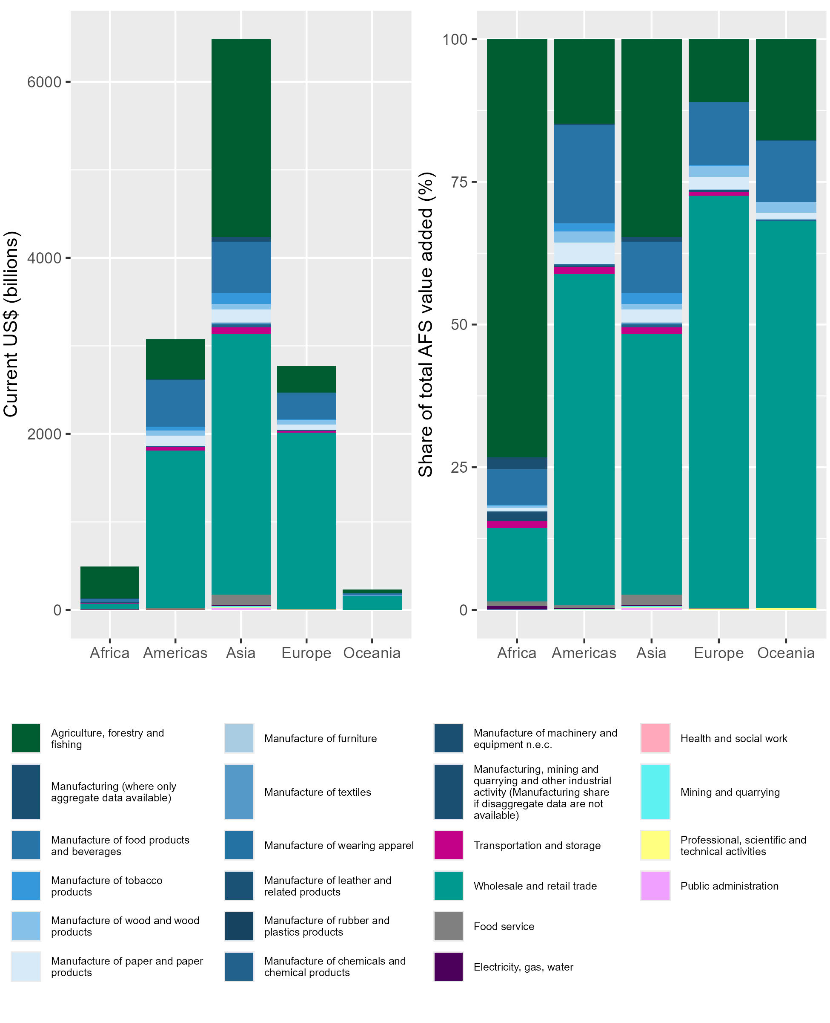
Results: Total value added from agrifood systems by region, 2019
Notes:
The story that emerges is that wholesale and retail trade is the largest single contributor at the global level and on all continents except Africa where primary production still dominates.
We can also see clearly that Asia dominates in terms of global value added from agrifood systems
Here’ you’re looking at 2019 data for 170 countries
(Details from the paper: In total, agrifood systems contributed nearly $13.1 trillion (nominal) to global GDP in 2019, 14.8% of the $87.7 trillion global GDP (25), or 15.5% of the total GDP ($84.1 trillion) of the 170 where the value added in AFS can be calculated. Most value added in Africa remains from primary production (agriculture, forestry, fishing) accounting for 73.3% of the continent’s agrifood value added, which is a small share ($494.4 million; 3.8%) of the global agrifood total. On all other continents wholesale and retail trade is the dominant contributing sector to total agrifood system value added. Nearly half of the global value added comes from Asia (nearly $6.5 trillion), with just under half of that ($3.0 trillion) from wholesale and retail trade and one third ($2.2 trillion) from primary production. Post-farmgate activities generate even larger shares of the value added – over 80% – in the Americas, Europe, and Oceania. Wholesale and retail trade dominates on these continents as well. Our estimate of value added from primary production in 2019 ($3.4 trillion) compares favorably with the estimate in FAOSTAT ($3.5 trillion) and the World Bank’s estimate of gross output value of agriculture in 2019 ($3.5 trillion), with the small differences likely accounted for by different data sources (United Nations Statistical Division (UNSD) in the case of our estimates and FAOSTAT vs. World Bank input-output tables) and the 24 countries for which there are no data in our analysis for 2019)

Slide 23
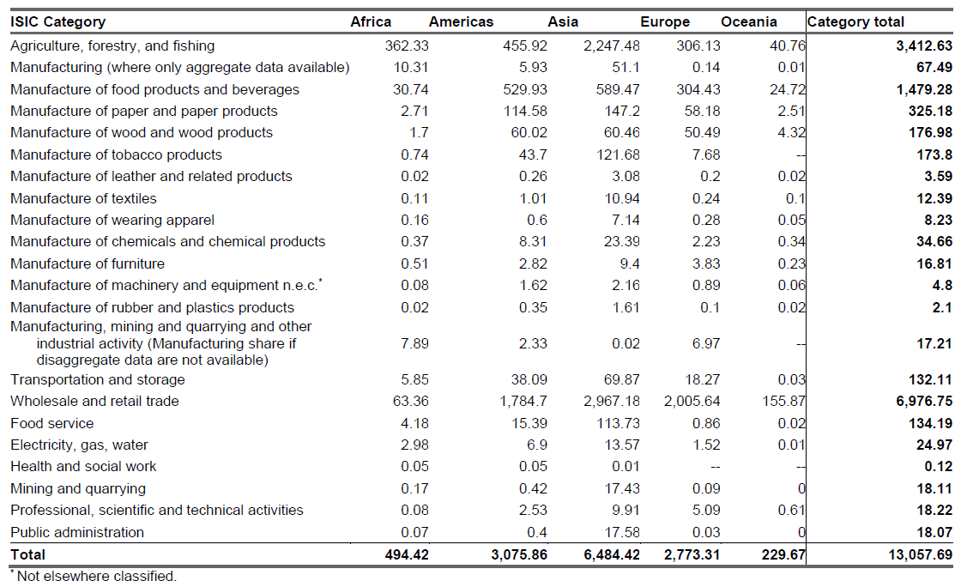
Agrifood systems contributed over US$13 trillion to global GDP in 2019
Current US$ trillions
Notes:
In exact terms – this is just over $13 trillion in 2019

Slide 24
Agrifood systems contributed over US$13 trillion to global GDP in 2019
Current US$ trillions
Notes:
Just one quarter from primary production

Slide 25
Agrifood systems contributed over US$13 trillion to global GDP in 2019
Current US$ trillions
Notes:
And just over one half from wholesale and retail trade

Slide 26
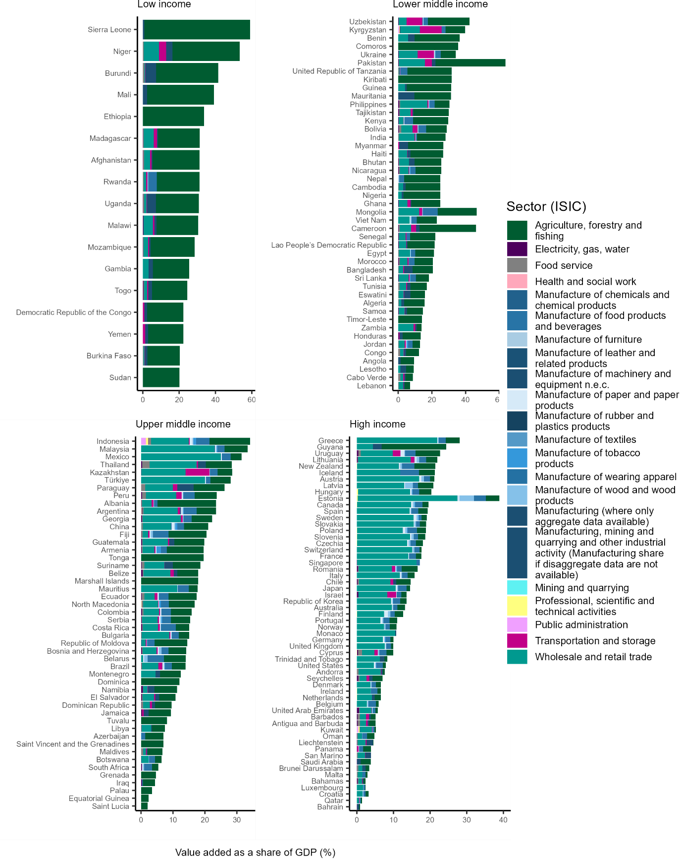
Value added from agrifood systems, by sector, country, and income level, 2019
Share of GDP from agrifood systems declines with country income
Countries have more diversified agrifood systems with increasing income
Notes:
Looking at the country level by income group we can see…

Slide 27
Changes in global agrifood systems value added over time, by sector excluding primary production, 1995-2019
Complete cases only (N=101)
Notes:
Change gears and look at the patterns over time for the 101 countries where we have complete data from 1995-2019
the dominant contributor to value added within agrifood systems beyond primary production is wholesale and retail trade,
followed by the production of foods and beverages, paper/paper products, wood and wood products, and tobacco.
(Details from the paper: Wholesale and retail trade generates more value added than all agrifood manufacturing combined. Much of the growth over the 1995 – 2019 period happened in Asia (Figure S2), which aligns with the earlier finding that Asia dominates in terms of global contribution to agrifood systems output value added by 2019.)

Slide 28
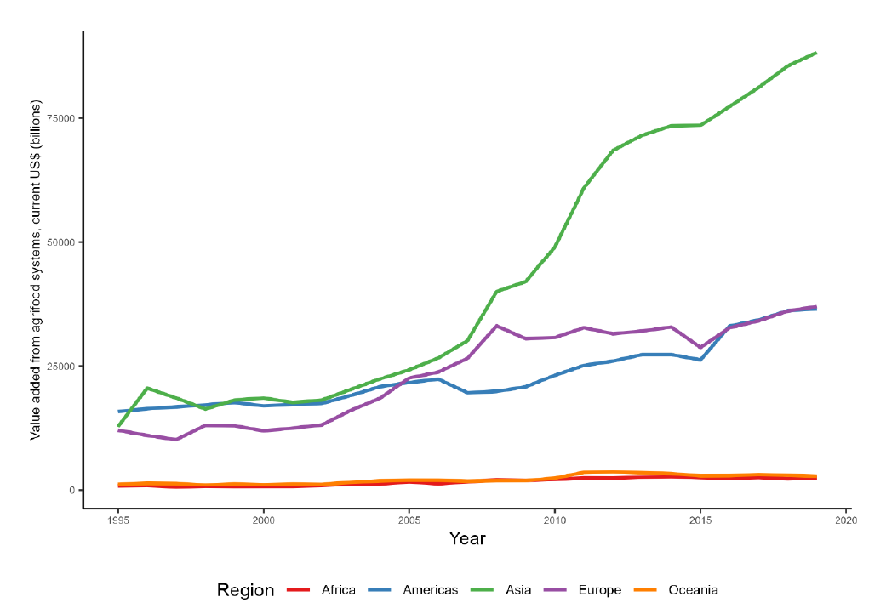
Changes in total agrifood systems value added over time, by region, 1995-2019
Complete cases only (N=101)
Notes:
Much of the growth over the 1995 – 2019 period happened in Asia

Slide 29
Limitations
To maximize country and time coverage, we combined statistics created under different SNA frameworks.
To create a single time series per country, we imposed decision rules that eliminated some existing data.
Data quality depends on country reporting capacity.
Official statistics exclude any value addition in final goods and services in the informal economy.
We could not identify any adequate inter-industry transaction fraction to disaggregate the data for certain categories that are conceptually partially attributable to agrifood systems.
Some countries only report combined main aggregate categories.
Notes:
These limitations suggest our estimates are likely to be a lower bound of the value added from agrifood systems’ output.
(Details if needed:
Country-years with UNIDO manufacturing sector data but no UNSD main aggregate sector data are dropped
Where countries have multiple series due to methodological revisions: we keep the most recent where it is also the longest, where not, we keep the shorter more recent series
No fraction: ISIC Revision 3: recycling (under manufacturing) and other services which contains washing of textiles. )

Slide 30
Conclusions
Wholesale and retail trade contribute more value added than any other parts of agrifood systems (53.4%), with primary production accounting for only 26.1% of total agrifood system value added.
After wholesale and retail trade, the manufacture of food and beverage products is the largest sub-sector contributor to total global value added outside of primary production.
High income countries have much more diversified agrifood systems, but nearly all countries have some output value added from sub-sectors beyond primary production
Notes:
Our finding that primary production accounts for only 26.1% of total value added is consistent with Yi et al’s estimates that >70% of consumer food expenditures accrue to post-farmgate segments of agrifood value chains
shows that the patterns of value addition accrual specific to consumer food expenditure are mirrored in the rest of agrifood systems.
A number of methodological differences between these approaches underscore the importance of these consistent results:
1. we estimate value added from all agrifood system primary production not just that associated with consumer food expenditures. i.e., we work from upstream to downstream, not vice versa and we include non-food products.
Looking at the destination of primary production using the IO data shows only half of primary production (52.6%) goes into food and beverage manufacturing and just 4.6% on top of that goes directly into hotels and restaurants, wholesale, or retail trade. The remainder (42.8% in 2019) generates value added that does not go into value chains that produce consumer food products and services and therefore would not be part of decomposition analysis of consumer food expenditure.
2. our analysis includes a greater number of countries and more low-income countries than in Yi et al. (2021)
3. To incorporate more countries and a longer time series, we use Eora data rather than OECD input-output data. Fourth, we include international trade, while Yi et al (2021) focuses solely on domestic value chains, which necessarily omits all primary production that is exported for processing or consumer purchase in other countries.
We thus consider these new estimates to be more comprehensive than prior published global estimates, yet they remain wholly consistent with the prior insights.
These results are also consistent with Yi et al. (2024) (24), which develops a parallel method working instead from consumer food expenditures upstream to primary production, similarly disaggregating value addition by sector, including international trade, and tapping the longer, more comprehensive Eora time series data.
Overall, we hope this work Shows how a bit of creativity can help to close data gaps critical to driving change in global food systems and monitoring progress.

Slide 31
Thank you!

