Slide 1
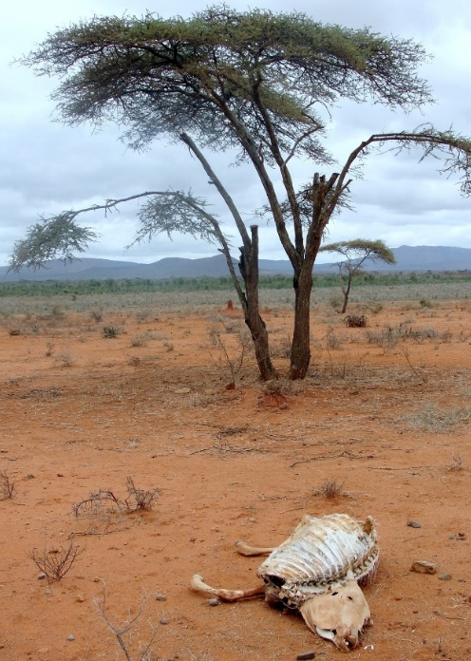
Engaging in Impactful Research:
Some Insights from the Index-Based Livestock Insurance research program
Chris Barrett
June 24, 2024
Laidlaw Fellows Program, Cornell University

Slide 2
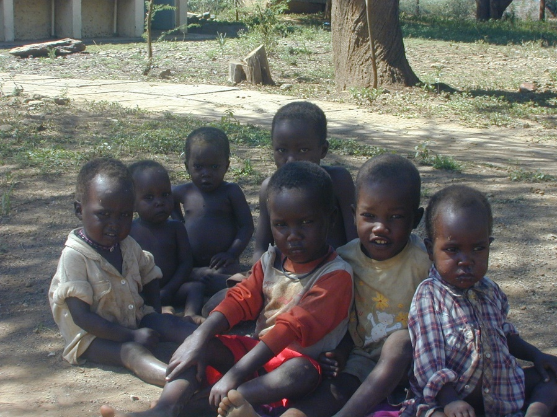
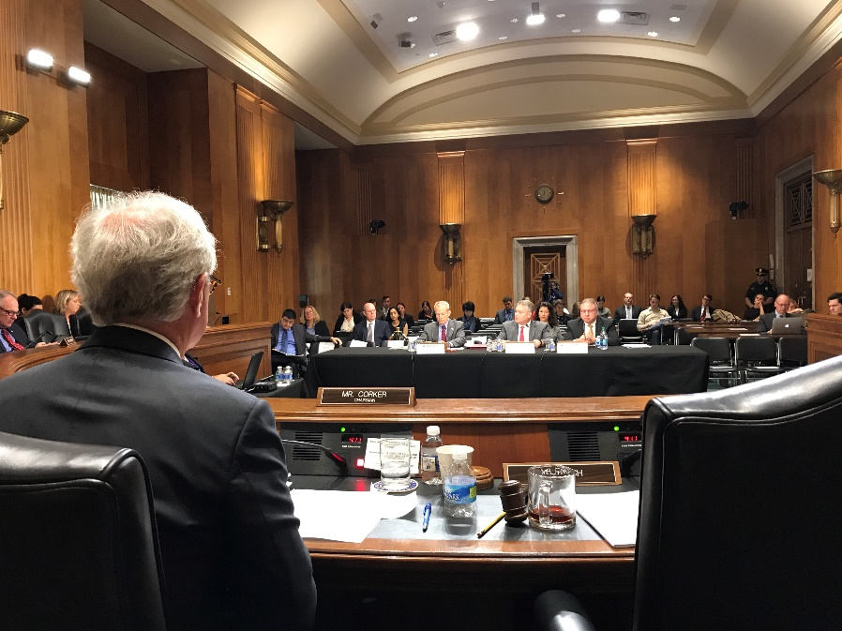
Why do applied economics (or most any) research? - intellectual stimulation (i.e., tackle interesting problems) - impact opportunities (i.e., help solve important problems)
Aim for Impact

Slide 3
Choosing topics
How to get intellectual stimulation and impact?
Identify topics that genuinely interest you and that matter to others’ lives.
Read the relevant literature(s) and talk to experts to identify key topics on the research frontier.
Talk to people affected by the issue(s) – not just researchers, but community members, practitioners, policymakers – to grasp their sense of the issues/ solutions (and dumb ideas!).

Slide 4
Doing the research
Key research inputs: time, technical skills, data
Develop good time management skills … rocks, jar and cup of coffee parable
Make good use of collaborators … gains from trade according to comparative advantage.
Invest in building and maintaining the technical skills necessary to operate at the research frontier in your space. Identify what new tools are needed and develop those (often, adapt from parallel domains of study)
High quality data … collect it if it doesn’t already exist!

Slide 5
Research outputs impacts
Focus on communicating beyond journal articles … blogs, media columns, policy outreach
Focus on clear communication for bright laypeople.
Visit with firms, NGOs, gov’t agencies, etc. and find out what they feel they need to learn (not what you think they need to learn). Respect non-academic experts and end-users.
Key questions are fundamentally normative and therefore heavily value-laden. Real world decision makers listen if and only if it’s clear that you will learn and use their language and respect well-founded opinions that differ from yours. Progress often comes from respectful disagreement.

Slide 6
Research outputs impacts
The Example of Index-Based Livestock Insurance (IBLI)
Intellectual origins: shared concerns about the poorest, most vulnerable peoples on the planet. How best to support/ empower them? More equitable/effective risk sharing.
Research process: talk with communities and w/other experts to understand the context and problems. Then collect and analyze original survey data to diagnose problems and prospective solutions.
Design an intervention to solve problem (uninsured catastrophic drought risk): IBLI. Combinatorial innovation: draw on remote sensing, range science, economics. Rigorously test innovation. Redesign to adapt to issues in pilot. Publicize results. Then scale with partners.

Slide 7
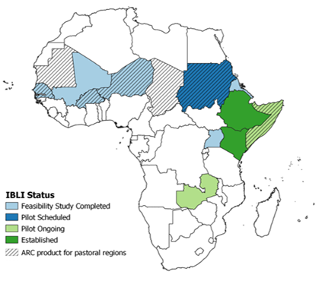
Research outputs impacts
The Example of Index-Based Livestock Insurance (IBLI)
End result: IBLI scaled from parts of 2 countries to broader use in 4 (and growing). ~600K people covered to date, expected >1.5M by end-2025.

Slide 8
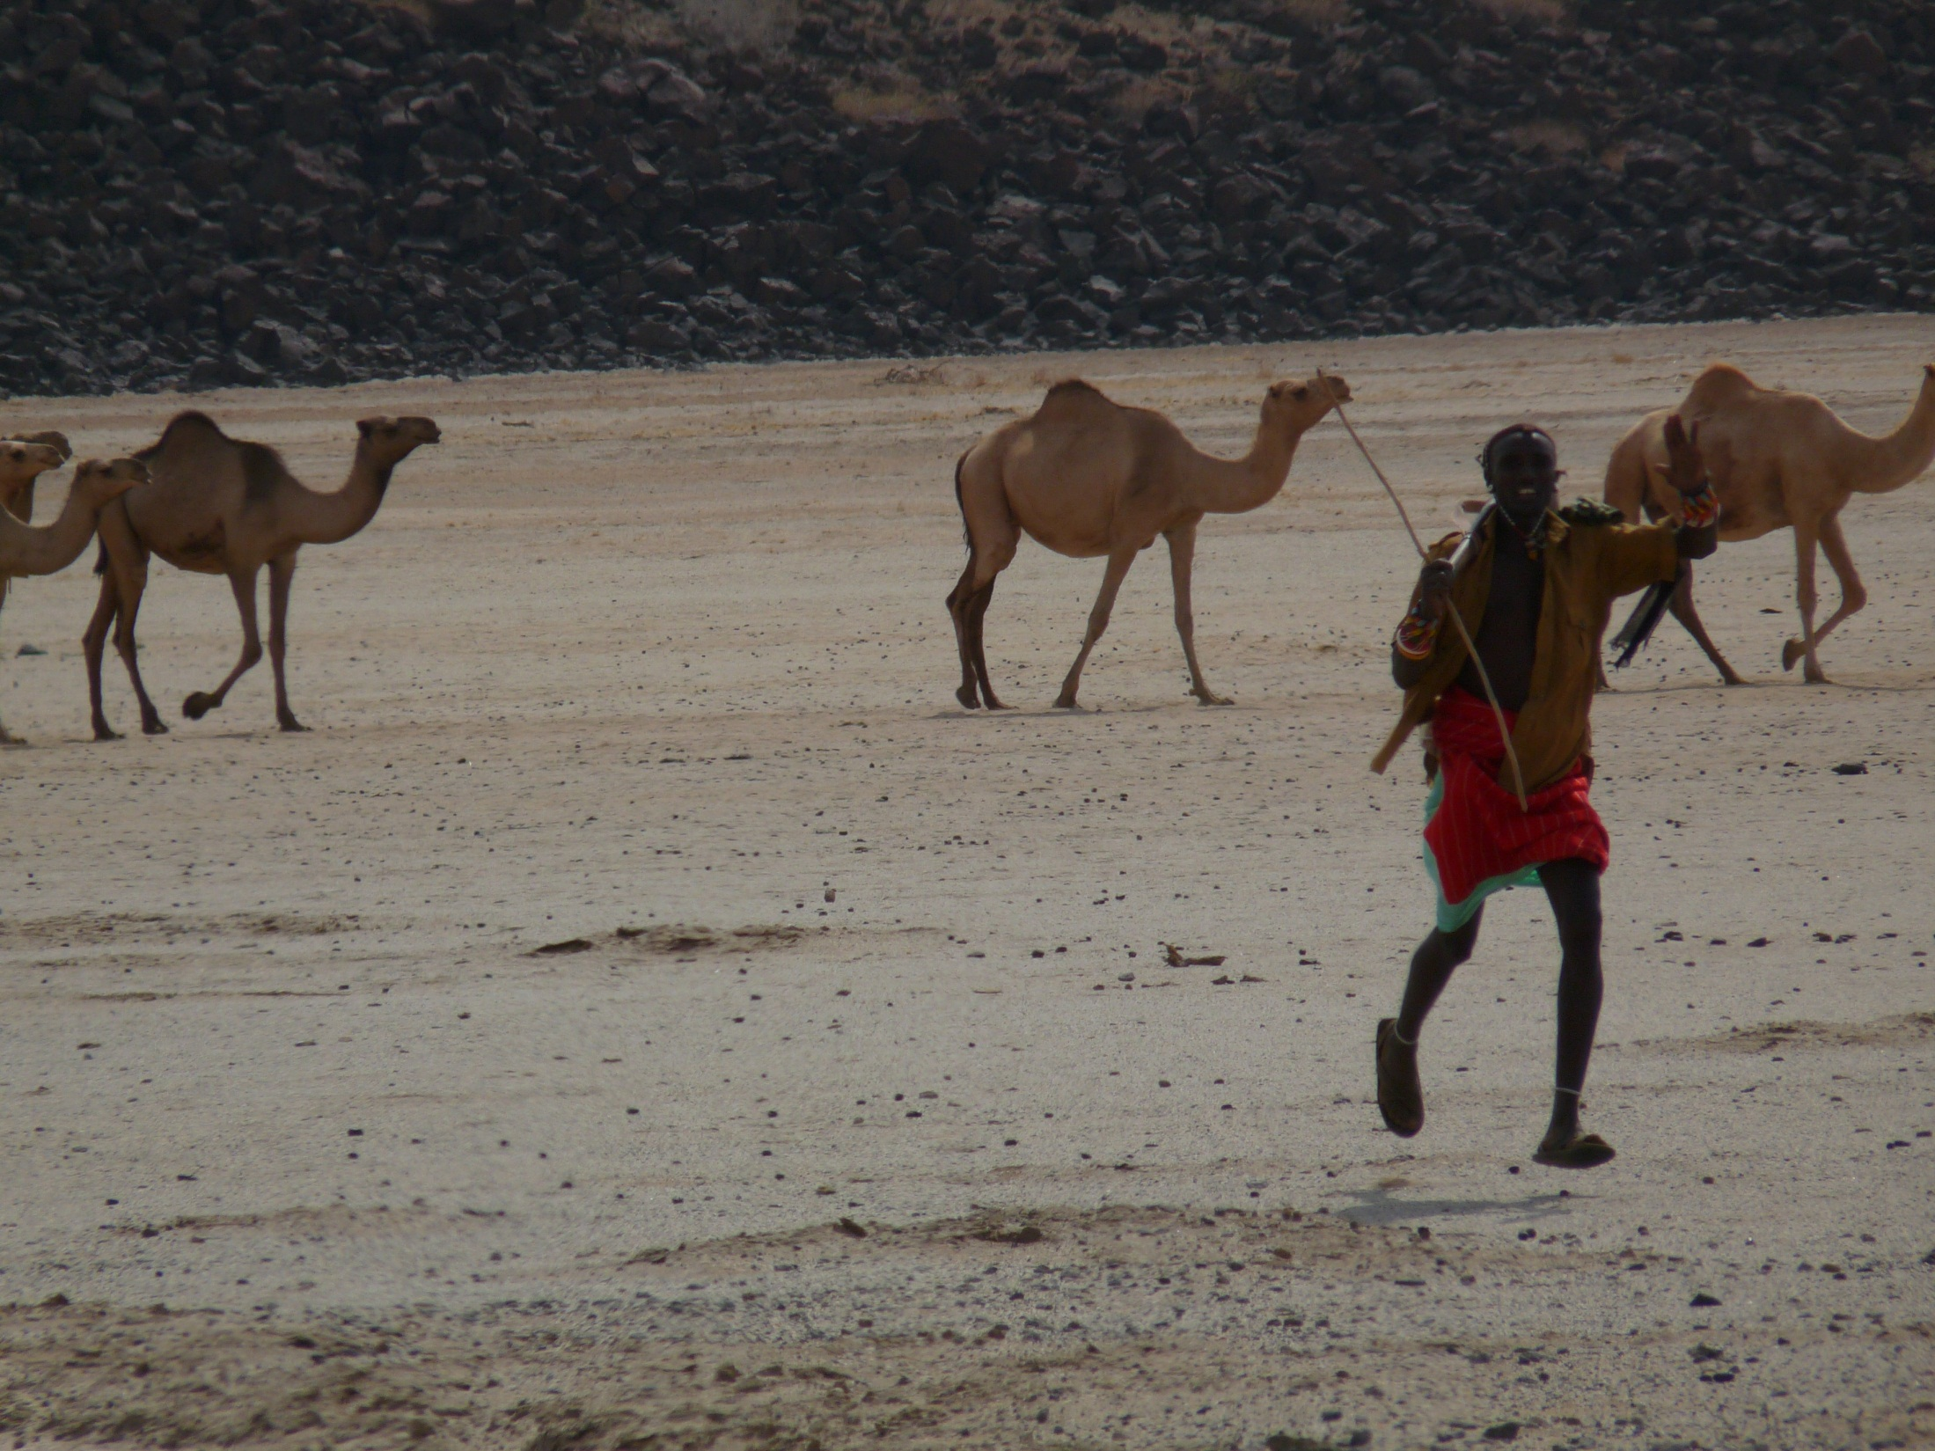
Good luck and Godspeed!

