Slide 1
The Intertemporal Evolution of Agriculture and Labor over a Rapid Structural Transformation: Lessons from Vietnam
Yanyan Liu, Christopher B. Barrett, Trinh Pham, William Violette
Seminar at KU Leuven
June 10, 2019

Slide 2
Objective
Provide a detailed description of the evolution of rural labor markets and agriculture over the course of Vietnam’s rapid structural transformation over the past quarter century.
Tap long-term nationally representative household datasets … an uncommon opportunity to study a rapidly evolving rural economy at generational scale.
  VLSS/VHLSS 1992-2016 (10 rounds, rotating household panels)
  LFS: 2007- 2016 (6 rounds, individual worker data)
Add to the emerging literature on structural transformation in low-income countries using micro-level data.
Descriptive evidence to help to answer several policy-related questions relevant to today’s low-income agrarian nations.

Slide 3
Why Vietnam?
For 3 decades, Vietnam has undergone one of the most rapid structural transformations of any low-income agrarian nation in history. Sustained GDP growth 4–8% pa, rapid poverty reduction, improved HDI indicators.
1992 Vietnam: ~$500/yr 2010 GNIpc and 34% GDP in ag (mainly rice, cassava, tree crops) … a low-income agrarian economy very similar to Liberia today. More agrarian than today’s Malawi, Mozambique. Poorer and more agrarian than Burkina Faso, Ethiopia, Haiti, Nepal, Rwanda, Tanzania, Uganda.
Today’s Vietnam: $2342 GNIpc, 15% ag/GDP … a (lower-)middle income country (like Egypt, India).
Thus perhaps some useful lessons here?

Slide 4
Key Policy Questions
Does structural transformation lead to regional specialization, with rural areas concentrating in farming and losing workers who leave for cities? Mostly yes
Do we see rapid transition into the non-farm sector within rural areas as well as urban? Yes
Does an increasingly productive farming sector absorb young workers? Not much
Do we see convergence in farm and non-farm wages? No In rural and urban wages? Yes
Do real wages rise in both farm and non-farm sectors? Yes, rapidly, driven by human capital
Do minimum wage laws - enacted primarily for urban non-farm workers - bind in ag sector? Less as the sector integrates w/non-farm
Does structural transformation lead to farm consolidation, mechanization, and the displacement of workers? No, Yes, No
Does the inverse farm size-productivity relationship - commonly observed in developing countries - attenuate over time, suggesting more competitive and integrated rural factor markets and less rationale for agricultural policies favoring smaller farms? Yes
Do farms diversify their production profile? No Do farms participate more in markets? Yes
Is structural transformation associated with rapid increases in well-being for households that remain in rural areas? Yes, but human capital replaces land as the key correlate

Slide 5
Data: VLSS/VHLSS 1992-2016
Rotating panel design
Survey instrument: Commune & household
Representative at national, regional, urban, rural, and provincial levels

Slide 6
Data: LFS 2007-2016
Representative at the national, urban, rural, and regional level
6-round repeated cross-sectional data
Household information: demographics
Individual information: education, employment status, occupation, wage, work conditions etc.
Survey round | Total individuals (persons) | Rural individuals (persons) | Estimated share of rural individuals (%) | Estimated labor force participation rate (%)
 |  |  |  | Total | Rural
2007 | 496,842 | 182,656 | 70.46 | 80.78 | 83.95
2009 | 49,431 | 21,729 | 69.24 | 82.42 | 85.03
2011 | 842,092 | 334,663 | 67.21 | 82.84 | 86.20
2012 | 562,168 | 288,426 | 66.71 | 82.98 | 85.98
2014 | 560,642 | 286,797 | 66.89 | 84.18 | 87.25
2016 | 615,986 | 348,445 | 64.72 | 83.52 | 86.96

Slide 7
Share of Households Involved in Agriculture (VHLSS)
Steady decline in ag participation, esp. in most urban regions (Red River Delta, South East) and emergent regional differentiation.
 | 1992 | 2002 | 2010 | 2016
Rural | 0.950 | 0.907 | 0.820 | 0.810
Total | 0.835 | 0.758 | 0.637 | 0.629
By region
Central Highlands | 0.961 | 0.894 | 0.805 | 0.814
Mekong River Delta | 0.844 | 0.787 | 0.675 | 0.666
North and South-Central Coast | 0.955 | 0.872 | 0.798 | 0.826
North East and North West | 0.875 | 0.819 | 0.746 | 0.749
Red River Delta | 0.838 | 0.777 | 0.651 | 0.563
South East | 0.533 | 0.439 | 0.297 | 0.307

Slide 8
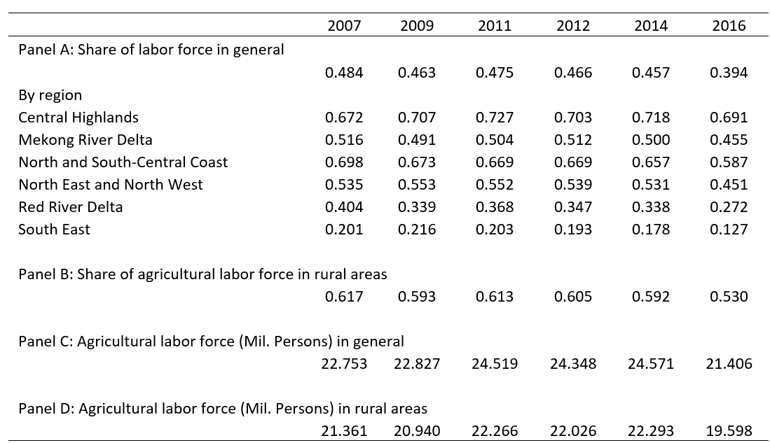
Agriculture Labor Force (LFS)
Share of workforce in ag lower. Only 53% of rural labor in ag by 2016.
Little or no absorption of new workers despite ag productivity growth.

Slide 9
Farming Within Ag Households (VHLSS)
Diversification into non-farm happening within ag households, too. Even among farm hhs, full-time farmers fell from 31 to 16% 2002-16.

Slide 10
Median Share of Agricultural Income and Wage Income in Total Household Income, 2002-2016 (VHLSS)
As in today’s high-income countries, since 2010, wage income has exceeded farm income among rural households

Slide 11
Labor Force Composition by Age, Gender and Education (LFS)
The agricultural workforce is aging faster than the overall workforce. Educational attainment growing very rapidly. Women’s workforce participation is high, and higher in ag than non-farm sectors.

Slide 12
No real difference in rural-urban demographic change
The aging of the agricultural workforce is not merely a reflection of greater aging of rural populations.
Source: Estimated from 5%, 3%, 15% Population and Housing Census 1989, 1999, 2009

Slide 13
Median daily real agricultural wages
Rapid growth in real agricultural wages in rural Vietnam, from $1.15-1.32/day in 1992 to $3.96-4.42/day in 2010 (in 2010 constant US$). ~7% annualized ag wage growth rate > national GDP growth rate.
Women suffer 11-14% wage gap (< global avg).

Slide 14
Have minimum wage rates driven real wages?
Mean/median wages increasingly exceed minimum wages, but also growing share of ag workers < min wage … increased dispersion, especially in most agrarian regions.

Slide 15
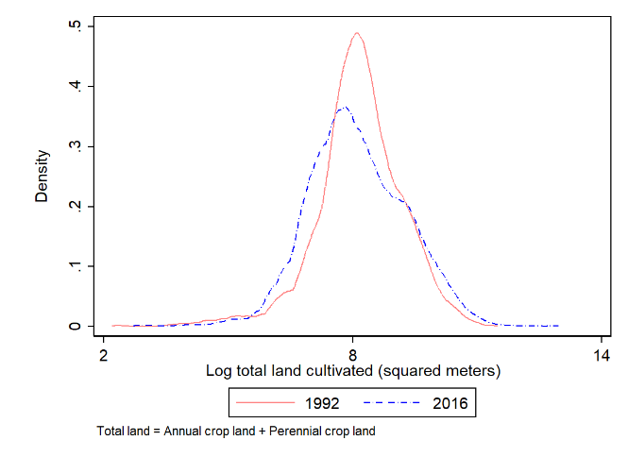
Farm size and land rental market
Vietnam ag remains small farm based. 0.3/0.6 hectare median/mean. No significant farm consolidation despite urbanization and human capital growth. Very little land rental; mainly owner cultivated.
Distribution of total cultivated land per household
Proportion of households which rent in/out land

Slide 16
Machinery adoption versus farm size, 1992-2016
Clear economies of scale, manifest in a pronounced positive relation b/n land-machinery ownership. Rental markets have virtually erased the farm size gradient in machinery use, leading to rapid mechanization in response to rising real wages and non-farm diversification of farm hhs.

Slide 17
Fertilizer and pesticide adoption versus farm size, 1992-2016
Differentiated agrochemical use patterns, with labor-saving pesticide use becoming more uniform, as with mechanization, and labor-demanding fertilizer use more size-biased. Seems a response to rising real wages and non-farm diversification of farm hhs that make labor scarcer/dearer.

Slide 18
Rice yield versus farm size, 1992-2016
Rapid rice yield growth in initial years (1992-2002), but slower growth 2002-2016.

Slide 19
Attenuating farm size-productivity relationship
Inverse farm size-productivity relationship has long signaled multiple rural market failures and supported policies favoring small farmers. IFSPR (rice yield on log planted area) attenuated dramatically in Vietnam since 1992.

Slide 20
Farms Not Diversifying
Rising productivity and market integration has not brought diversification. Small farms have concentrated more in rice. Largest farms diversifying somewhat (into industrial and non-traditional food crops).
Herfindahl–Hirschman Index (HHI) of agricultural output (by value)

Slide 21
But farms increasingly engaging markets
Dramatic rise in farm households’ reliance on markets and decrease in autoconsumption of own farm production.

Slide 22
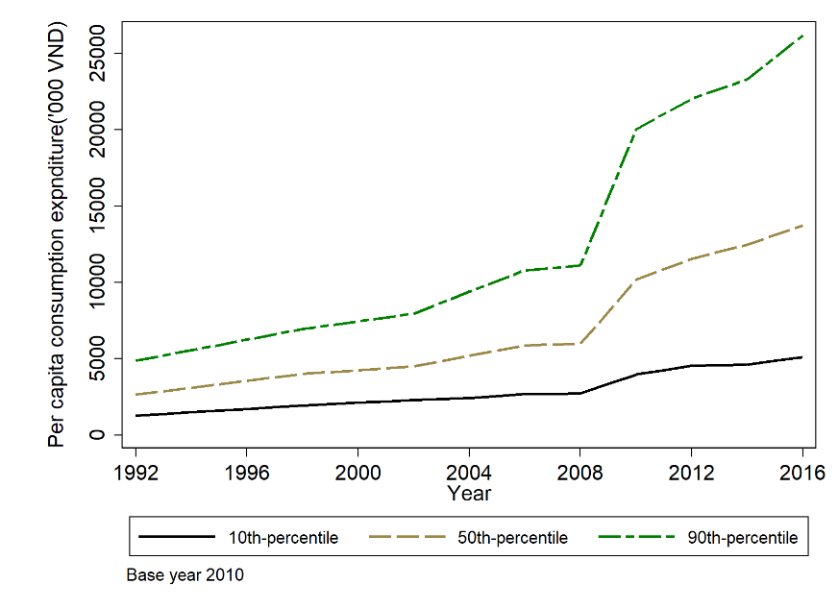
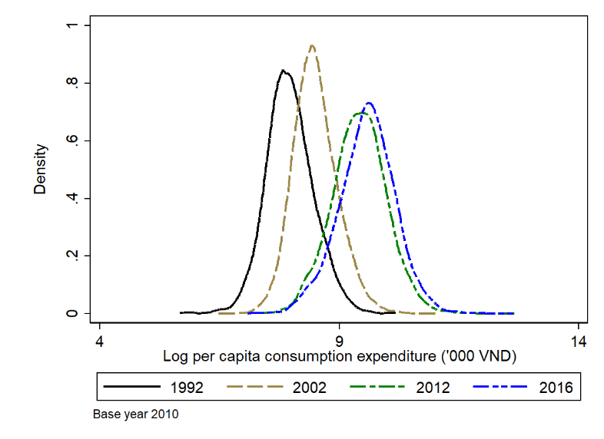
Per capita real consumption expenditure growth
Rural well-being improved steadily, but growing inequality too. Median ( base 2010) exp pc grew from $10.11/m to $52.75/mo, 1992-2016.
10, 50, 90 percentiles of expenditure p.c.
Distribution of log expenditure p.c.

Slide 23
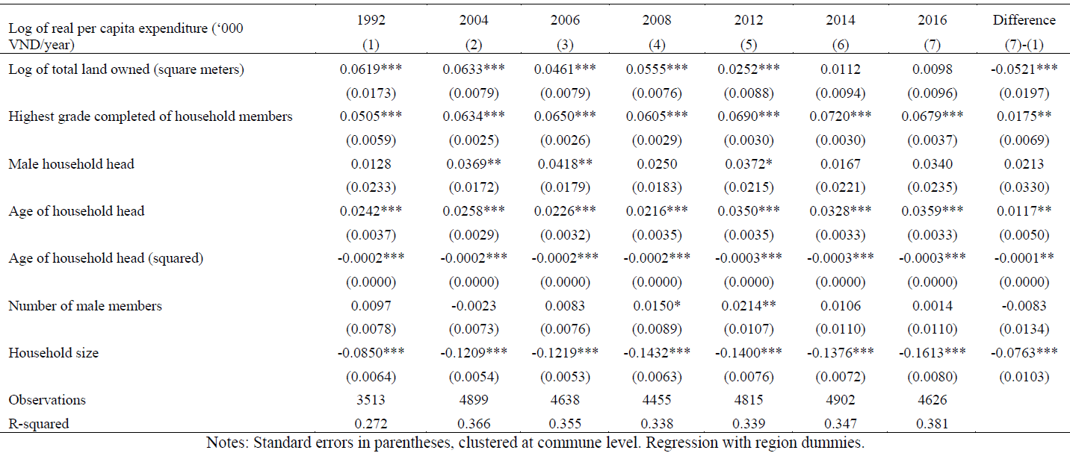
Correlates of Household Per Capita Expenditures
Correlation w/land holdings steadily decline, w/educational attainment and age/experience rising, while hh size penalty grows.

Slide 24
Summary of findings
The agricultural labor force is slowly shrinking and aging more rapidly than is the labor force as a whole. Potential ag employment of youth is limited.
Even farming families are diversifying out of agriculture, increasingly earning more of their total household income from the non-farm sector.
Rural-urban real wage convergence has gone hand-in-hand with increased diversification of the rural economy into the non-farm sector nationwide and rapid advances in educational attainment in all sectors’ and regions’ workforce.
Enhanced inter-sectoral integration also manifests in steady attenuation of the longstanding inverse farm size-yield relationship.
Minimum wage restrictions do not seem to explain growth in real agricultural wages. Indeed, noncompliance w/ min wage laws has increased, especially in the most ag-dependent regions.
Farming remains smallholder household-based. No farm consolidation. But robust mechanization thanks to emergence of vibrant equipment rental markets. Agrochemicals likewise show effects of rural labor changes.
Farms have not been diversifying; still heavily rice-based. But farm households increasingly rely on markets for food, auto-consuming far less of output than a generation ago.
Rural nonfarm expansion assoc w/sharply improved rural well-being. Living standards increasingly driven by human capital, less by landholdings.

Slide 25
Thank you for your interest and comments!

