Slide 1
How a Global Oil Price Rise Might Impact Local Maize Market Prices in Africa January 7, 2013 Brian Dillon, Cornell University Chris Barrett, Cornell University A presentation for the “Oil Prices and African Food Security” workshop Cornell University, Jan 7-8, 2013 Sponsored by the Bill and Melinda Gates Foundation

Slide 2
Motivation: Maize is central to food security in east Africa
Hectares under cultivation, by crop, 2007-2010
 | Ethiopia | Kenya | Tanzania | Uganda
Area ('000 Ha)
Maize | 1,751 | 1,802 | 2,878 | 871
Other cereals | 7,214 | 432 | 1,956 | 920
Fruit | 90 | 188 | 814 | 1,835
Pulses | 1,486 | 1,149 | 1,542 | 1,106
Tubers | 803 | 261 | 1,542 | 1,102
Vegetables | 368 | 140 | 310 | 188
Total | 11,700 | 3,972 | 9,042 | 6,022
Source: FAOSTAT

Slide 3
Motivation: Maize is central to food security in east Africa
From the FAO Food Balance Sheets (2009):
Ethiopia: 418 kcal/day (20% of total)
Kenya: 672 kcal/day (32%)
Tanzania: 519 kcal/day (23%)
Uganda: 190 kcal/day (9%)

Slide 4
Motivation: Numerous possible links between oil prices and maize prices
Transport costs
Biofuels and the US ethanol mandate
Fertilizer costs
We ignore the fertilizer channel, because of low usage rates in the region and difficulty acquiring data

Slide 5
Plan of this talk:
Price co-movement on global markets
Connection to port-of-entry prices in the 4 study countries
Within-country price transmission
Simulations of the impacts of global oil and maize price changes on local maize prices

Slide 6
Global oil prices and global maize prices 1990-2012 (Nominal)

Slide 7
Global oil prices and global maize prices Oct 2006 - Nov 2012 (Nominal)

Slide 8
Price correlations at the global level
 | Jan 1990 - Nov 2012 | Jan 1990 - Sep 2006 | Oct 2006 - Nov 2012
Nominal
Avg oil price ($/bl) | 41.38 | 25.61 | 84.79
Avg maize price ($/mt) | 136.65 | 107.78 | 216.17
Correlation | 0.83 | -0.11 | 0.81
Real
Avg oil price ($/bl) | 47.96 | 39.38 | 71.59
Avg maize price ($/mt) | 183.96 | 184.76 | 181.76
Correlation | 0.45 | 0.58 | 0.74
Source: World Bank GEM commodity database

Slide 9
Testing for cointegration
Is there a long-run relationship between oil and maize prices that can be described as follows
P_{oil} = α + βP_{Maize} + ε
where ε is “white noise”?
1990-2012: No
2006-2012: No
Exclude the constant: No
Include a trend: No

Slide 10
VAR: global prices (1/2)
Oil price equation
 | Jan 1990 - Nov 2012 | Oct 2006 - Nov 2012 | Oct 2006 - Nov 2012
LD.Oil price ($/bl) | 0.332*** | 0.284* | 0.303**
 | 0.064 | 0.136 | 0.117
L2D.Oil price ($/bl) | 0.061 | 0.127 | 0.098
 | 0.062 | 0.121 | 0.104
LD.Maize price ($/mt) | 0.083*** | 0.122* | 0.119*
 | 0.024 | 0.05 | 0.048
L2D.Maize price ($/mt) | 0.006 | 0.009 | 0.012
 | 0.025 | 0.05 | 0.048
Constant | 0.119 | 0.033 | 0.036
 | 0.232 | 0.742 | 0.742
R² | 0.22 | 0.305 | 0.304
N | 271 | 72 | 72

Slide 11
VAR: global prices (2/2)
Maize price equation
 | Jan 1990 - Nov 2012 | Oct 2006 - Nov 2012 | Oct 2006 - Nov 2012
LD.Oil price ($/bl) | -0.232 | -0.104
 | 0.169 | 0.37
L2D.Oil price ($/bl) | 0.121 | 0.158
 | 0.163 | 0.33
LD.Maize price ($/mt) | 0.206** | 0.13 | 0.11
 | 0.064 | 0.135 | 0.117
L2D.Maize price ($/mt) | 0.107 | 0.064 | 0.08
 | 0.065 | 0.136 | 0.117
Constant | 0.564 | 1.927 | 1.943
 | 0.61 | 2.024 | 2.023
R² | 0.055 | 0.024 | 0.021
N | 271 | 72 | 72

Slide 12
Global price co-movement: summary
Global oil and maize prices are highly correlated, especially since passage of the 2005 US Energy Act
But:
No stationary long-run relationship is evident
Causation is not clear

Slide 13
Port-of-entry (POE) prices
Each study country has one major POE market:
Addis Ababa, Ethiopia
Mombasa, Kenya
Dar es Salaam, Tanzania
Kampala, Uganda
Most international trade passes through these markets

Slide 14
Study markets

Slide 15
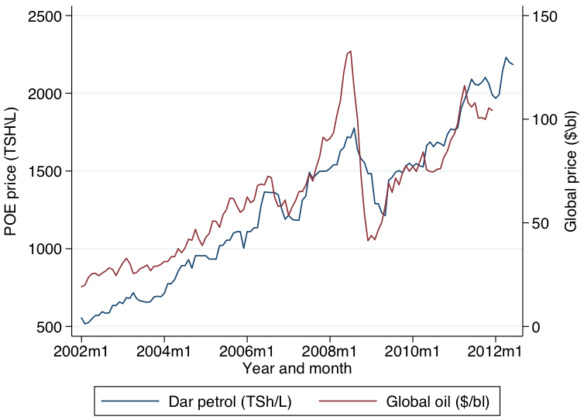
Global oil prices and Dar es Salaam fuel prices

Slide 16
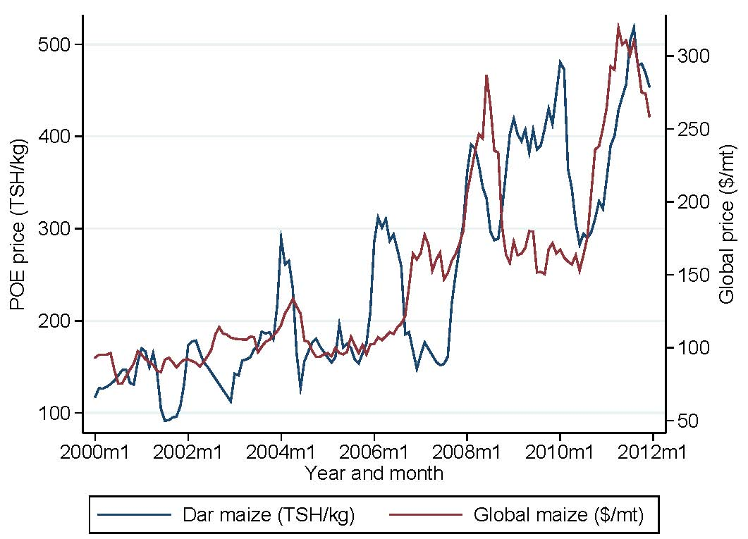
Global maize prices and Dar es Salaam maize prices

Slide 17
Global oil prices and POE fuel prices
We use an error-correction framework:
(1)
(2)
Exchange rates and CPI are from the IMF IFS database

Slide 18
Global oil prices and POE fuel prices
Second-stage ECM results
 | Tazania | Kenya | Uganda
L.ECT | -0.075*** | -0.051*** | -0.057***
LD.POE price (Local/L) | -0.042 | 0.263*** | 0.158**
LD.Global oil ($/bl) | 3.408*** | 0.213*** | 0.905
D.Domestic CPI | 1.549 | 0.181*** | 7.981*
LD.Domestic CPI | -0.921 | -0.055 | 0.115
D.ER Local/USD | 0.409* | 0.096 | -0.163
LD.ER Local/USD | 0.198 | 0.320*** | 0.432***
R² | 0.21 | 0.61 | 0.17
N | 118 | 142 | 142
Mean POE price (Local/L) | 1282.60 | 69.55 | 2175.71

Slide 19
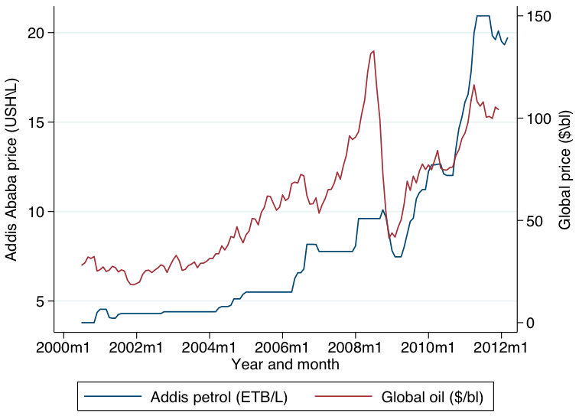
Global oil prices and Addis Ababa fuel prices

Slide 20
Global oil prices and Addis Ababa fuel prices
Ethiopia, second-stage ECM and VAR results
 | ECM | VAR | VAR w/ constant
L.ECT | -0.007
D.Domestic CPI | 0.01 | 0.01 | 0.009
D.ER ETB/USD | -0.097 | -0.103 | -0.117
LD.POE price (ETB/L) | 0.441*** | 0.435*** | 0.431***
LD.Global oil ($/bl) | 0.020*** | 0.020*** | 0.020***
LD.Domestic CPI | -0.001 | 0 | -0.001
LD.ER ETB/USD | 0.475*** | 0.467*** | 0.455***
Constant |  |  | 0.022
R² | 0.44 | 0.44 | 0.39
N | 136 | 136 | 136
Mean POE price (Local/L) | 8.15 | 8.15 | 8.15

Slide 21
Maize net imports, 2000-2010
Country | Mean | Min | Max
Quantity (metric tons)
Ethiopia | 22,236 | -9,659 | 59,599
Kenya | 295,493 | -13,711 | 1,502,523
Tanzania | 18,690 | -88,937 | 272,193
Uganda | -21,366 | -125,857 | 34,371
Net imports as % of domestic production
Ethiopia | 0.6% | -0.3% | 1.5%
Kenya | 11.7% | -0.6% | 61.6%
Tanzania | 0.5% | -3.0% | 8.0%
Uganda | -1.6% | -9.2% | 3.2%
Source: FAOSTAT

Slide 22
Global maize prices and POE maize prices
Second-stage ECM results
 | Ethiopia | Kenya | Tanzania | Uganda
L.ECT | -0.153*** | -0.115*** | -0.085*** | -0.158***
D.Domestic CPI | 0.032*** | 0.157** | 4.030** | 4.389
D.ER Local/USD | -0.014 | -0.084 | 0.023 | 0.095
LD.POE maize (Local/kg) | 0.176** | 0.226*** | 0.334*** | 0.225***
LD.Global maize ($/mt) | -0.004** | 0.016 | -0.276* | 0.12
LD.Domestic CPI | -0.006 | 0.001 | -0.334 | 0.267
LD.ER Local/USD | -0.063 | 0.223** | -0.064 | -0.051
R² | 0.183 | 0.241 | 0.465 | 0.247
N | 142 | 141 | 142 | 142
Mean POE maize price | 979.76 | 17.54 | 2.04 | 244.62

Slide 23
Within-country price transmission
We repeat this procedure for each sub-national market, treating the POE price as exogenous
Oil prices: rapid return to long-run equilibrium:
2-5 months across study markets
Maize prices: similarly rapid
1-3 months in Ethiopia, Kenya, Tanzania
3-6 months in Uganda

Slide 24
Within-country price transmission
Maize price equations directly allow for local fuel price effects:
(5)
(6)

Slide 25
Simulations
To simulate the impact of global oil and maize price changes on local maize prices, we use the co-integrating vectors (long-run relationships)
We consider 3 scenarios:
25% increase in global oil prices above the 2012 average
25% increase in global maize prices above the 2012 average
Both increases simultaneously

Slide 26
Simulation: results
 |  | Avg annual inflation, 2000-2012 | % change in maize price, over 2012 average*
Country | Market |  | Scenario 1 | Scenario 2 | Scenario 3
Ethiopia | Addis Ababa | 11.93 | 0.00 | 37.09 | 37.09
 | Bahir Dar | 11.93 | 0.10 | 36.16 | 36.26
 | Dire Dawa | 11.93 | 0.79 | 34.26 | 35.05
 | M'ekele | 11.93 | -1.29 | 35.39 | 34.10
Kenya | Kisumu | 10.34 | 3.09 | 20.29 | 23.38
 | Mombasa | 10.34 | 0.00 | 21.44 | 21.44
 | Nairobi | 10.34 | 1.70 | 19.45 | 21.15
 | Nakuru | 10.34 | 0.22 | 23.50 | 23.72
Tanzania | Arusha | 6.70 | 1.06 | 25.35 | 26.41
 | Dar es Salaam | 6.70 | 0.00 | 26.43 | 26.43
 | Dodoma | 6.70 | 0.68 | 26.02 | 26.70
 | Kigoma | 6.70 | 9.04 | 16.34 | 25.38
 | Mbeya | 6.70 | 5.54 | 19.75 | 25.29
Uganda | Gulu | 8.02 | 6.27 | 21.08 | 27.35
 | Kampala | 8.02 | 0.00 | 30.38 | 30.38
 | Mbale | 8.02 | -0.98 | 31.71 | 30.73
 | Mbarara | 8.02 | 13.57 | 21.21 | 34.78

Slide 27
Conclusions
At this stage our findings indicate:
Oil and maize prices co-move on global markets, but with no clear causation
Within-country, POE price changes are rapidly transmitted to other markets
Global price changes are slower to impact POE prices, likely because of policy-induced frictions
Higher oil prices would put some upward pressure on maize prices, but the effects are small compared to those due to maize prices themselves

