Slide 1
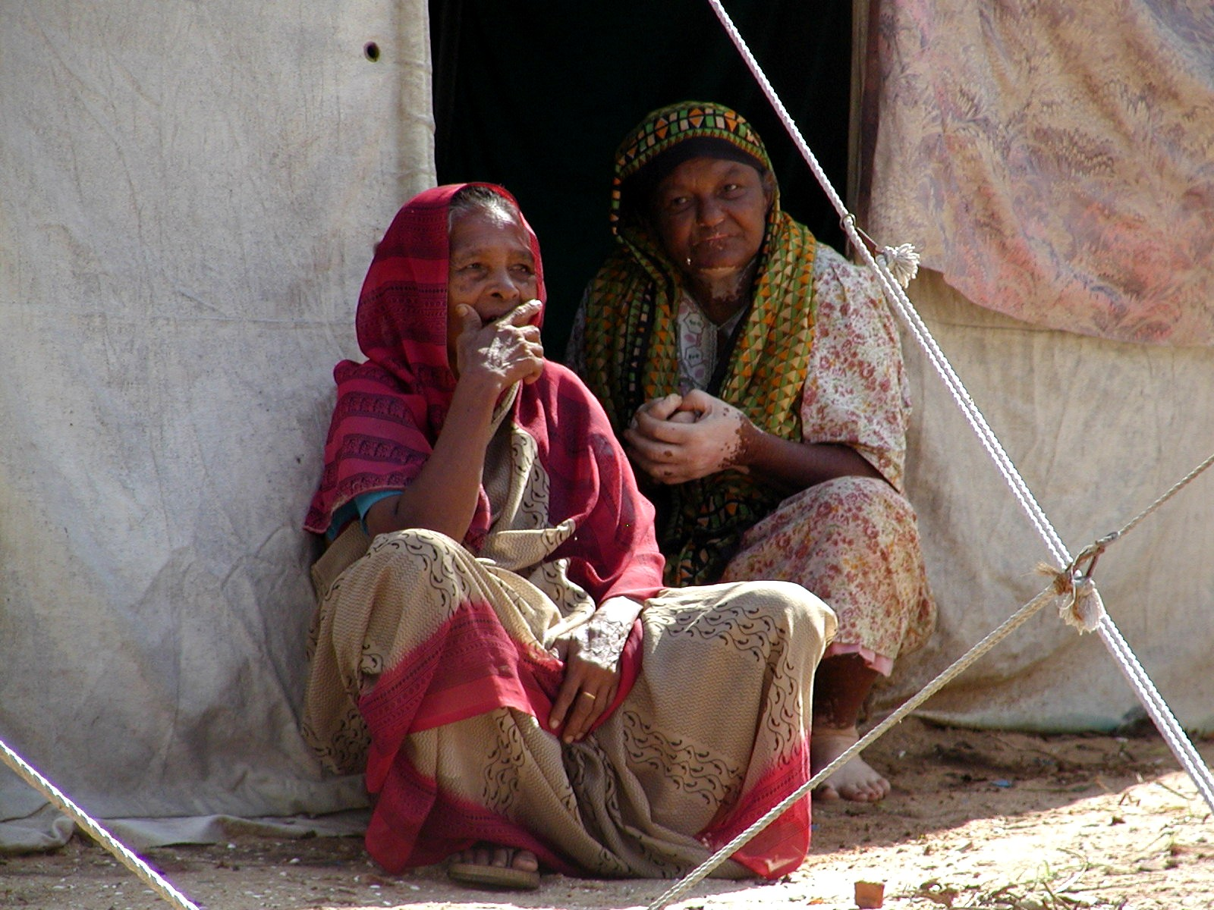
Food Aid and Food Assistance: What Have We Learned Here? What Key Things Do We Still Need to Learn?
Christopher B. Barrett
Cornell University
4th Transatlantic Dialogue on Humanitarian Action
Potsdam, Germany
July 9, 2010

Slide 2
What Have We Learned Here?
With more people food insecure and policy reforms by many donors and implementing partners, there are both demand and supply side pressures for increased flexibility in programming options. This is now nearly universal across donors, recipients and implementing partners.
Significant and growing evidence exists on many issues – local and regional procurement, nutritional needs and feasibility of food aid fortification, needs assessment, etc. Growing demand for rigorous evidence.
Not much truly new being said … but FAR more common language and ambitions than, say , a decade ago.

Slide 3
Key things to learn 1
Proliferation of multi-party actors and fora:
FAC, CFS, OECD/DAC, HLTF, CERF, Food Security Cluster, Sphere, World Bank, WTO, Codex, etc. …
- What is the mapping of definitions, objectives and responsibilities among these bodies? Reconciliation?
- Form follows function: what do we want out of multilateral mechanisms? How to simplify/harmonize?
- How to promote cost-effective inclusiveness in these dialogues, given budget pressures and capacity constraints faced by all parties?
- What are practical solutions? What can be achieved in FAC renegotiation and what is beyond the scope of FAC? Beware letting the perfect be the enemy of the good!

Slide 4
Key things to learn 2
Increased programming flexibility demands:
i) More and better evidence on performance variation across modalities (cash vs. food, LRP vs. transoceanic). What works, why and under what circumstances?
This likely means fewer evaluations but higher quality per evaluation … reduce the noise/signal ratio. Meta-studies?
ii) New decision support tools for food assistance programming choices made with very limited time, funding, data or technical skills.
iii) How to crowd-in parallel improvements in private food systems on which the poor and vulnerable most depend?
iv) Pooling data, evaluation and tools: global public goods.

Slide 5
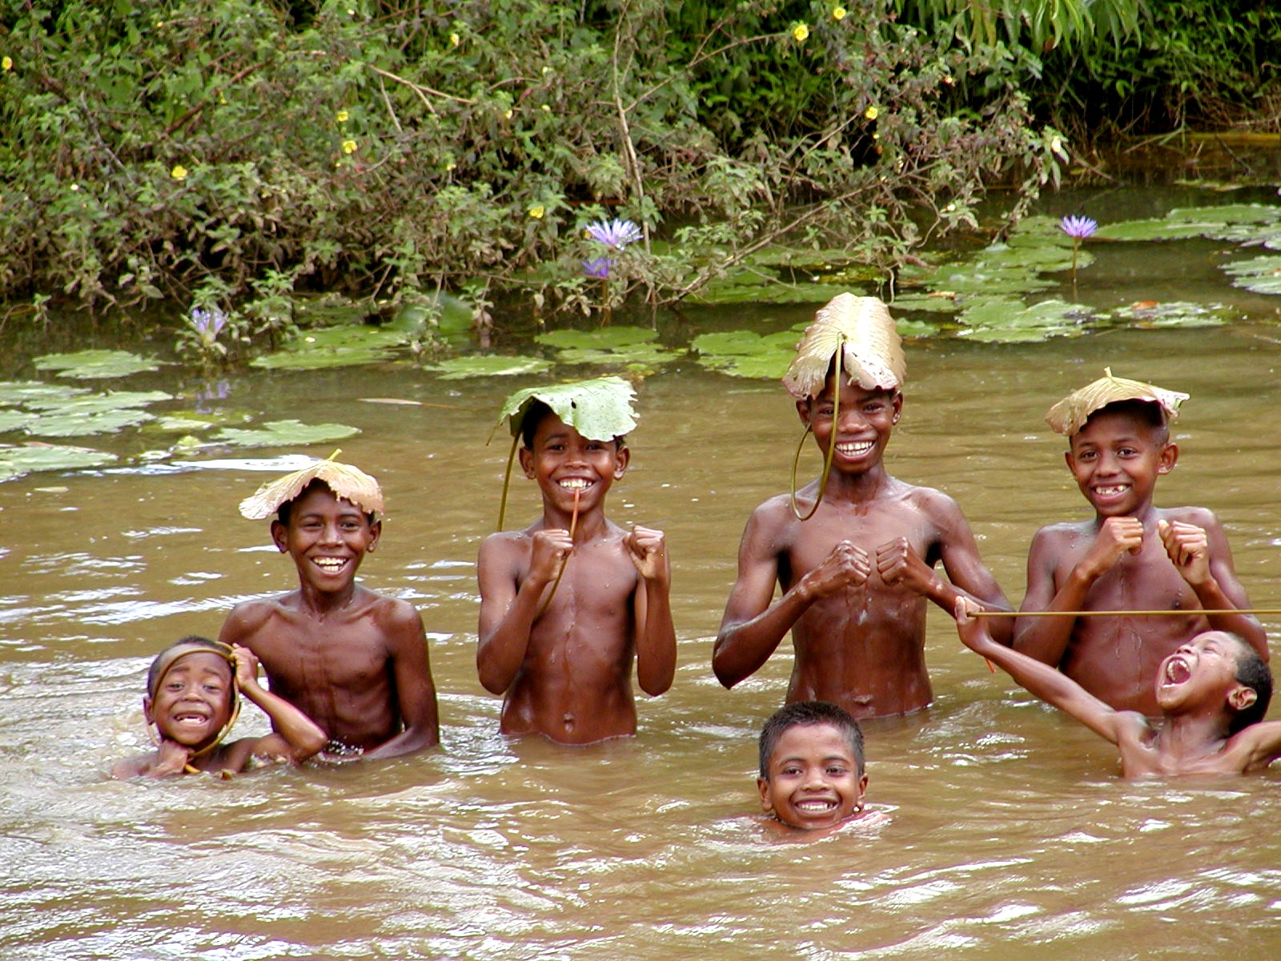
Thanks for a great dialogue!

