Slide 1
In Honor of Per Pinstrup-Andersen: The Micronutrient Deficiencies Challenge in African Food Systems
Christopher B. Barrett and Leah E.M. Bevis
Charles H. Dyson School of Applied Economics and Management
Cornell University

Slide 2
Two of Per’s (many) major contributions …
A holistic focus on food systems and systems-based approaches to policy analysis and design
Calling high-level policy and research attention to the ‘triple burden’ of malnutrition, including often-overlooked micronutrient deficiencies

Slide 3
Persistent, severe micronutrient deficiency
25% of the global population suffers from anemia
1/3 of school age children suffer from iodine deficiency
21% of children under 5 suffer from vit A deficiency
1/3 of the global population suffers from zinc deficiency
MN deficiencies deeply problematic b/c of irreversible cognitive/physical effects … nutritional poverty traps

Slide 4
A foods systems approach
Why do MN deficiencies decline so slowly with increasing income?
Answer requires a food systems approach: interlinkages between producers, consumers and market intermediaries
Consumers: information problems, nutritional transition, urbanization, prices
Food market chains: perishability, food processing, fortification
Production: cropping choices, agricultural practices, MN deficiencies in soil, biofortification

Slide 5
Consumer demand patterns
Information: mild MN deficiencies rarely manifest in obvious sensory ways
Does education / increased information about micronutrients decrease MN deficiency?
Rising GNI is associated with a “nutritional transition”
↓ consumption of traditional staples, ↑ consumption of refined grains
↑ consumption of animal-sourced food – ↑ intake & bioavailability of zinc and iron
Urbanization
Increased opportunity cost of women’s time leads to > intake of fast food, street food
Much of this food relies on refined wheat or rice, fats, oils, salt, sugars

Slide 6
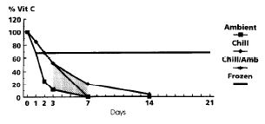
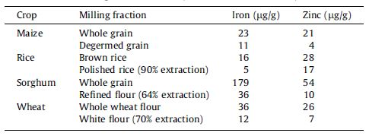
The Food Value Chain (FVC)
Perishability: foods loose vitamins over time, especially at ambient temperatures. Vitamin C & B vitamins are especially unstable.
Increased processing of grain often removes bran and germ - including much of the Fe, Zn, Ca, vitamins, phytate, and protein
Spinach (Favell 1998 Food Chemistry)
Food fortification (e.g. milk, sugar, oils, salt) can increase levels of MNs, but success depends on large processing plants, government oversight, and consumer WTP
Miller & Welch 2012 Food Policy, Welch & Graham 1999 Field Crops Research

Slide 7
Producer decisions
Micronutrient-deficient soils lead to MN-deficient crops and humans
Selenium deficient soils in Malawi cause low selenium intake; can be remedied with selenium-enriched fertilizers (Chilimba 2012 Field Crops Research)
Green Revolution technologies increases cereal mono-cropping while decreasing production of iron- and zinc-rich legumes
South Asia experienced 200% (400%) increase in rice (wheat) production, a decline in diet iron density and a marked increase in anemic women in the 30 years following the Green Revolution (United Nations ACC SCN 1992)
Increased fertilizer use affects micronutrient levels in plants
Excessive application of NPK fertilizer decreases vitamin C in horticulture, decreases uptake of zinc and iron in grains (Gao et al. 2011 Field Crops Research, Panda et al. 2012 Comm Soil Sci Plant Anal, Harris & Karmas 1975)

Slide 8
Producer decisions
Biofortification targets poor, agrarian populations. Success depends on adoption, marketability, & longevity of MN density. (
HarvestPlus Crop Strategies Brochure 2013

Slide 9
Looking forward
The stubborn persistent of micronutrient deficiencies clearly arises at multiple levels of food systems.
Forward-looking policy research and action must:
identify where MN deficiencies are severe and widespread
determine the root sources of those deficiencies for distinct groups
evaluate the cost-effectiveness of options comparatively, across the food system
develop useful rules of thumb for targeting interventions to those groups

Slide 10
Thank you, Per (and all)

