Slide 1
Food Security and Sociopolitical Instability in Sub-Saharan Africa
Christopher B. Barrett and Joanna B. Upton
Food Security and its Implications for Global Stability
Authors’ Workshop
Ithaca, NY
June 19, 2012

Slide 2
Motivation
Sub-Saharan Africa bears an unfortunate triple distinction among world regions: highest incidence of (i) undernourishment, (ii) ultra-poverty and (iii) conflict-related deaths. Mutually reinforcing phenomena.
Uniquely, food availability limiting for 2/3 SSA nations. Increasing productivity crucial to SSA food security.
Access ultimately key. SSA ultra-poverty (<$0.62 pc/day) stuck at ~20% … now 65% of world’s ultra-poor (up from 12% in 1981).

Slide 3
Motivation
Evolving conditions
1980-2000: sluggish, uneven progress.
2000-present: the “awakening lions”
Looking forward:
continued rapid pop. growth and urbanization place added demands on food mktg systems
growing demand for land and water: potential for resource competition, esp. around “land grabs”
rising global prices + demand growth raises prospects of renewed urban unrest if gov’ts do not manage social safety nets effectively.

Slide 4
Supply-side factors
Agro-ecological Factors
Land and water abundant. But variable quality, often weak tenure security and diverse distribution and accessibility.
Very low uptake of modern ag tech.
Most African farmers are net food buyers

Slide 5
Supply-side factors
Agricultural productivity growth more in land (than labor) productivity, albeit less imbalanced than 1980-2000.

Slide 6
Demand-side factors
Population very rural (64%)
but growing/urbanizing
fast. Demographic trend
expected to continue.
In 8 of last 10 years, econ. growth in SSA > east Asia ! But very uneven growth among countries. Slowest in countries in protracted conflict.
Sharp increase in global food market prices in 2008 and 2011 have nonetheless driven increased food insecurity in SSA..

Slide 7
Bridging supply & demand
Markets
Accessibility: limited and poor quality road/rail infrastructure. High cost and delay.
Int’l Trade: net food deficit region. Yet unusually dependent on dom. production: >90% (vs. ~85-87% globally). Landlocked countries near 95%.
Slow growth in domestic and regional food productivity combined with rapid growth in urban populations puts increasing stress on SSA’s food marketing systems.

Slide 8
Globalization and new pressures
Increased investment from new sources
BRIIC now comprise 20% of SSA trade (<1% in early 90s)
Chinese FDI presence esp. pronounced in rural areas
Vulnerability to world price shocks
Oil – SSA net oil exporting region. But SSA ag is very vulnerable (esp. given distances/infrastructure)
Food prices (increasing populations exposed)
Land investments (‘land grabs’)
SSA is principal target: 2009 deals of 39.7 mn ha (> ag land in Belgium, Denmark, France, Germany, the Netherlands, and Switzerland combined!)
2008 Daewoo deal to lease 1.3 mn hectares led to gov’t overthrow in Madagascar. More to come?

Slide 9
Globalization and new pressures
Sociopolitical unrest /difficult political transitions
At least 14 countries suffered food riots in 2008.
Riots disproportionately in urban areas of coastal countries more heavily reliant on imported foods, with lower per capita domestic food productivity.
Gov’ts try to respond with trade and price policy measures to buffer impacts of price shocks. But gov’t capacity is quite uneven.
Pressures also around competition for natural resources, esp. land/water (Zim, Mali, Sudan, etc.).
- Quite different pressures in rural and urban areas.

Slide 10
Looking Forward: Major Drivers
Africa will remain heavily dependent on smallholder farming and pop. @ risk of hunger grows by 2020-5.
Demand Pressures => need for enhanced supply
Pop/income growth of 2.5/5% pa => 50% increase in food demand by 2025.
Even faster growth in mkt demand due to rapid urbanization (esp. in west/central SSA). Will put pressure on infrastructure and tensions over corporate control.

Slide 11
Looking Forward: Major Drivers
Opportunities to meet the challenge:
Land investments under equitable/transparent terms?
Technological advance: but little private or public R&D
GMOs – only SA and BF use them now
Irrigation
Soil fertility (organic fertilizers; integrated crop-livestock)
Other trends worthy of attention…
Growing labor force (median age just 20 vs. 20 in Asia, 40 in Europe/NA)…but under potential strain of urbanization
Climate change and increased climate variability – esp. vulnerable to droughts and floods given poor water mgmt, spatial heterogeneity and weak mktg systems.

Slide 12
Looking Forward: Key Indicators
Real Food and Fuel Prices
Prospective pressure on urban pop., esp. coastal nations
Urban Population Growth
Population density ; vulnerability to price volatility
Poverty
Change and spatial concentration
Land, Labor and Total Factor Productivity
Which crops ; distribution of benefits
GMO Diffusion
TFP improvements ; politicization and (proxy) conflict

Slide 13
Looking Forward: Key Indicators
(6) Water Resources
Change in availability. Flow, rainfall, irrigation patterns
(7) Land Degradation
Soil nutrient loss (=> desertification) ; land restoration
(8) Natural Disasters
Frequency/intensity ; poor institutional response capacity
(9) Pests and Disease
Pre-harvest / production risks ; post-harvest / health risks
(10) Land Investments (‘grabs’)
Equitable? Productivity/employment enhancing? Transparent?

Slide 14
Summary
Sub-Saharan Africa will likely remain the region most vulnerable to food insecurity and conflict.
The big challenges turn on meeting the demands of rapid demographic change and economic growth.
Low productivity combined with relative abundance of land/water and low rates of use of modern agr. technologies invite external interventions (land deals, GMOs, FDI) which need to managed effectively.
Both challenges and opportunities abound.

Slide 15
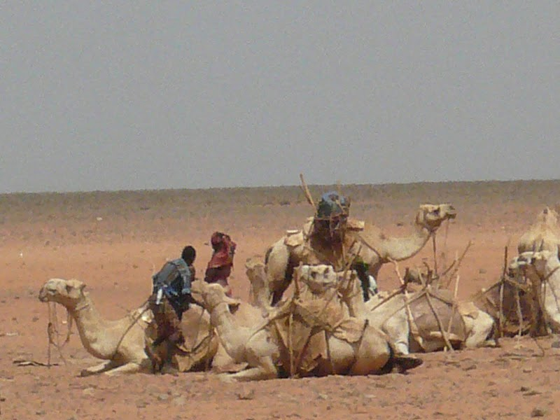
Thank you for your time, interest and comments!

