Slide 1
Financial Innovation
For Famine Prevention
Christopher B. Barrett
C.H. Dyson School of Applied Economics & Management and Dept. of Economics
Trustee Council Annual Meetings
October 27, 2012

Slide 2
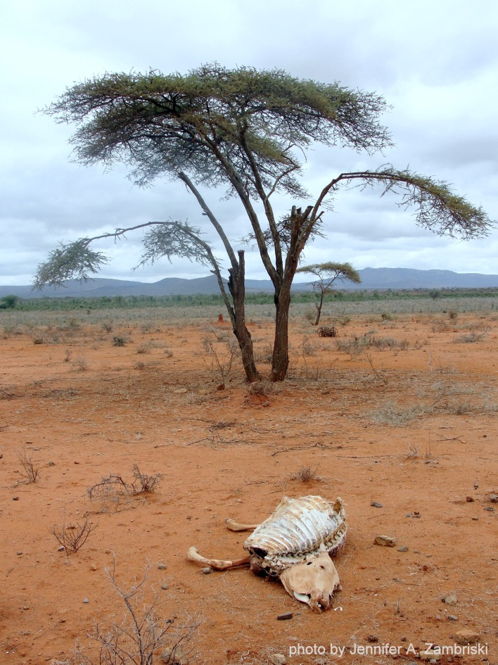
Droughts and Humanitarian Emergencies in East Africa
Catastrophic herd loss risk due to major droughts appear the primary cause of pastoralists falling into poverty traps. If other factors conspire, famine can result (e.g., Somalia 2011). Potentially aggravated by
increasing drought frequency in this region.

Slide 3
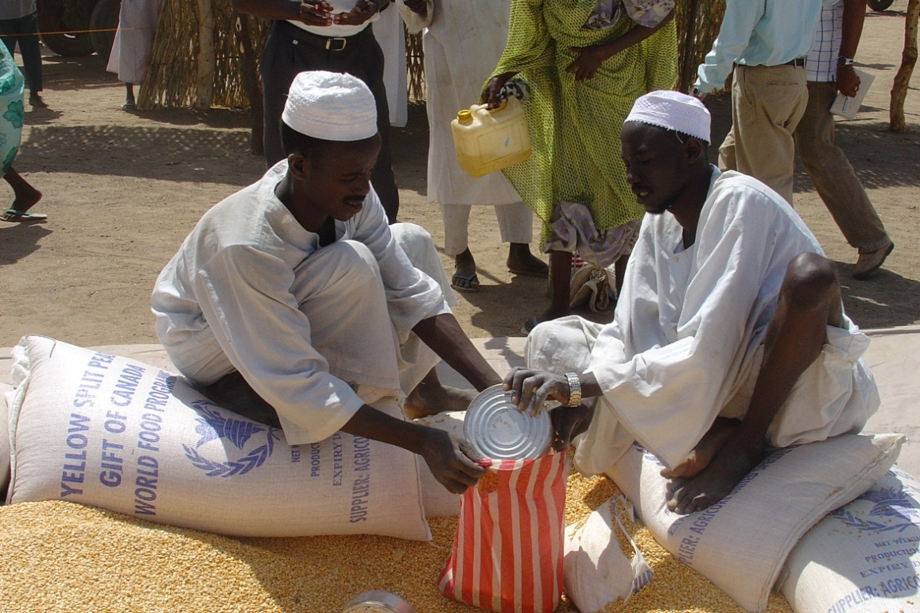
Standard Responses to Drought
Standard responses to major drought shocks:
Post-drought
herd restocking
2) Food aid
Key Problems:
Slow
Targeting challenges
Expensive (in part, because it’s slow and hard to target well)
Food aid can reinforce sedentarization/foster dependency
Core issue: Facilitate recovery from shocks … finance can help!

Slide 4
Alternative Responses: Insurance?
Commercially sustainable insurance can:
Prevent downward slide of vulnerable populations
Crowd-in investment and accumulation by the poor
Induce financial deepening by crowding-in credit
Let us focus humanitarian resources on the needy
But can insurance be sustainably offered in these areas?
Conventional (individual) insurance unlikely to work (and hasn’t worked), especially in small-scale agro-pastoral sector:
Very high transactions costs, esp. w/little financial intermediation among pastoralists
Moral hazard/adverse selection
Small market for covering fixed costs of product

Slide 5
The Potential of Index Insurance
Index insurance is a promising variation on traditional insurance:
Do not insure individual losses.
Instead insure some “index” measure that is strongly correlated with individual losses. (Examples: rainfall, remotely sensed vegetation index, area average yield, area average herd mortality loss). Index needs to be:
objectively verifiable
available at low cost in real time
not manipulable by either party to the contract

Slide 6
The Potential of Index Insurance
Index insurance can obviate the problems that make individual insurance unprofitable for small, remote clients:
- No transactions costs of measuring individual losses
- Preserves effort incentives (no moral hazard)
- Adverse selection does not matter as payouts do not depend on the riskiness of those who buy the insurance
Index insurance can, in principle, provide a timely, financially sustainable safety net against catastrophic drought shocks:
- individual (retail) products
- agency/group (wholesale) products
Could also accelerate herd recovery, alter herd dynamics, crowd in investment and avert system collapse if drought frequency grows!

Slide 7
Example: Pre-finance disaster response
Current stage of emergency response
Goal: Use index insurance to pre-finance effective response to severe droughts
3 - 6 months
Time
Seasonal rains fail /EWS alert
Assess
Appeal
Aid arrival
Time
Appeal for insurance premiums
Seasonal rains fail /EWS alert (triggers payout)
Aid arrival
(insurance payout)

Slide 8
The Major Challenges of Index Insurance
For both wholesale and retail index insurance:
High quality data (reliable, timely, non-manipulable, long-term) to design/price product and to determine payouts
Innovation incentives for insurers/reinsurers to design and market a new product and global market to support it

Slide 9
The Major Challenges of Index Insurance
And for retail (but not necessarily wholesale) products:
Minimize uncovered basis risk through product design. Is it insurance or a lottery ticket? Much turns on basis risk!
Establish informed effective demand, especially among a clientele with little experience with any insurance, much less a complex index-based insurance product
Low cost delivery mechanism for making insurance available for numerous small and medium scale producers

Slide 10
Example: Index-based Livestock Insurance
New commercial IBLI product launched commercially as a pilot in January 2010 in northern Kenya. (http://blip.tv/file/3757148)
Based on technical design developed at Cornell, refined and led in the field by the International Livestock Research Institute (ILRI) in collaboration with university and private sector partners.
Worked as planned in 2011. Now scaling out to southern Ethiopia and broader areas of northern Kenya.

Slide 11
Conclusions
Standard drought responses have had limited effectiveness.
Traditional insurance not viable in pastoral areas.
Index insurance, in principle, could be very effective.
But major challenges exist to developing/scaling index insurance to address this problem. We are experimenting, so far successfullly, with innovative financial products to help avert famine.
That’s why this is so exciting … it is both a serious research project as well as a commercial project.

Slide 12
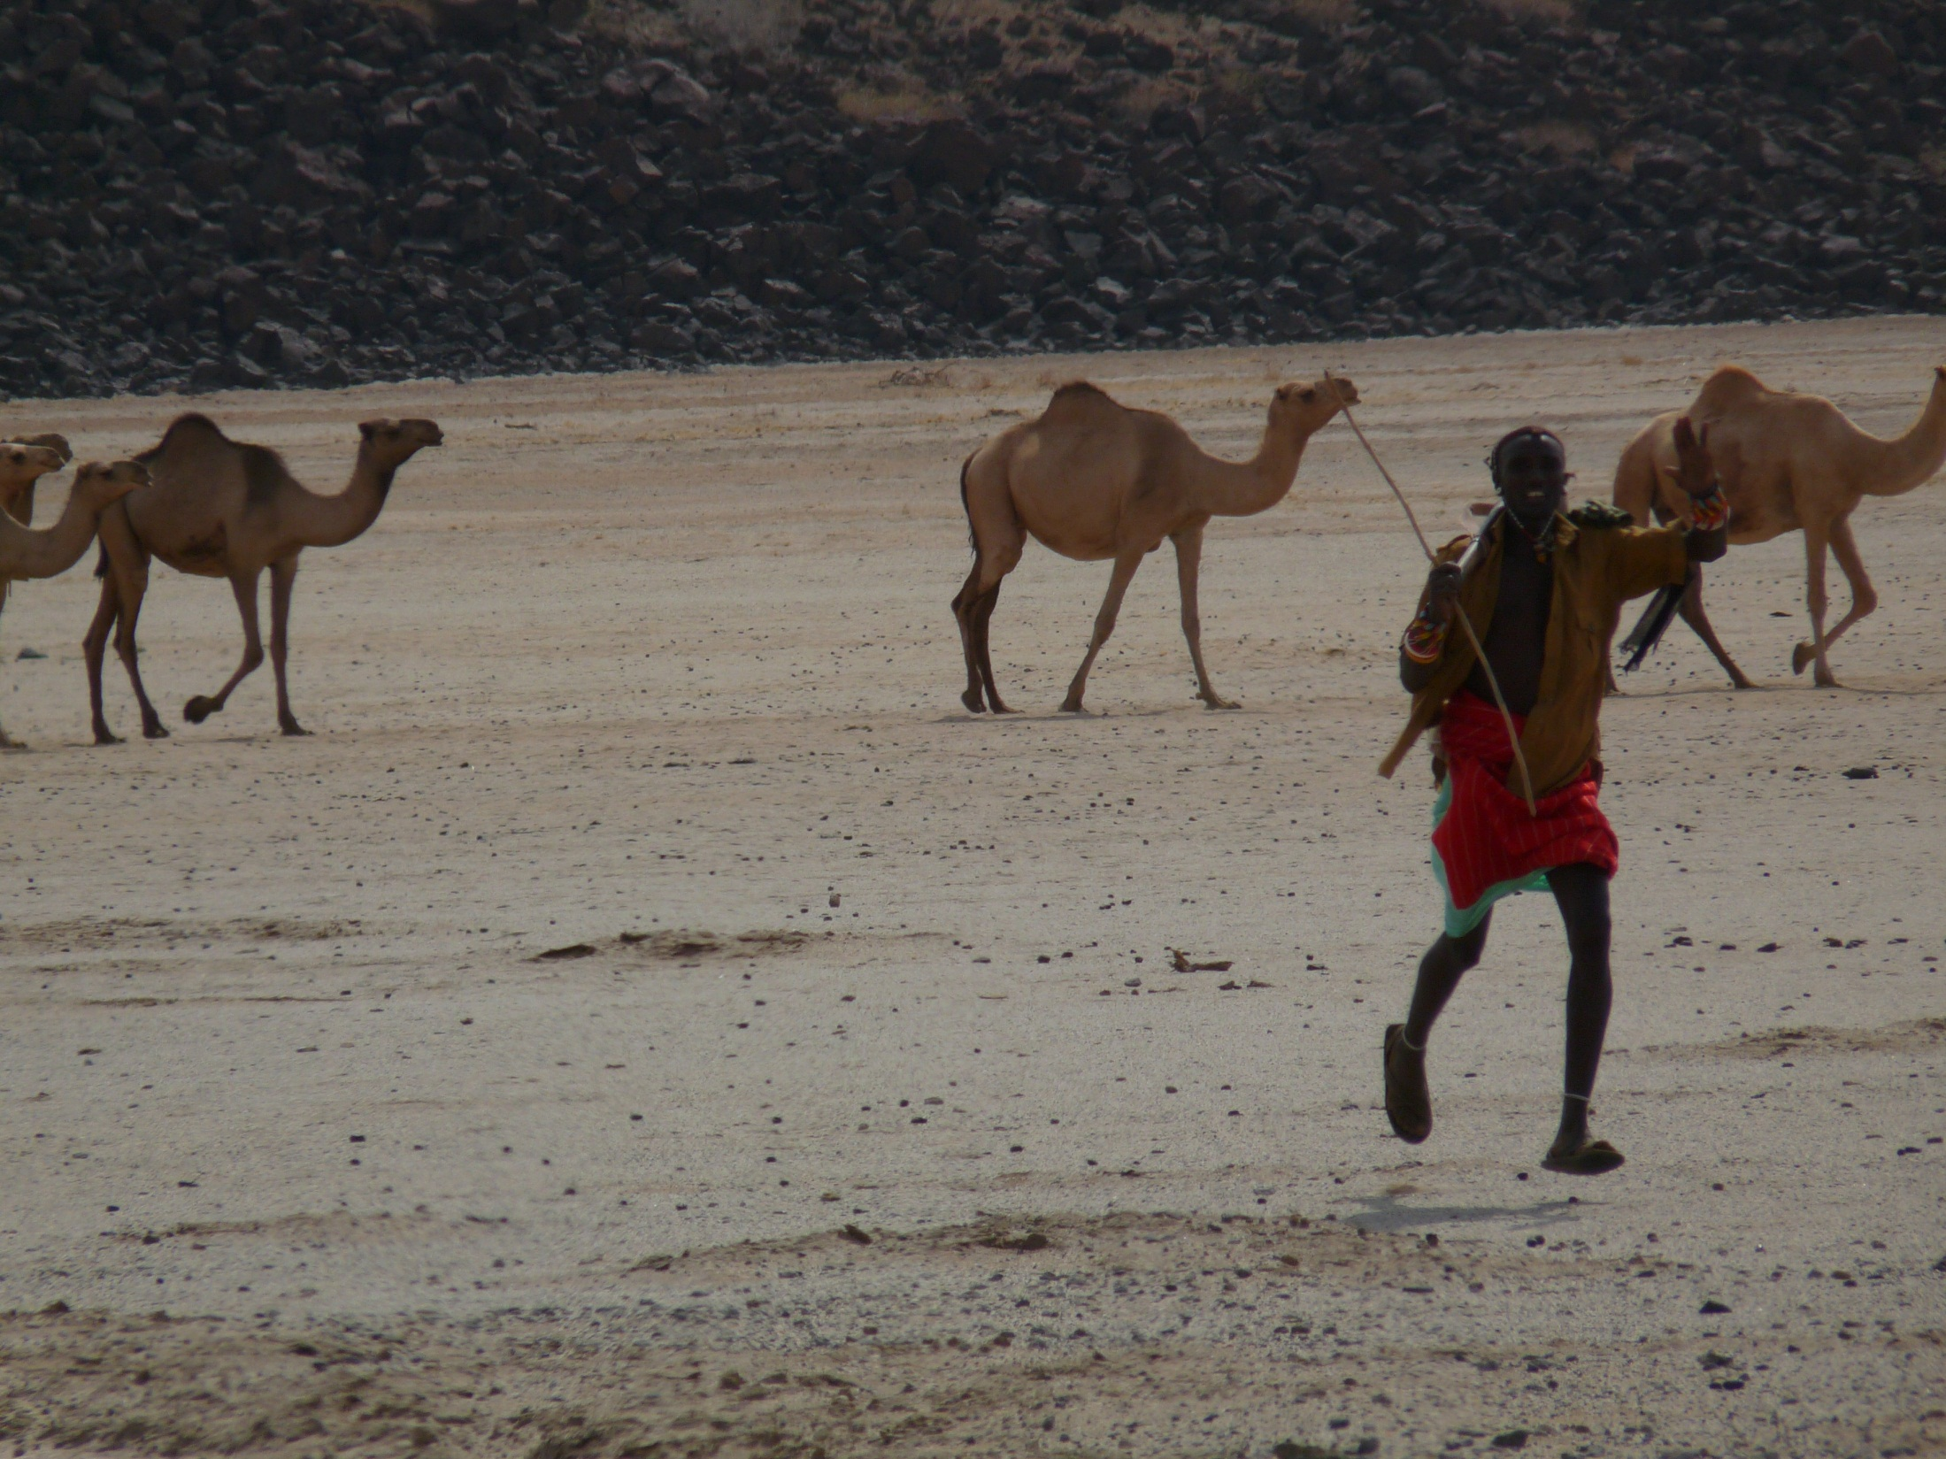
IBLI appears a promising option for addressing poverty traps that arise from catastrophic drought risk
Thank you for your time, interest and comments!
For more information visit www.ilri.org/ibli/
Notes:
12

