Slide 1
Imperfect policy instruments and agrifood systems transformation
Chris Barrett
Guest Lecture to
GDEV 2300
Food Systems and Sustainable Development
April 16, 2024

Slide 2
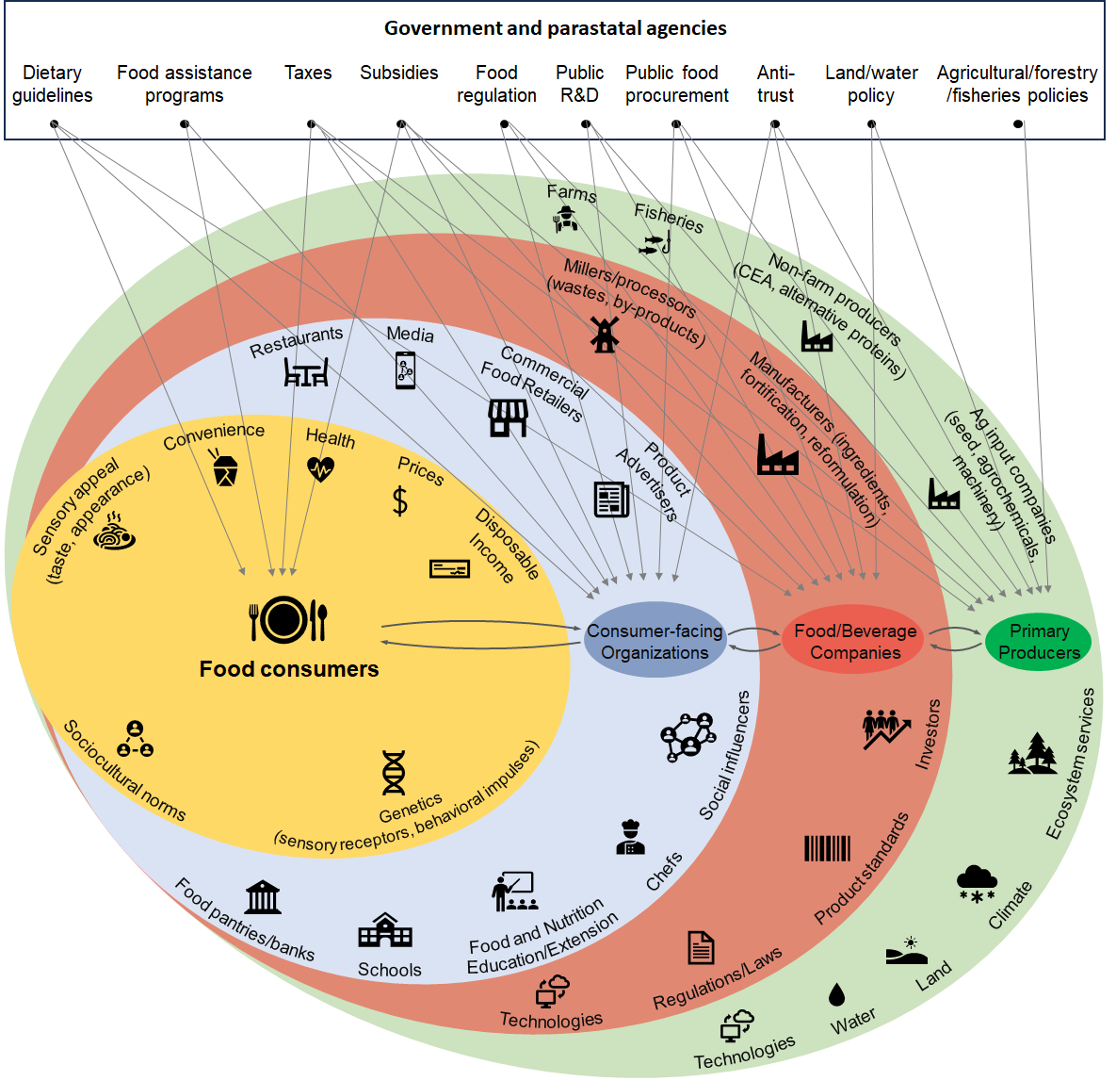
Imperfect
policy instruments
Why do unintended consequences arise from well-intended policies? Human agency!

Slide 3
Markets, Regulation & Taxes
A quick refresher: market-based exchange can improve living conditions due to gains from trade.
But what happens when gov’t introduces a costly regulation intended to help consumers?
Price
Supply w/ineffective regulatory costs
CS
New CS
Supply = producers’ MC
P^{*IR}
New PS
New PS
New PS
Who loses from regulation that only increases producer costs?
P*
PS
Demand = consumers’ WTP
Q^{*IR}
Q*
Quantity
Note that gains from trade REQUIRE diversity!

Slide 4
Markets, Regulation & Taxes
But what if the policy is effective?
Price
Supply w/costs of ineffective regulation
Newer CS
Supply
CS
P^{*ER}
New CS
P^{*IR}
Newer PS
New PS
New PS
New PS
P*
Demand boosted by regulatory oversight
PS
Demand
Quantity
Q^{*IR}
Q
There are gains from reliable information. Regulation can boost demand. Who, if anyone, is better off from such regulation?

Slide 5
Markets, Regulation & Taxes
Do we need government regulation to relieve information problems to benefit all?
If cannot product differentiate, a low price ‘pooling equilibrium’ results
Price
Superior product supply
SP CS
CS
P^{*SP}
Inferior product supply
P*=P^{*IP}
SP PS
Demand boosted by product quality signal
PS
Demand
Quantity
Q^{*IR}
Q
Producers have an incentive to product differentiate, to create ‘separating equilibria’ w/both high and low price offerings.

Slide 6
Markets, Regulation & Taxes
What if gov’t imposes a tax rather than regulates?
Who loses from taxation if it doesn’t boost supply or demand? What determines who loses most? Are there conditions under which anyone gains from imposing taxes?
Price
Supply
CS
P^{*CT}
P*
Gov Rev
DWL
Tax = P^{*CT} – P^{*PT}
P^{*PT}
PS
Demand
Quantity
Q^{T}
Q

Slide 7
How do we bring down food prices?
Population and income growth raise demand and prices. Must expand supply. Three options exist:
Increased use of inputs (land, water, labor, capital) brings more output, but typically at diminishing rate. Implies reduced marginal returns to labor (i.e., lower real wages and higher poverty) and environmental degradation (X⁰ to X¹).
Increased efficiency in using existing inputs and technologies, commonly through extension (Y⁰ to Y¹). But Schultz’s (1964) “poor but efficient” hypothesis suggests limits to this option.
Technological change to increase output potential given same inputs. Requires innovation, diffusion and farmer adaptation to change. Main long-term source of productivity/income growth for sustainable poverty reduction.
Output
New Production Possibility
Production Possibility
Y¹
Y⁰
Input
X⁰
X¹

Slide 8
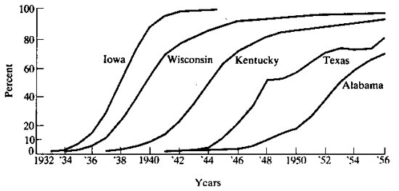
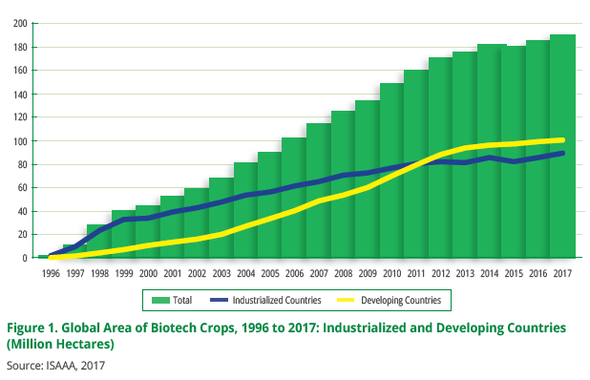
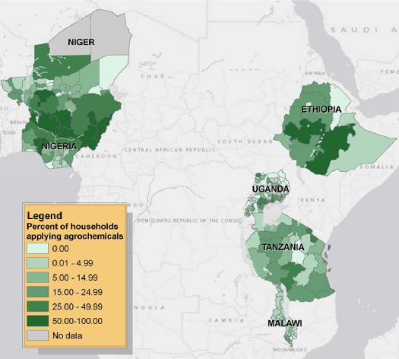
How does tech
change happen?
Diffusion of innovations
Standard diffusion pattern is logistic …
(Griliches, Econometrica, 1957 on hybrid corn diffusion in the US)
Rapid diffusion of GM crops worldwide … fastest ag innovation diffusion in history!
Varies a lot among/within countries
Sheahan and Barrett, Food Policy 2017

Slide 9
Who gains from tech change and why?
“Technology treadmill” and gains from change
Naïve model
If demand is perfectly elastic, gains accrue to producers.
But when, if ever, does this really happen?
Small-scale change: early adopters (who?)
Perfect market integration … export surplus production
New Supply
Price
Original Supply
Demand
P
Producer
Surplus
Added Producer
Surplus
Quantity

Slide 10
Who gains from tech change and why?
“Technology treadmill” and gains from change
Irony: big winners from most ag tech change are typically consumers not producers. Why?
Price
More realistic model
Price inelastic demand.
Fallacy of composition: what’s true at small scale (tech. change profitable for first few adopters) not true at large scale.
Hence tech treadmill
Demand
New Supply
Original Supply
Consumer
Surplus
P ^{old}
New Consumer
Surplus
Old Producer
Surplus
P ^{new}
New Producer
Surplus
Quantity

Slide 11
Who gains from tech change and why?
So how does ag tech change matter?
Increase farm profits, at least for early adopters: Those with best access to ICT, extension, credit/insurance, input and output markets, etc. These farmers gain from yield increases, cost reductions, or both.
Boost rural labor demand: Rural poor typically work off-farm (at least part-time). Enjoy labor market gains, both through more hours worked and higher real wages.
Reduce food prices: If enough adoption, aggregate supply shifts and prices fall (by how much depends on integration with national and global markets). Poor usually net food consumers who gain.
Result: Broad-based but uneven and evolving gains

Slide 12
Implications
“Technology treadmill” and gains from change
Some key policy implications
Extension
Essential to complement discovery and diffuse innovations faster and more equitably.
Intellectual Property
What differences emerge from open source/public licensing vs. private IP?
How does the income/wealth of target consumers influence induced innovation?
Financing
Who should pay for R&D? How does it depend on IP?

Slide 13
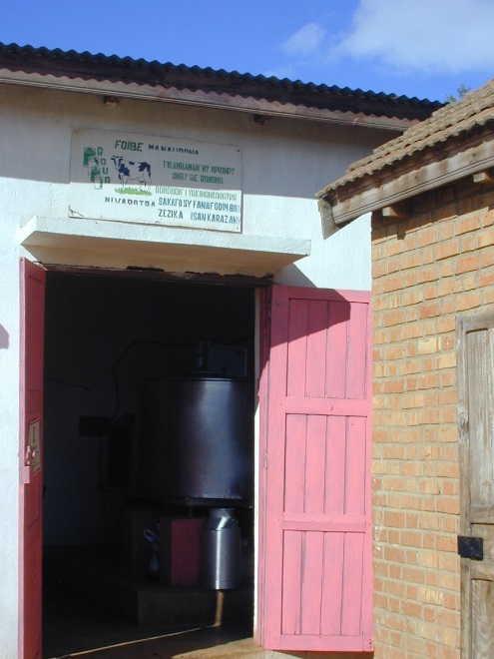
Questions?

