Slide 1
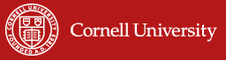
Agrifood systems innovations to boost human and environmental resilience to shocks
Christopher B. Barrett
Dyson School of Applied Economics & Management
and Brooks School of Public Policy, Cornell University
Rachel Carson Distinguished Lecture
Michigan State University
February 15, 2024

Slide 2
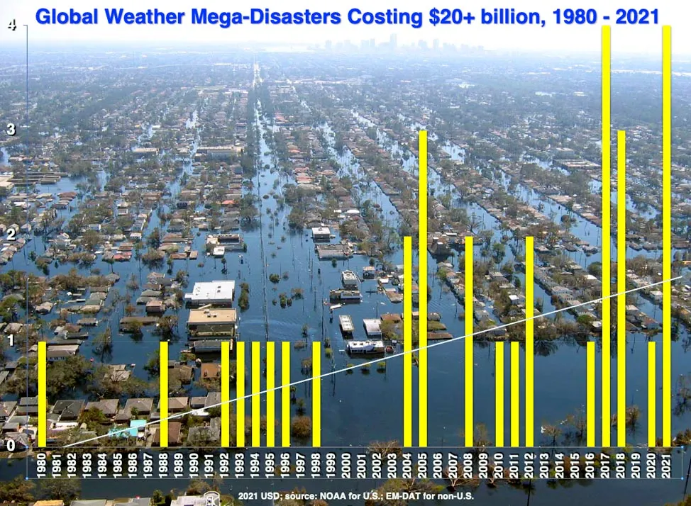
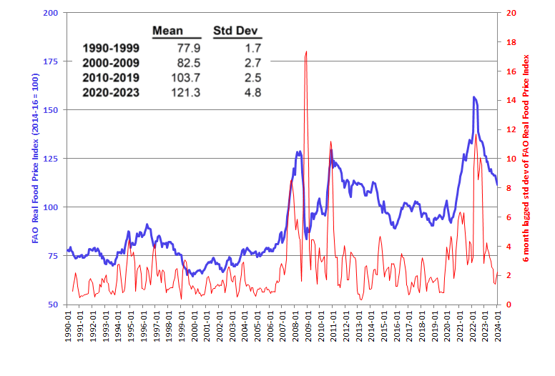
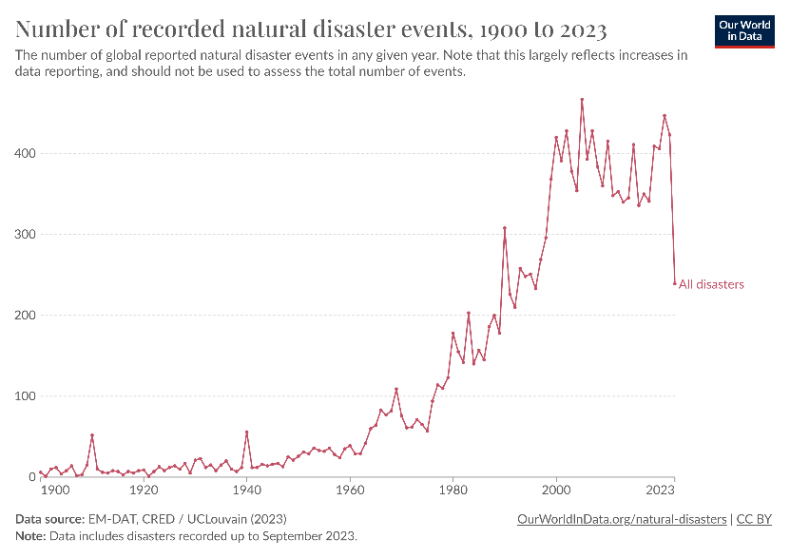

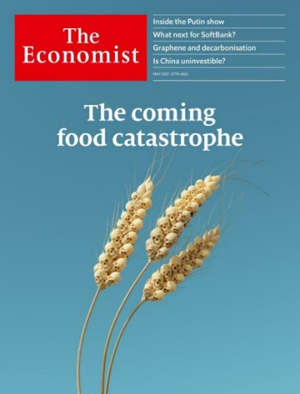
Must build resilience to rising catastrophic risk exposure
The world – and especially low-income, rural communities – face increasing risk of climate/conflict/pandemic/price/other shocks.
Source: J.Masters, Yale Clim. Conn. 2022

Slide 3
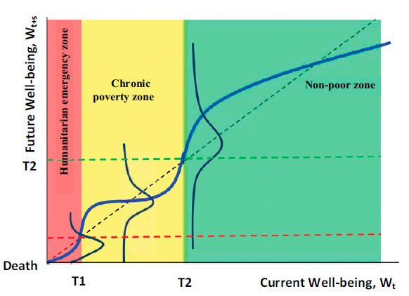
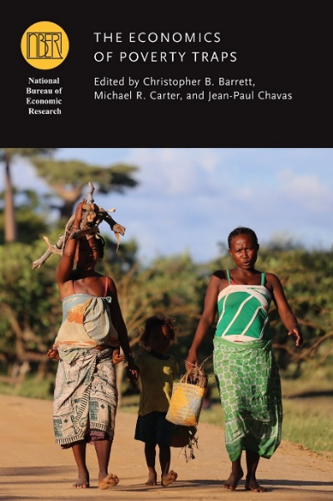


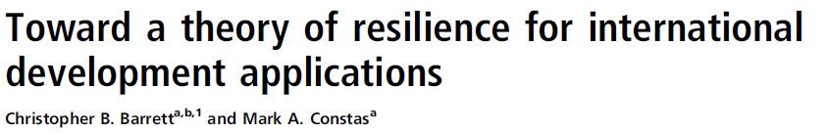
Risk is especially important w/poverty traps
Poverty traps increasingly understood as arising due to catastrophic risk exposure and/or the experience of uninsured shocks in systems with a low-level (often multiple) stable states.
poverty line
Resilience exists when people and systems can absorb or quickly recover from potentially catastrophic shocks and stressors.

Slide 4
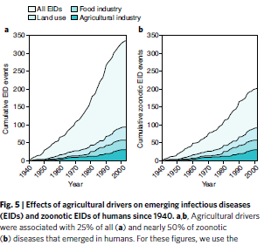
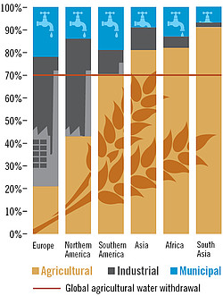
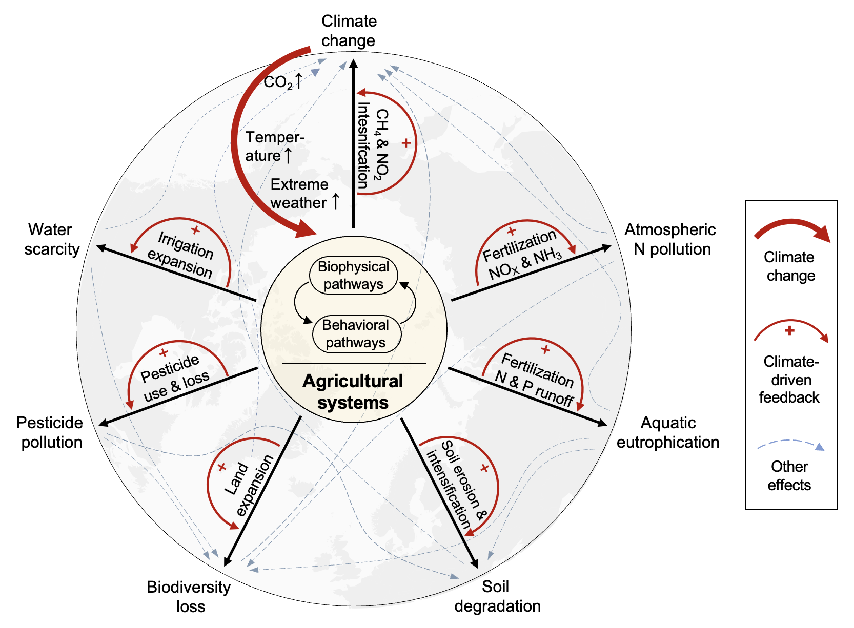
Natural environment is similarly vulnerable to shocks
Climate, biodiversity, forests, soils, disease ecology, water similarly subject to multiple stable states and thus vulnerable to shocks.
Agrifood systems (AFS) especially important sources of shocks.
Source: Rohr et al. Nature Sustainability 2019
Source: https://www.globalagriculture.org/report-topics/water.html
Source: Yang et al. (in review)

Slide 5
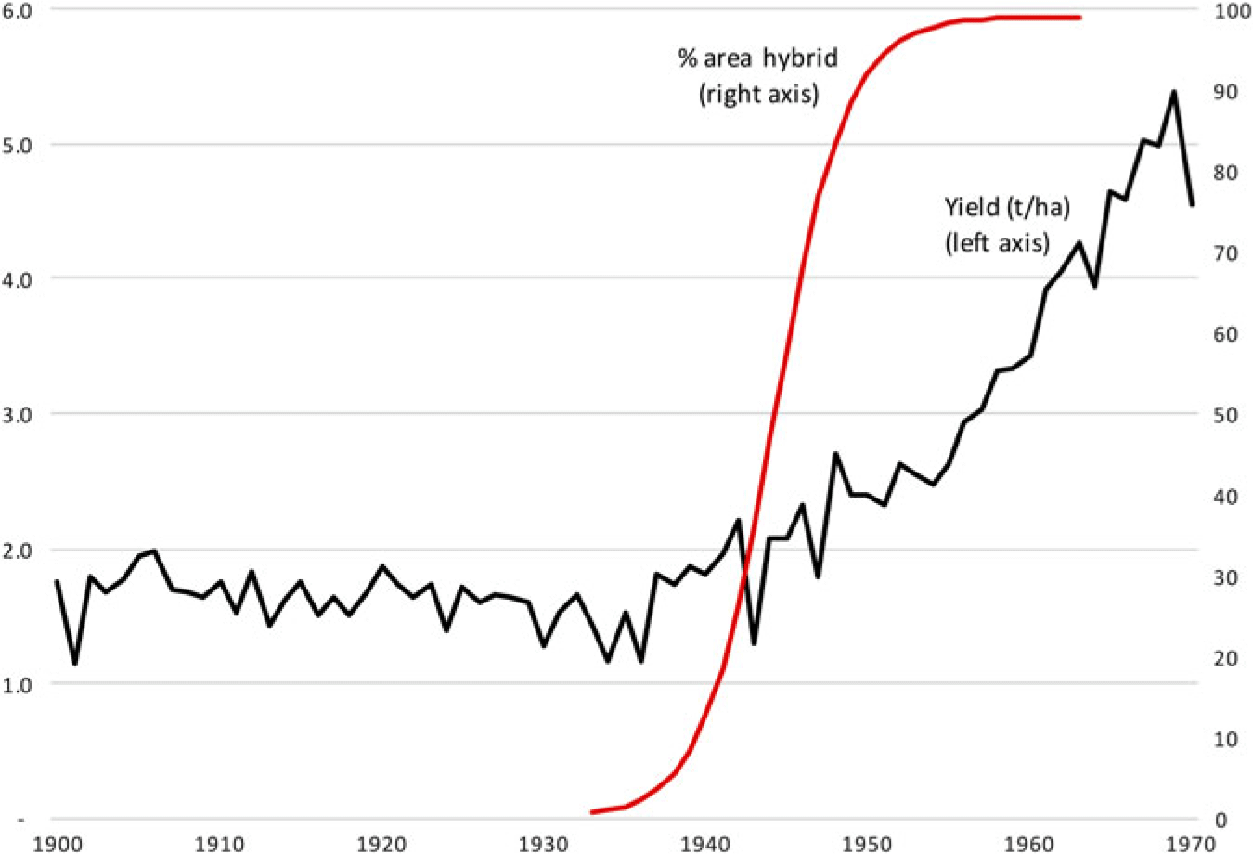

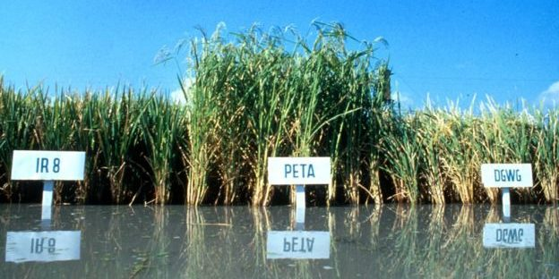
Building resilience requires AFS transformation
Agrifood systems are a common denominator to today’s polycrises.
Building resilience will require AFS transformation.
Hard but feasible. Overcame similar threats in 1930s-60s w/a “doubly progressive” strategy: progress through science + solidarity w/poor. Resurrect that strategy, but tailor to current needs.
Source: IRRI
Yield of maize (tons per hectare) and percentage area sown to hybrid seed, USA, 1900–70. Source: Byerlee (2020)

Slide 6

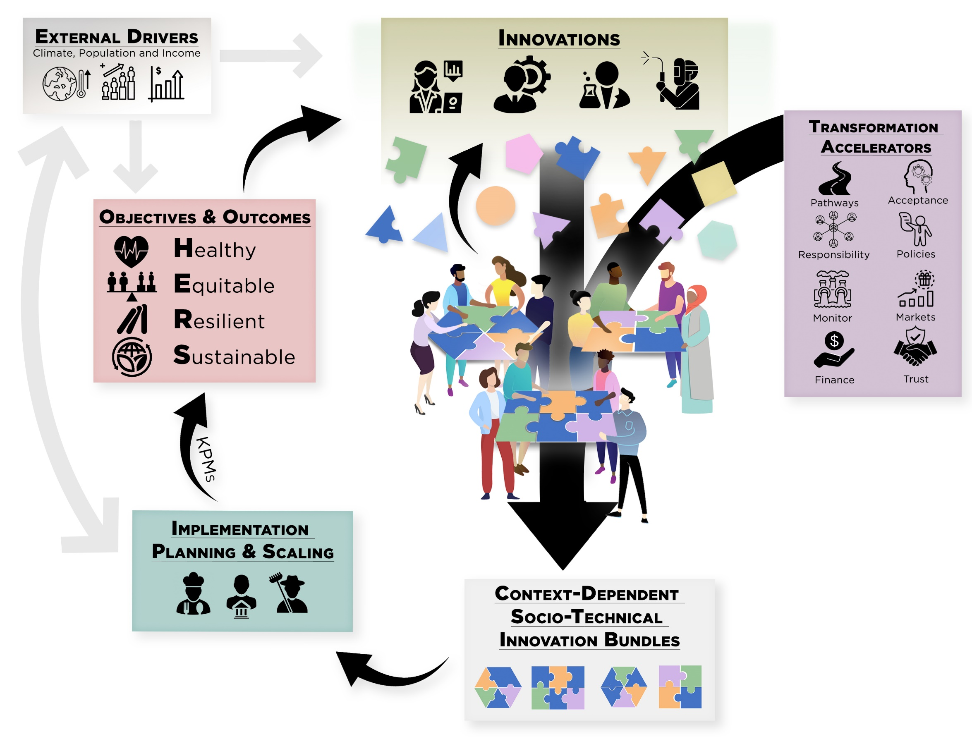
Define objectives correctly for mid-21st century
Priorities are no longer need increasing yields / caloric availability.
Need sustainable TFP growth and induced demand shifts to build healthy, equitable, resilient and sustainable AFS.
Bundle technological, policy and institutional innovations:
- Solutions are never just technical
- Populations are never homogeneous
- Political economy requires coalition building

Slide 7
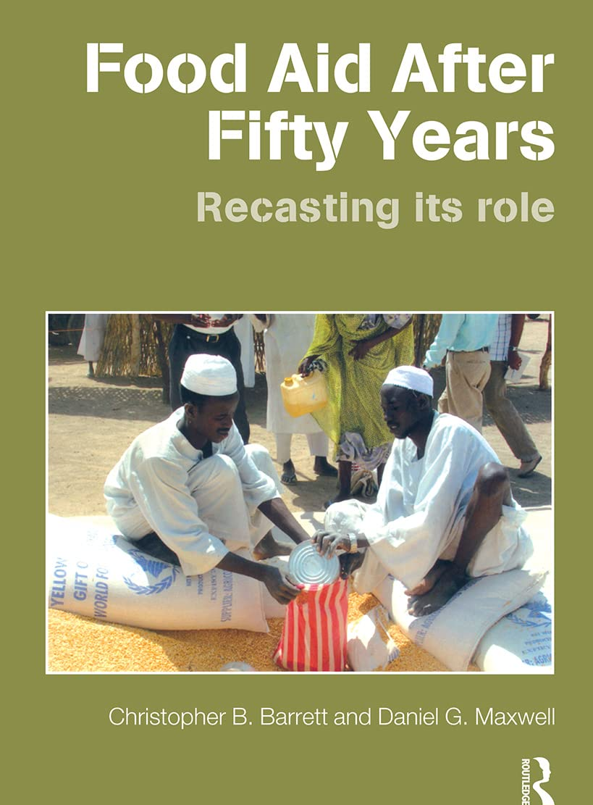
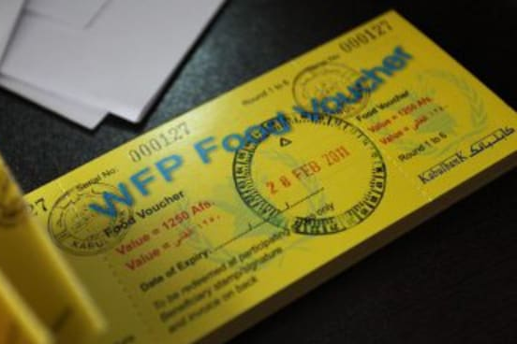
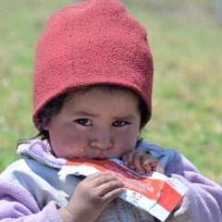
Example 1: Improved humanitarian response
For decades, global response to humanitarian disasters was to ship surplus food from US/Canada/Europe: slow, inefficient, often culturally inappropriate, sometimes harmful to recipients.
Past 15 years big shift towards modern EWS, cash-based assistance using local foods/markets. Supplement w/novel therapeutic foods.
Photo credits: Devex, Edesia

Slide 8
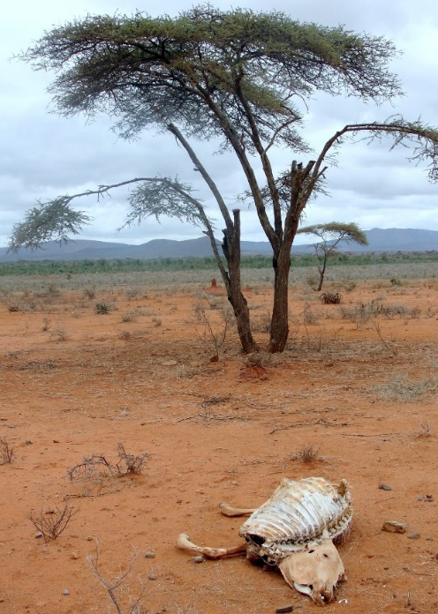
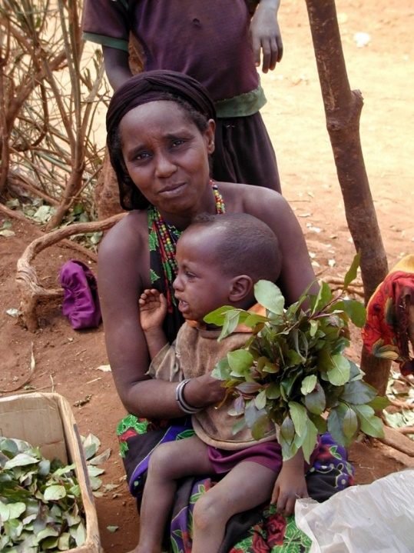
Example 2: Index-based livestock insurance (IBLI)
Poverty traps exist in the arid and semi-arid lands of Kenya/Ethiopia. Catastrophic herd loss risk due to major droughts is the major cause of these dynamics. Puts a premium on drought risk management, both for individuals and for society.
Sources: Lybbert et al. (2004 EJ) and Santos & Barrett (2011 JDE, 2019 UCP/NBER volume) on Boran in s. Ethiopia. Barrett et al. (2006 JDS) and Chantarat et al. (2017 WD) in n. Kenya.

Slide 9
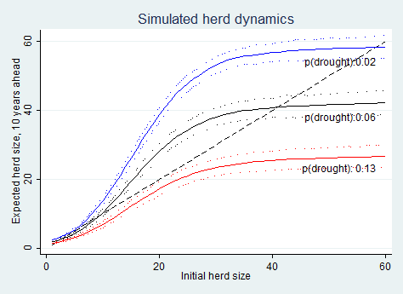
IBLI: The threat of climate change
Seems worsening. Pastoralist systems adapted to weather shocks. But is it resilient to a shift in climate? Many models predict increased rainfall variability (i.e., increased risk of drought).
Herd dynamics differ b/n good and poor rainfall states, so change w/drought (<250 mm/yr) risk.
In southern Ethiopia, in expectation, doubling drought risk leads to system collapse in the absence of any change to prevailing herd dynamics.
Source: Barrett and Santos (Ecol Econ 2014)

Slide 10
Why IBLI? Standard responses to drought
Standard responses to major drought shocks:
1) Post-drought restocking (futile at low levels, Santos & Barrett 2019 NBER)
2) Food aid (slow, expensive, can reinforce sedentarization, lots of excess mortality due to US policies Nikulov et al. PLoS ONE 2016)
3) Conventional insurance (infeasible/unaffordable)
Core issue: the social protection paradox: Must stop collapses into poverty else overwhelm social protection programs for poor (Ikegami et al. 2019 NBER). Reduced protection feeds resource overuse and conflict, igniting a vicious cycle of reinforcing feedback.

Slide 11
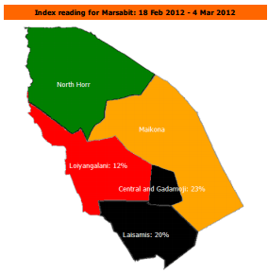
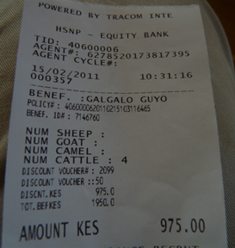
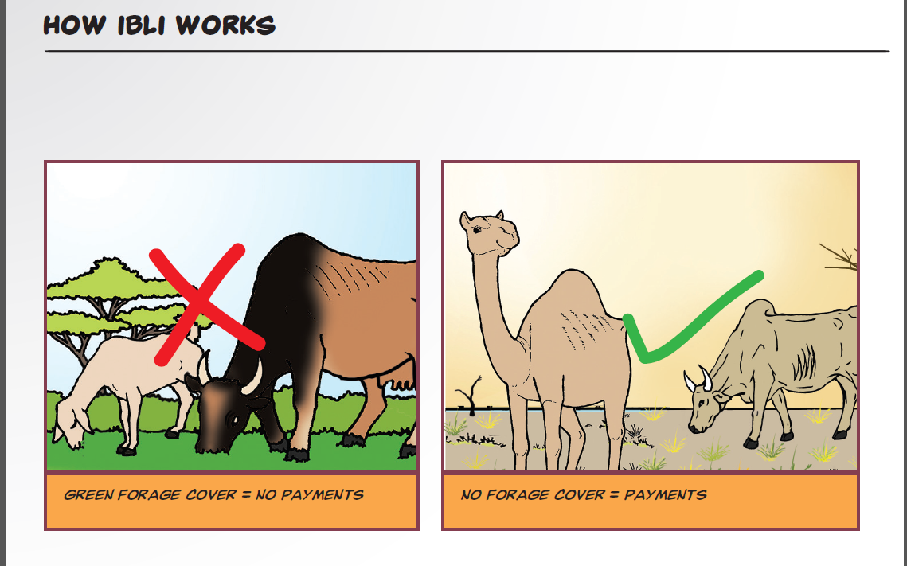
(Jensen, Barrett &2014)
Original IBLI product design
Use near-real-time Normalized Difference Vegetation Index (NDVI) MODIS satellite data to define losses based on historical NDVI-mortality relationship. For expected losses >15%, seasonal payment from reinsured insurer.
Imperfect product, but worked largely as designed, with big impacts. Marginal impact on income or MUAC is 6-45x that of cash transfers! Scaled out to Kenya, Djibouti, Ethiopia, Mauritania, Somalia, Zambia.
See Jensen et al. Cambridge Univ. Press IBLI book in press

Slide 12
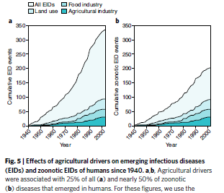
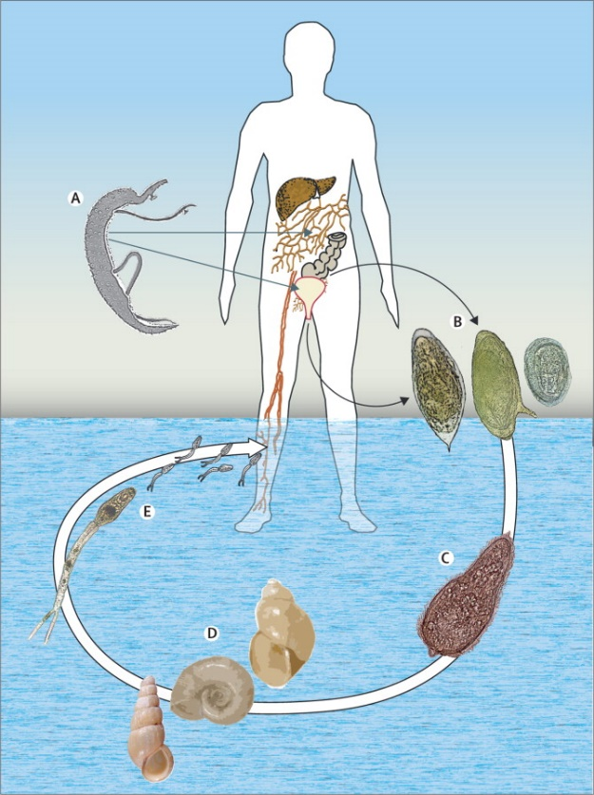
Example 3: Schistosomiasis in Senegal
Ag dev’t can aggravate infectious disease burdens.
Schistosomiasis affects >240m globally (>800m at risk).
Great example of a poverty-disease trap. Impedes child cognitive/physical dev’t via anemia, morbidity. Disrupts work/school attendance. Suppresses immunoresponse.
Deworming (MDA of praziquantel) has high reinfection rates. Biocontrols (e.g., prawns) largely ineffective.
Source: Colley et al. The Lancet 2014

Slide 13
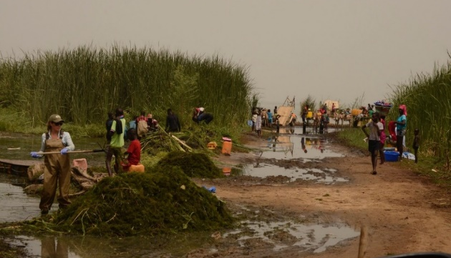
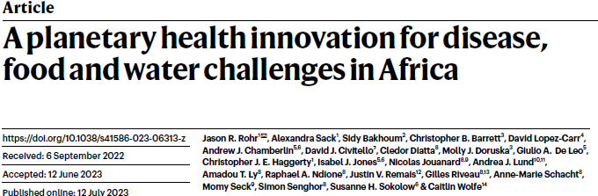
Example 3: Schisto in Senegal
Remedy: clear snails’ preferred habitat: submerged Ceratophyllum demersum.
It works! Snails and infections (esp. S. mansoni) sharply reduced. Use the biomass as compost:
Private B/C =[2.7,4.0]; Public B/C=[3.1,8.8]

Slide 14
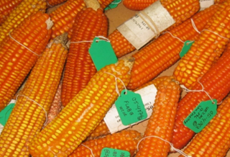
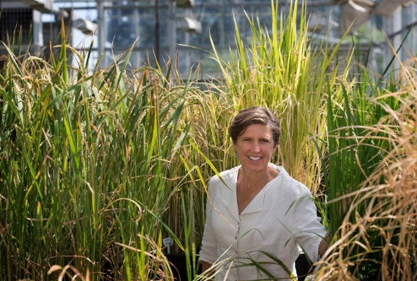
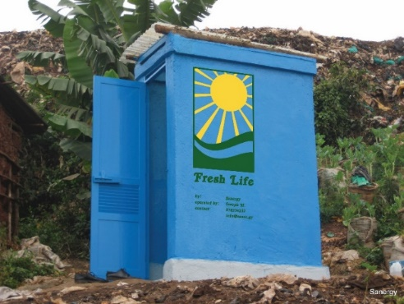
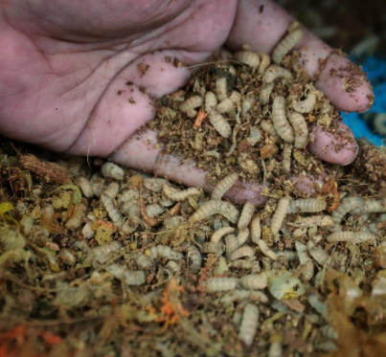
Plenty innovations are on the way!
Agricultural innovations:
- Biofortified crops to help boost micronutrient access for poor.
- Stress-resistant crops to cope w/flooding, drought, heat, pests.
- Livestock feeds to reduce methane, food-feed competition
- Upcycling wastes for fertilizer/feeds
New Genomic Techniques raise likelihood and accelerate rate of breakthroughs!
Photo credits: Genetic Literacy Project, Mike Gore, Alexander Mathys, Sanergy, Andrew Simons

Slide 15
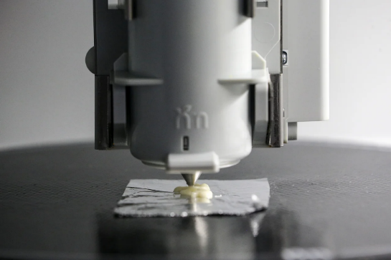
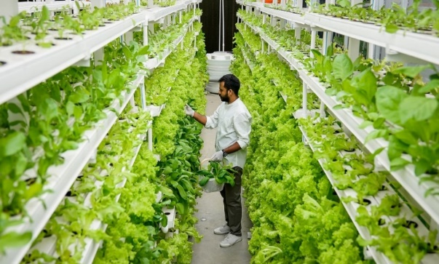
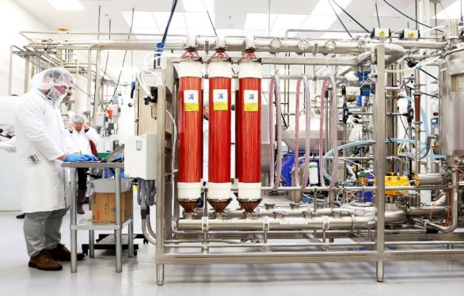
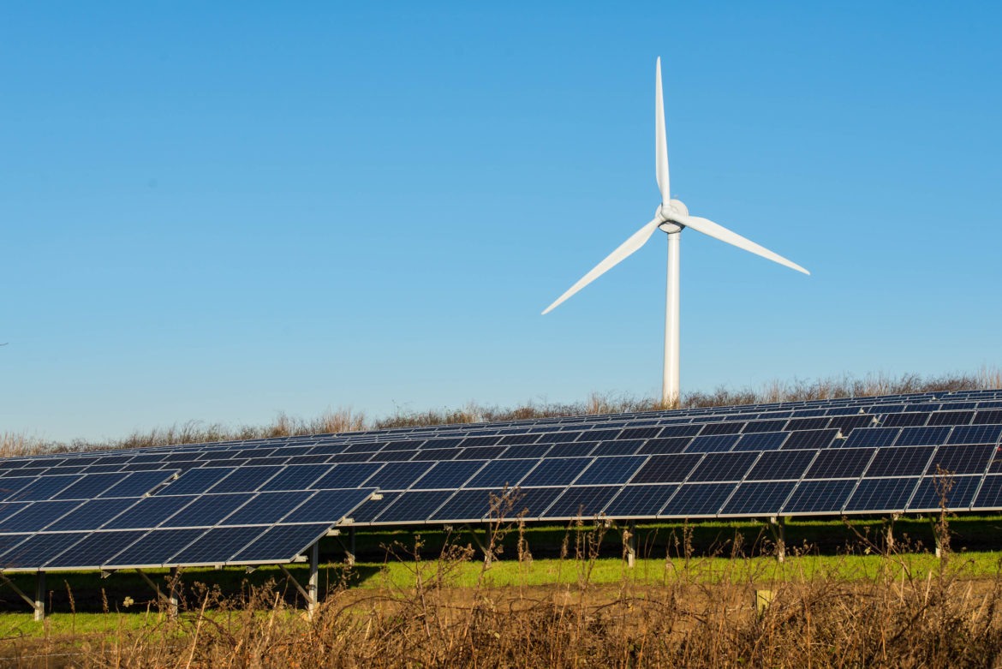
Post-farmgate options especially promising
Decoupling food production from land is increasingly culturally, economically, technologically feasible. Crucial for climate, infectious disease control, healthier/safer foods.
Photo: Betterindia.com
Photo: Beck Deifenbach/Reuters
Profit-seeking, risk- reducing non-farm companies can drive change w/enough regulatory oversight and stakeholder pressure. Improve reformulation/fortification.
Learn the lesson of rennet.
Manage rural transitions proactively to build rural livelihood opportunities: farm carbon, solar, wind and wildlife; CEA in idle, low-cost structures.
Photo: Gerry Machen/Creative Commons
Photo credits: Photo: Wallace Woon (Straits Times), Betterindia.com, : Beck Deifenbach/Reuters, Gerry Machen/Creative Commons

Slide 16
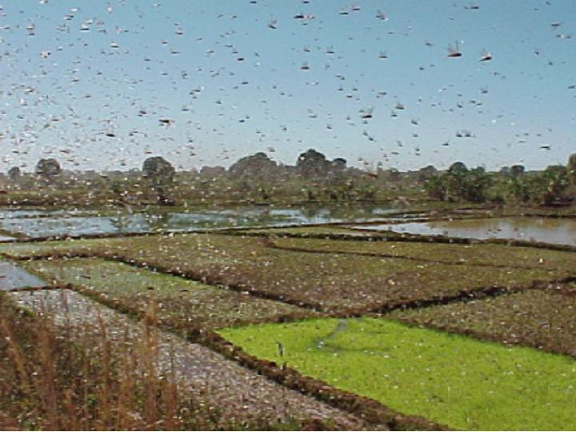
We can build human and environmental resilience to shocks, even in low-income rural communities
-
Requires renewed commitment to innovation, in both technologies and institutions/policies
Shift focus from calories/yields to HERS indicators
Devote more effort to mid-stream/non-farm options
Social protection and enhanced risk management are handmaidens of innovation and progress.
Notes:
16

Slide 17
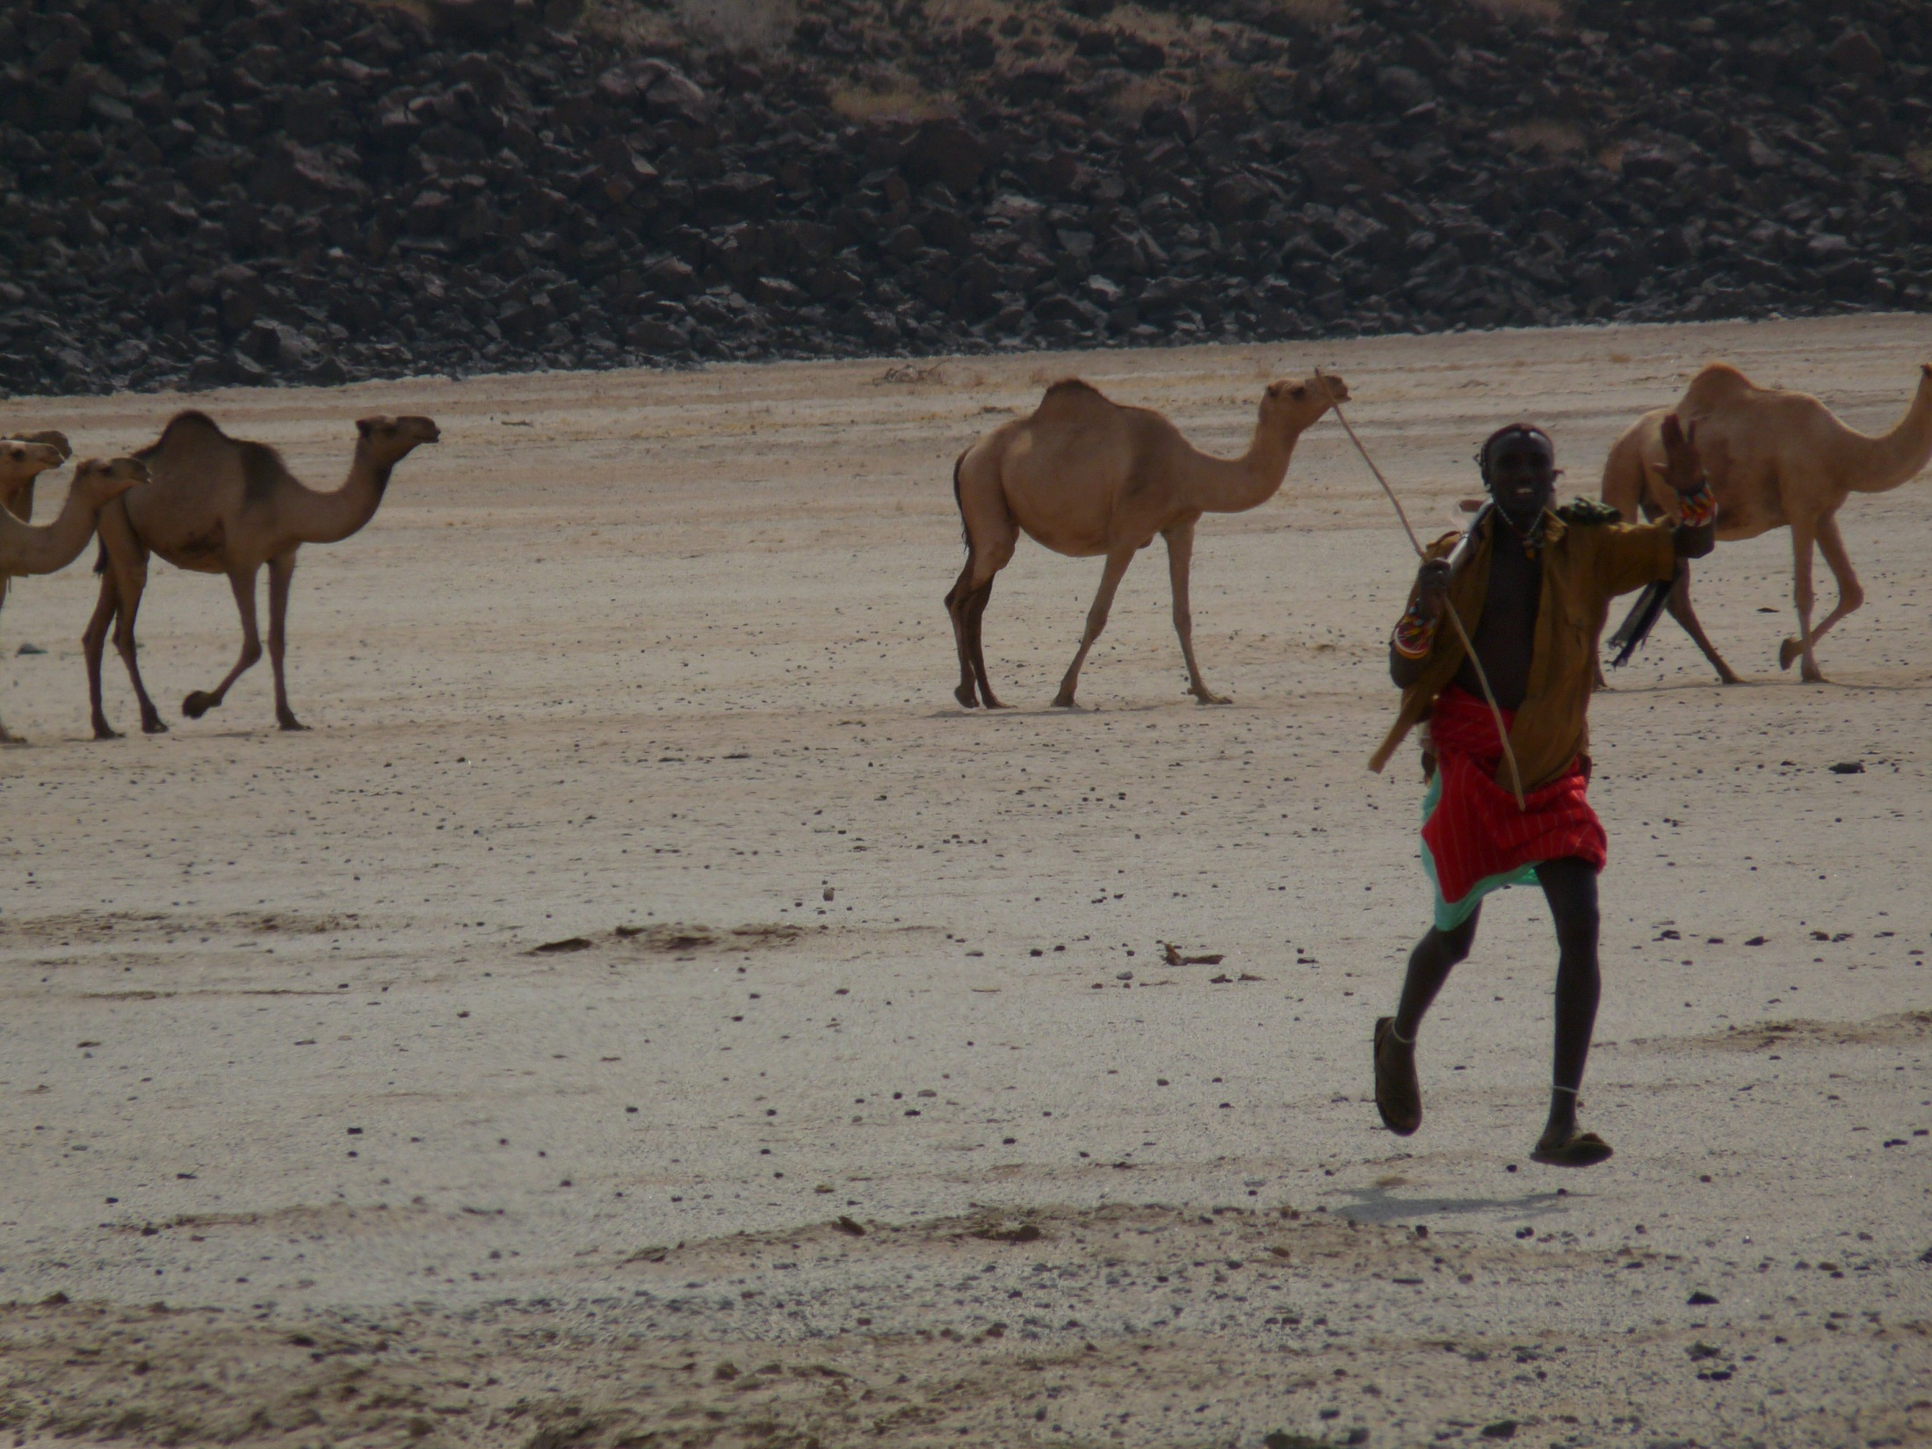
Thank you for your time, interest and comments!
Background literature available at
https://barrett.dyson.cornell.edu/
Or email me at chris.barrett@cornell.edu
Notes:
17

